Slide 1
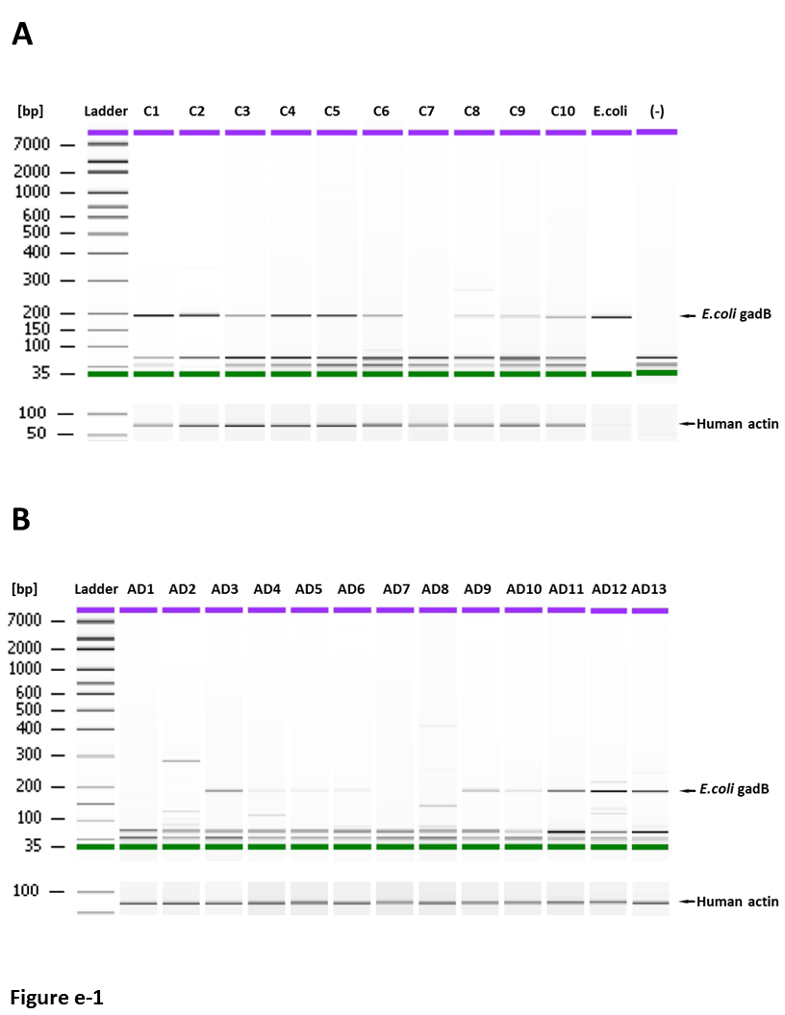
Figure e-11. Detection of E. coli DNA in human brains. PCR for the E. coli glutamate decarboxylase B gene (gadB) showed a 175 bps DNA fragment for the ATCC 8739 E. coli strain which was the same size in control and AD brains. 175 bps E. coli gadB DNA was detected in 9/10 normal control and 9/13 AD brains. Among these, 1/10 control and 4/13 AD brains had DNA fragments that were larger than 175 bps (A, B) which is of unknown significance. DNA fragments less than 175 bps likely represent primer interactions. C = control samples; AD = Alzheimer’s Disease samples; (-) = negative control with no brain DNA. Human Actin DNA was used for a loading control.

