Slide 1
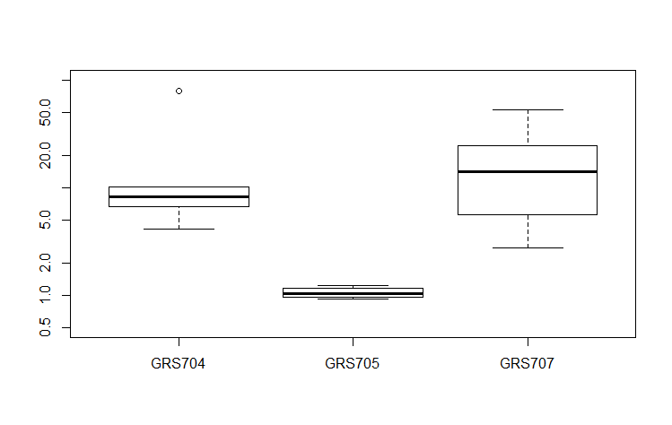
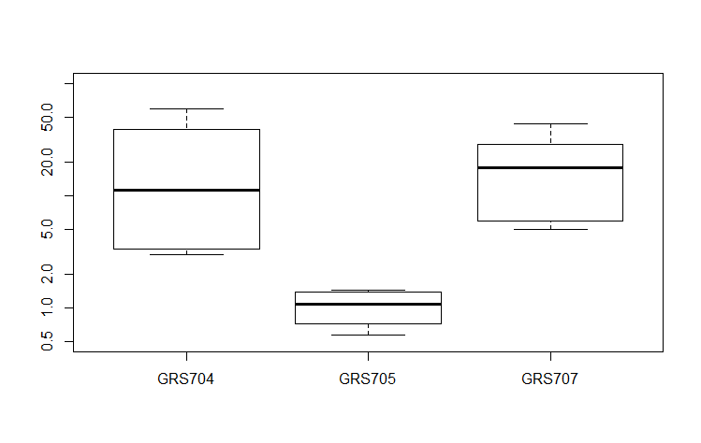
Perrier et al.
(A)
efpR mutant Sp^{R} or Gm^{R}
SPE 1
SPE 2
Mixed inoculum
1:1
GMI1000-WT
(B)
CI in tomato
CI in cabbage
50
*
50
*
*
*
5
5
1
1
∆efpR
efpR^{D49N}
∆efpR
efpR^{D49N}
∆efpR::efpR
∆efpR::efpR

