Slide 1
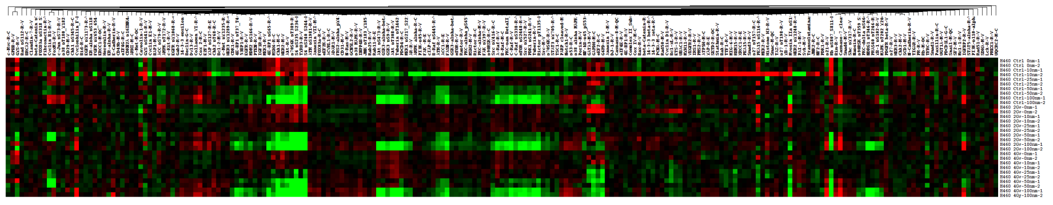
RPPA of H460 cells
(Log 2)
-3.9251
4.9660
EGFR
Akt
p70S6K
S6
Akt
GSK3
MEK1
Src
mTOR
p21
Rb
Cleaved Caspase-7
Supplemental Figure 1
4Gy
2Gy
0Gy
100
100
0(nM)
100
0
0

Slide 2
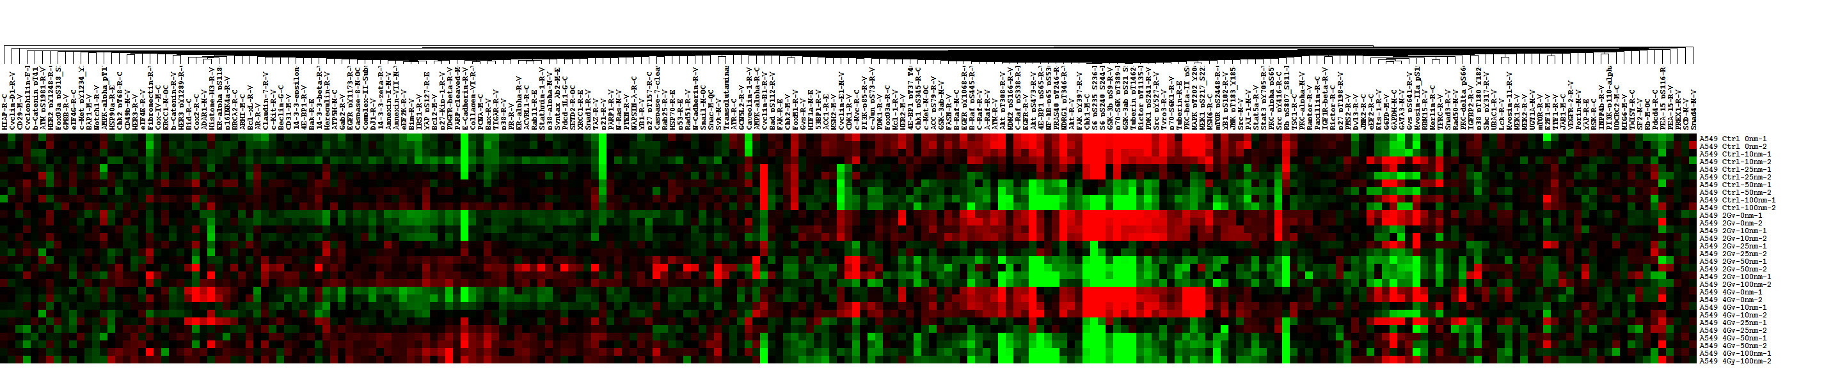
RPPA of A549 cells
(Log 2)
-1.8744
5.2989
p27
E-cadherin
p21
Chk1
S6
p70S6K
Rb
Supplemental Figure 2
4Gy
2Gy
0Gy
100
100
0(nM)
100
0
0

Slide 3
A
0 Gy
2 Gy
4 Gy
0
10
25
50
100
0
10
25
50
100
0
10
25
50
100
nM
pAKT (thr)
tAKT
pmTOR
tmTOR
pEGFR
tEGFR
β-actin
B
4 Gy
0 Gy
2 Gy
0
10
25
50
100
0
10
25
50
100
0
10
25
50
100
nM
pP90RSK
tP90RSK
pS6
p21
pCDC2 (thr)
tCDC2
ΔCaspase-9
ΔCaspase-7
pγH2AX
GAPDH
Supplemental Figure 3

Slide 4
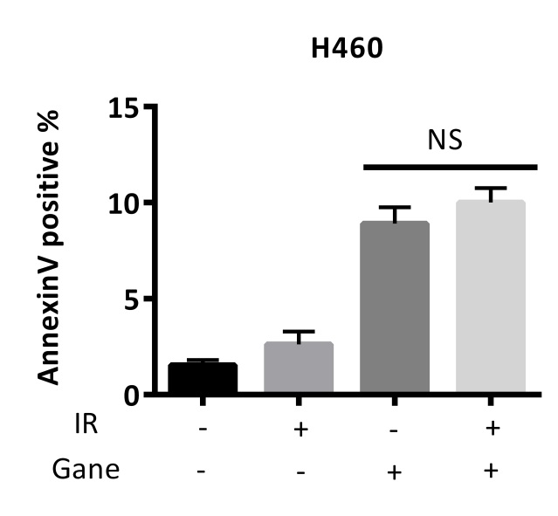
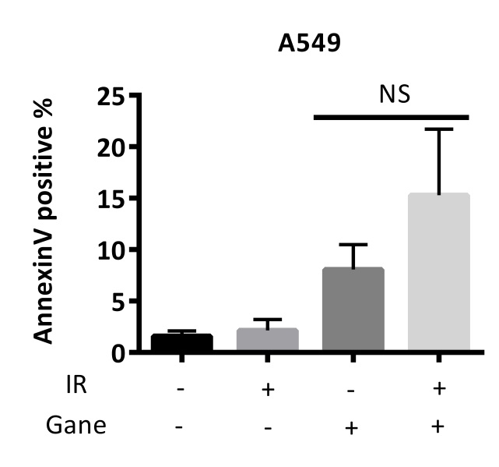
A
B
Supplemental Figure 4

Slide 5
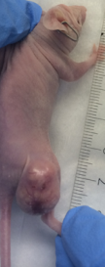
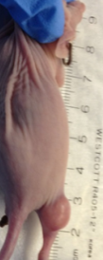
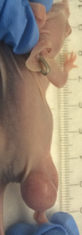
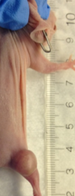
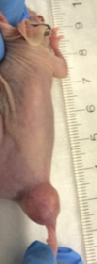
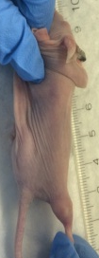
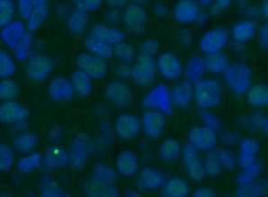
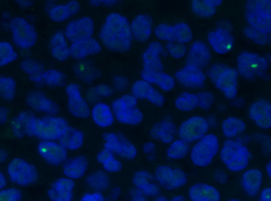
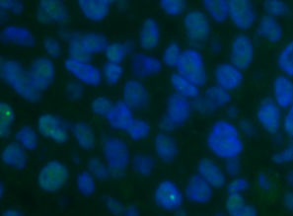
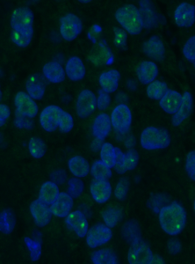
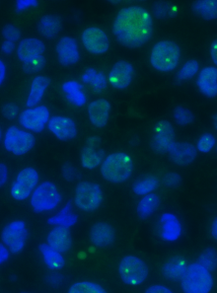
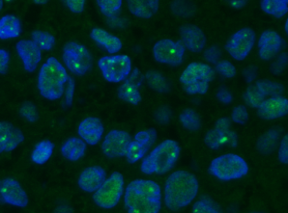
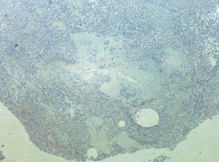
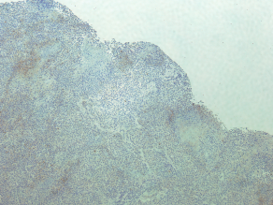
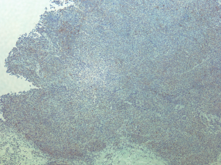
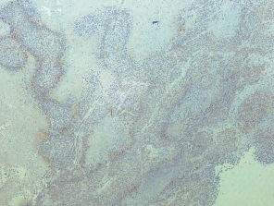
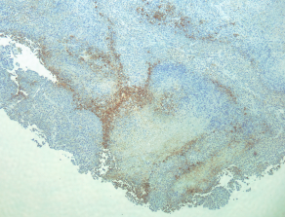
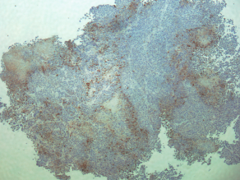
A
control
IR
Chemo
Chemo+IR
Chemo+
Ganetespib
Chemo+IR+
Ganetespib
B
control
Chemo
Chemo+Ganetespib
P=0.043
IR
Chemo+IR
Chemo+IR+Ganetespib
C
control
Chemo
Chemo+Ganetespib
P<0.05
IR
Chemo+IR
Chemo+IR+Ganetespib
Supplemental Figure 5.

