Slide 1
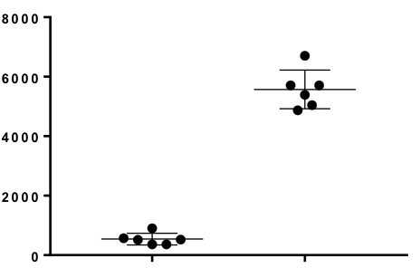
Suppl. Figure S2
P<.005
MFI IFNγ
Tbx21^{-/-}
WT
Figure S2. Tbx21^{-/-} T cells produce less IFNγ after IL-2c treatment compared to WT. MFI of IFNγ staining was assessed by intracellular flow cytometry in Tbx21^{-/-} and WT T cells after ex vivo restimulation with Gag peptide.

