Slide 1
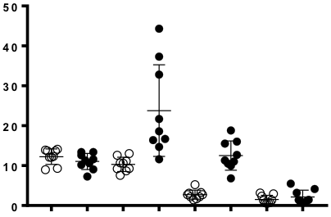
Suppl. Figure S4
untreated
IL-2c
P<0.001
Frequency in spleen
ns
P<0.001
ns
CD4
CD8
NK
Treg
P<0.02
P<0.01
P<0.01
P<0.02
Frequency in TIL
CD4
CD8
NK
Treg
Figure S4. IL-2/JES6-5H4 complex selectively expands CD8⁺ T cells and NK cells. The frequency of specified endogenous cell populations was determined in the spleen (upper) and TIL (lower) of FBL-bearing Alb:Gag mice left untreated (open circles) or after 7 daily treatments with IL-2c (closed circles).

