Slide 1
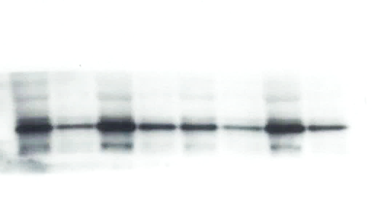
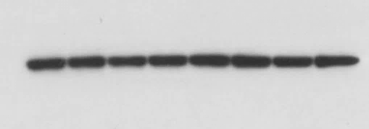
G-CSF
*
*
*
AMD3100
*
*
*
G-CSF AMD3100
C57BL/6J C57BL/6J
TLR3-KO TLR3-KO
*
*
HO-1
β-Actin

