Slide 1
Supplemental Figure S1, Supplement to Fig. 3C
Tumor 1
Tumor 2
H&E
10X
20X
HuD
10X
20X
isoAspHuD
10X
20X
PCMT1
10X
20X
Competition
native HuD
500X molar excess
10X
20X
Competition
isoAspHuD
500X molar excess
10X
20X
Figure S1, related to Figure 3C. Larger versions of IHC panels shown in Fig. 3C
See legend to Fig. 3C.

Slide 2
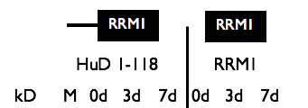
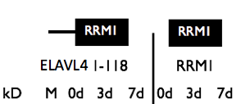
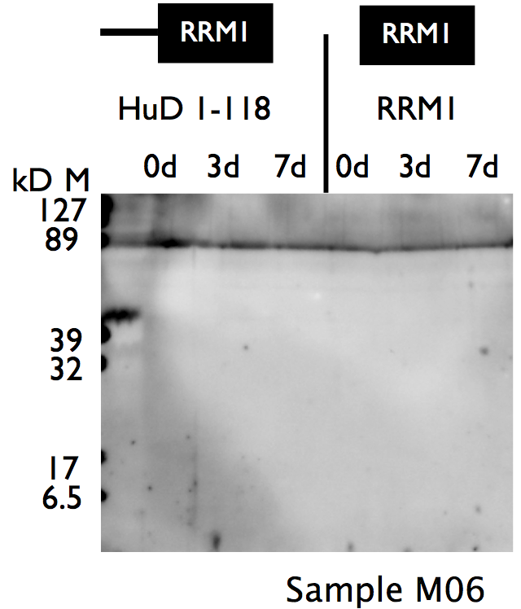
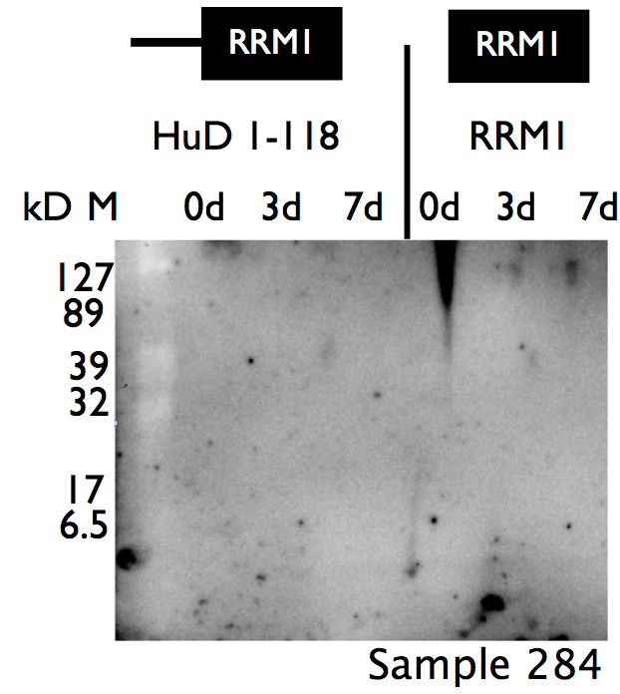
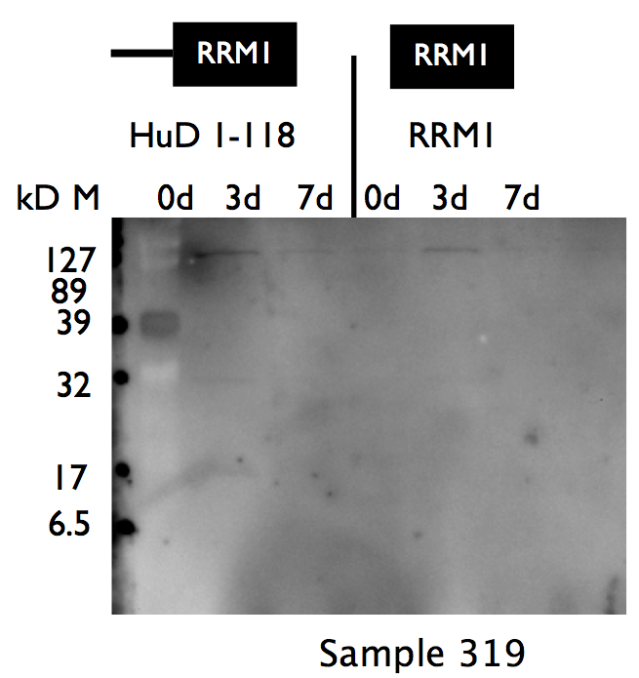
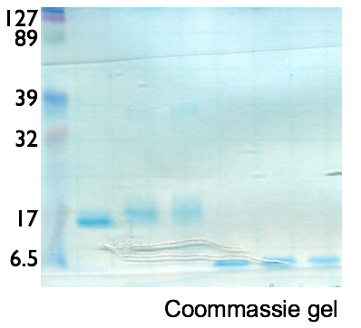
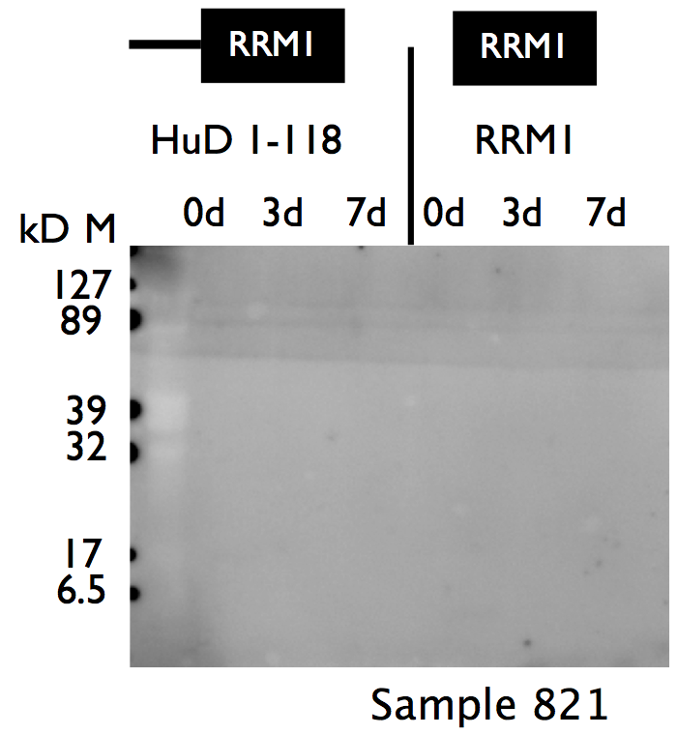
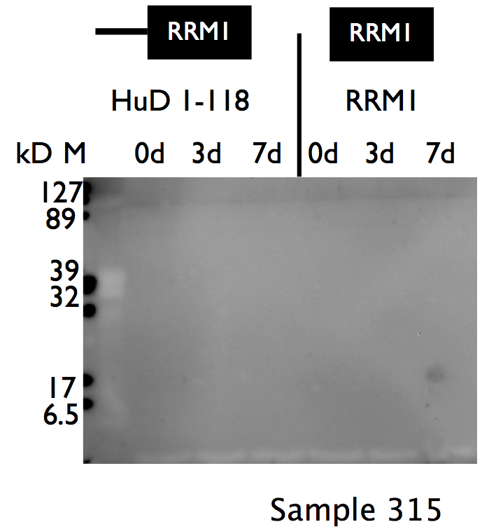
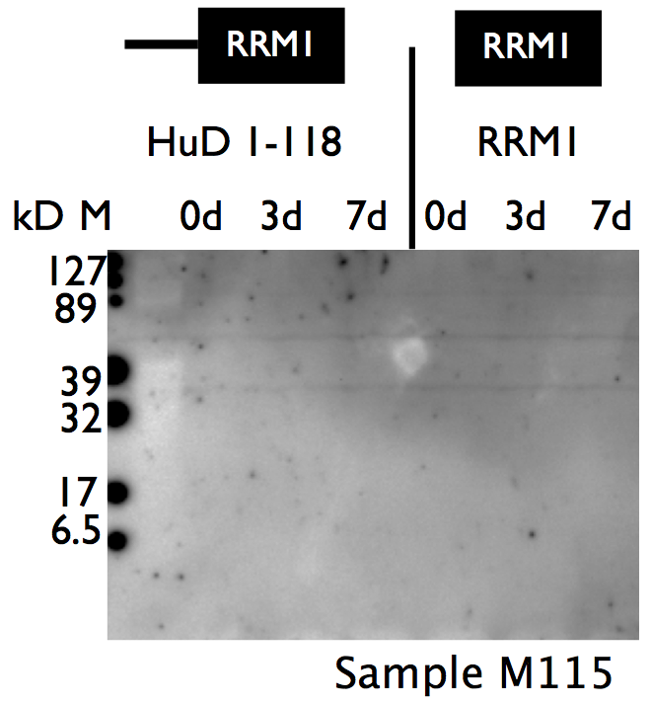
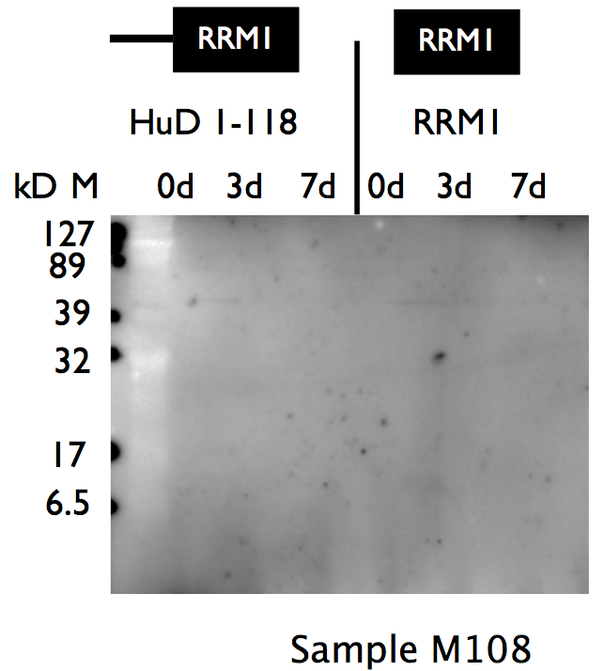
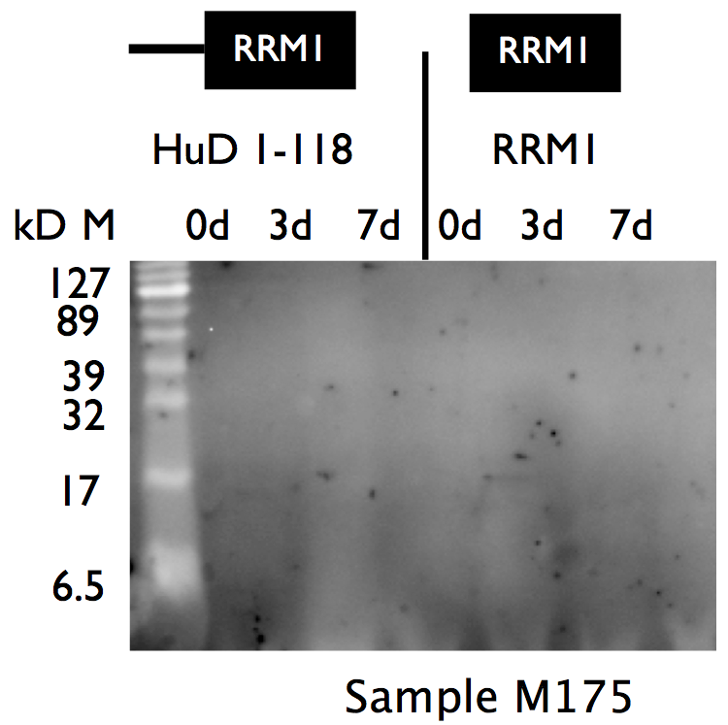
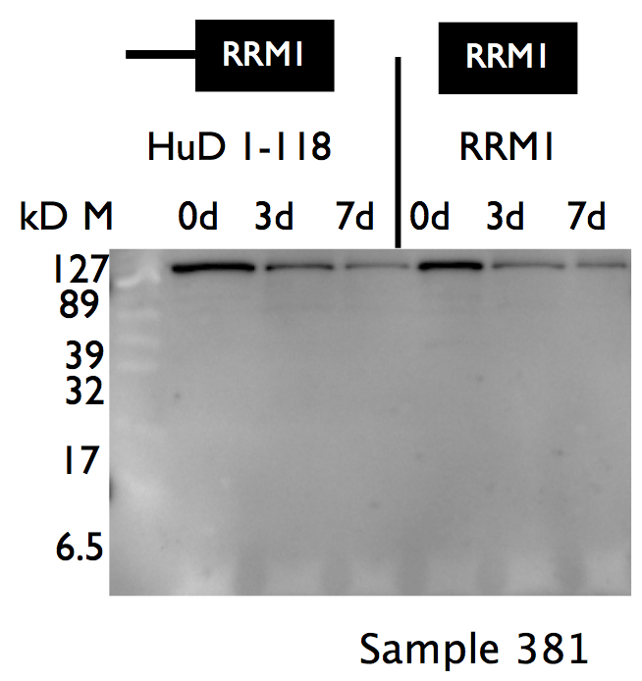
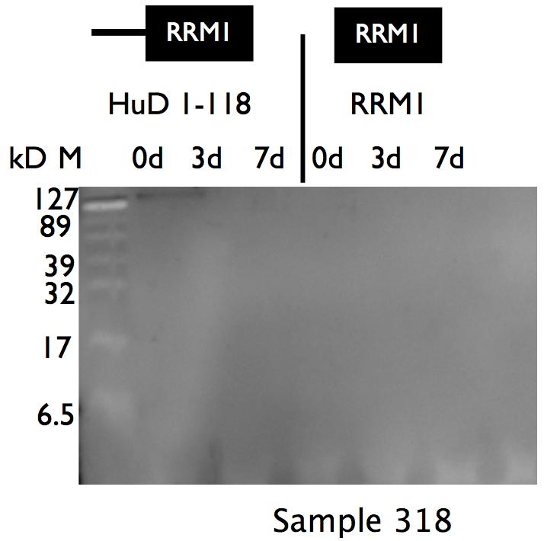
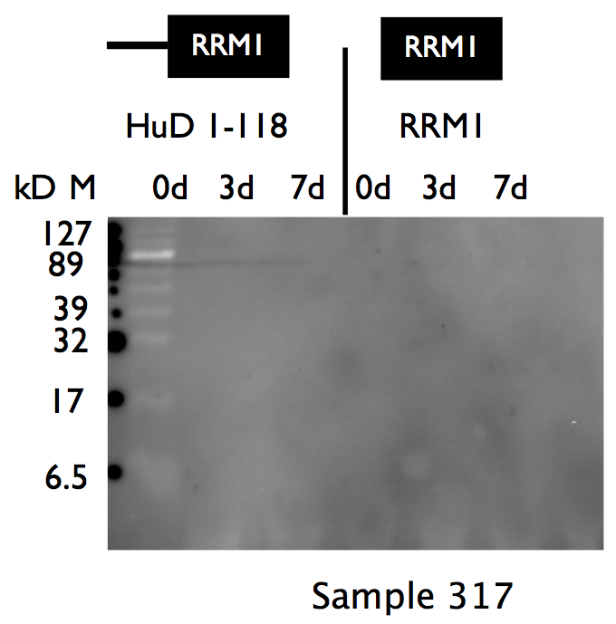
Supplemental Figure S2, Supplement to Fig. 5
ELAVL4
PatientRUL06
PatientRUL284
PatientRUL319
PatientRUL821
PatientRUL315
PatientRUL115
PatientRUL108
PatientRUL175
PatientRUL381
PatientRUL318
PatientRUL317
Figure S2, related to Figure 5. Examples of sera from SCLC patients previously shown to be anti-ELAVL4 negative, that do not react with native protein or protein that has undergone isoaspartylation.
The top left corner shows a Coomassie blue-stained representative gel with recombinant ELAVL4 fragment of amino acids 1-117 or the RRM1 domain alone. Recombinant proteins were incubated under isoaaspartylation conditions for 0,3 or 7 days. Blots were generated as in Fig. 5, and upon transfer, the presence of recombinant protein on the blots was confirmed by Ponceau Red staining. Blots were incubated with patient sera and secondary antibody as in Fig. 5 at a 1:1000 dilution, and exposed as described for Fig. 5.

