Slide 1
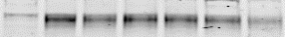
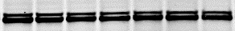
Supplementary Figure 1
0
1.5
3
18
2% O₂ (h)
-
-
+
-
+
-
+
VX-970
HIF-1α
HIF-2α
GAPDH

Slide 2
Supplementary Figure 2
OE33
DMSO
VX-970
1
Surviving fraction
*
0.1
0.0
0.5
1.0
Cisplatin (
µM)

Slide 3
Supplementary Figure 3
A
B
C
D

Slide 4
Supplementary Figure 4
A
OE33
21% O₂
1
0.1
Surviving fraction
0.01
*
DMSO
VX-970
0.001
0
2
4
6
8
Dose (Gy)
B
OE33
<0.1% O₂
1
Surviving fraction
0.1
**
DMSO
0.01
VX-970
0
2
4
6
8
Dose (Gy)

Slide 5
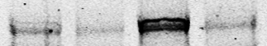
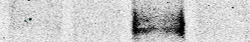
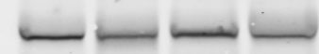

Supplementary Figure 5
A
H&E
CTRL
PIMO
B
-
+
-
+
VX-970
-
-
+
+
IR (10 Gy)
ATR-T1989
Chk1-S345
Chk1
GAPDH
C
ATR-T1989
D
53BP1
No IR
IR
No IR
IR
Control
Control
VX-970
VX-970

Slide 6
Supplementary Figure 6
0
5
10
15
20
25
30
35
40
45
50
VX-970
IR (10 Gy)

