Slide 1
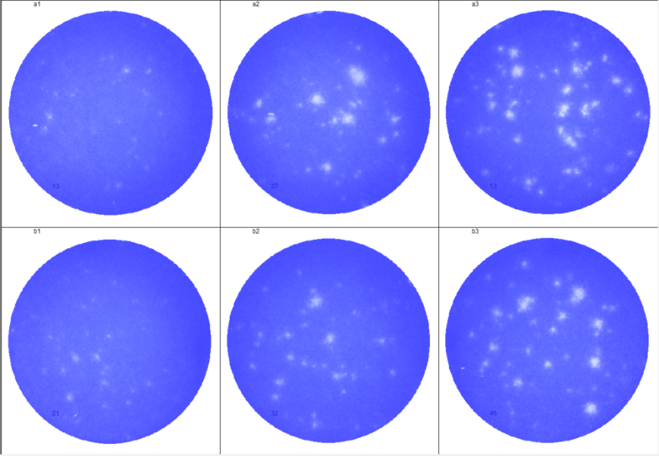
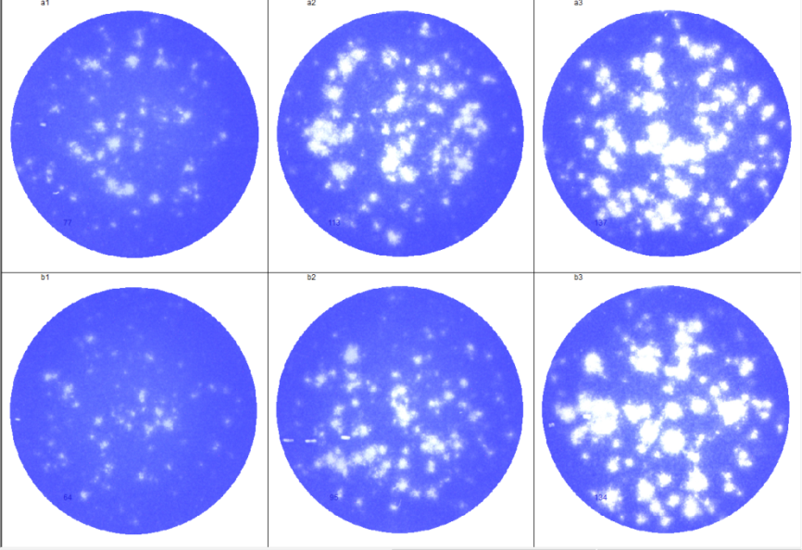
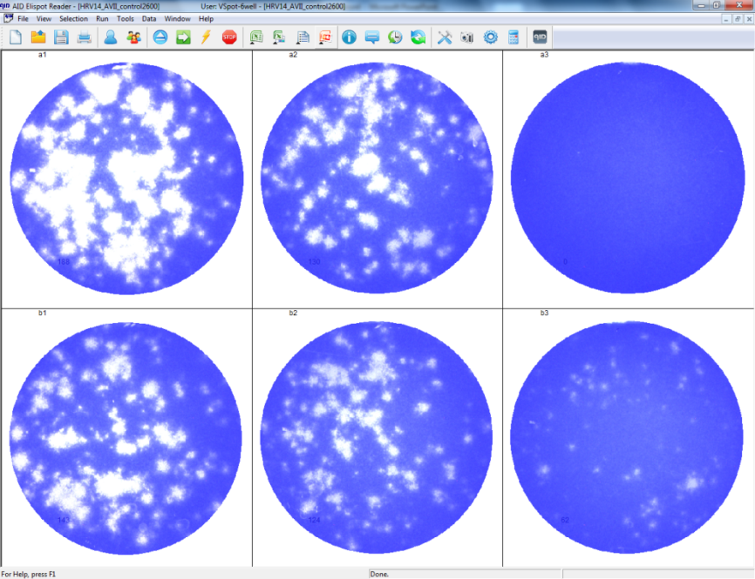
Supplementary figure 2
HRV14
1mM
0.5mM
0.3mM
13
37
53
21
32
46
0.1mM
0.05mM
0.005mM
77
113
137
64
95
134
EtOH control
Ribavirin
143
124
62
Virus control
Non infected
188
130
0

