Slide 1
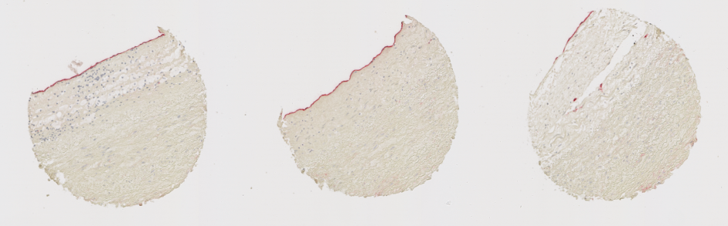
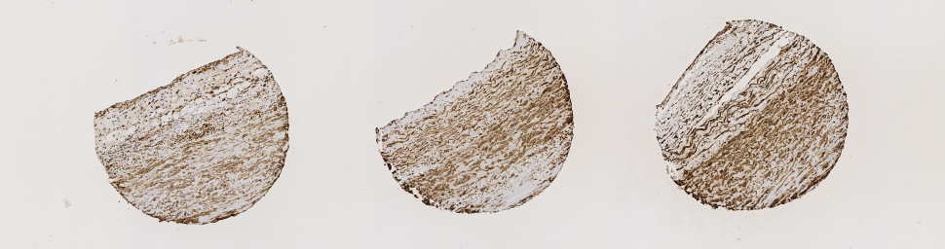
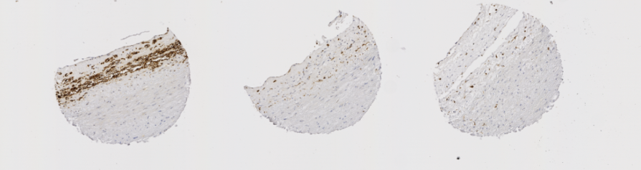
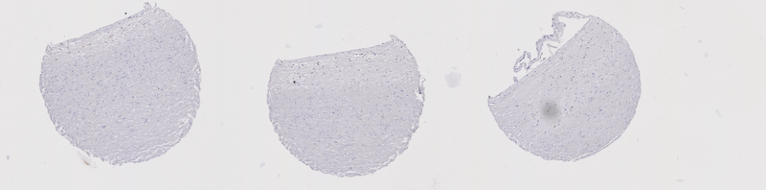
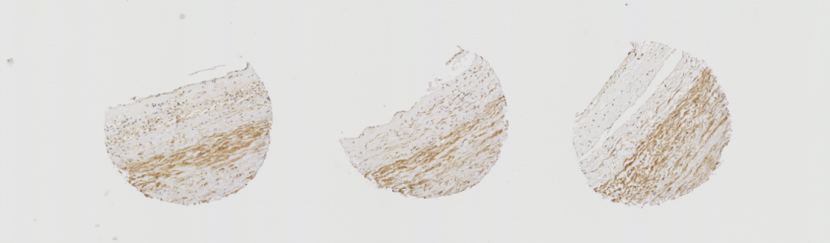
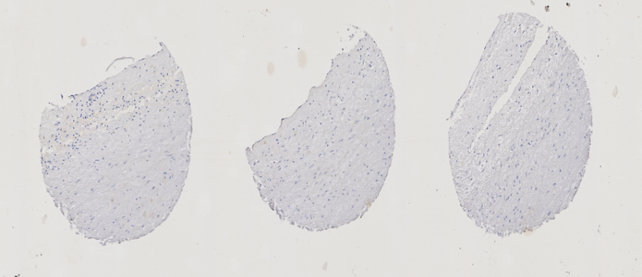
Figure S1. LPP3 expression in vascular cells
CD34
α-actin
CD68
CD3
LPP3
Rabbit serum

Slide 2
Figure S2: Silencing of LPP3 in HAECs with siLPP3 (2)
**

Slide 3
Figure S3. LPP3 downregulates IL1B mRNA level but not cytokine secretion HAECs
A
B
**
**
IL1β mRNA (fold change of Ctrl)
IL1β mRNA (fold change of Ctrl)
C
IL1β (pg/ml)
ns
Ctrl
siLPP3

Slide 4
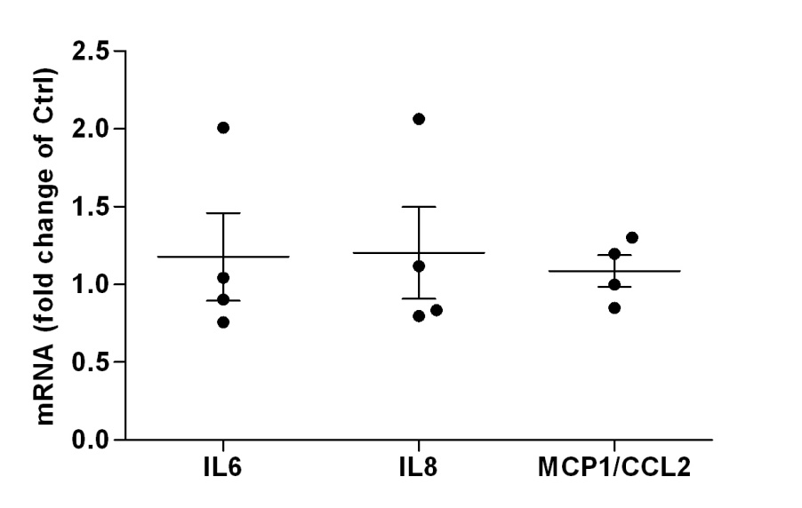
Figure S4. Overexpression of LPP3 does not modify pro-inflammatory cytokines in HAECs
A
ns
B
20000
ns
15000
ns
Cytokine (pg/ml)
10000
ns
5000
0
Ctrl
hLPP3
Ctrl
hLPP3
Ctrl
hLPP3
IL6
IL8
MCP1/CCL2
Notes:
Refaire le graph avec ctrl variation

Slide 5
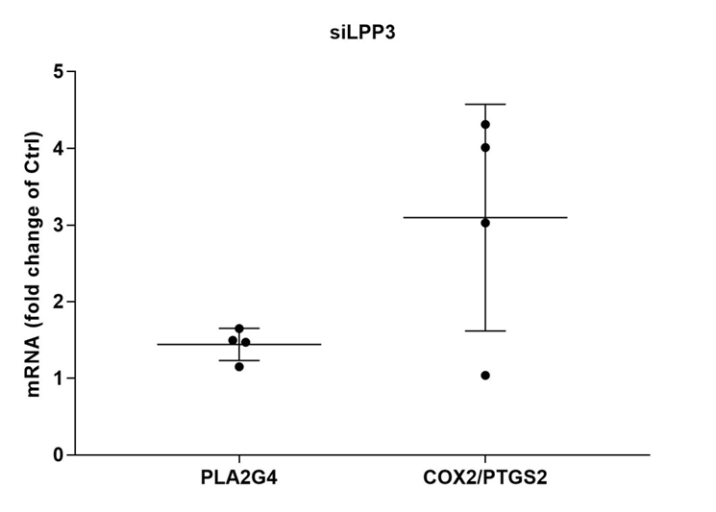
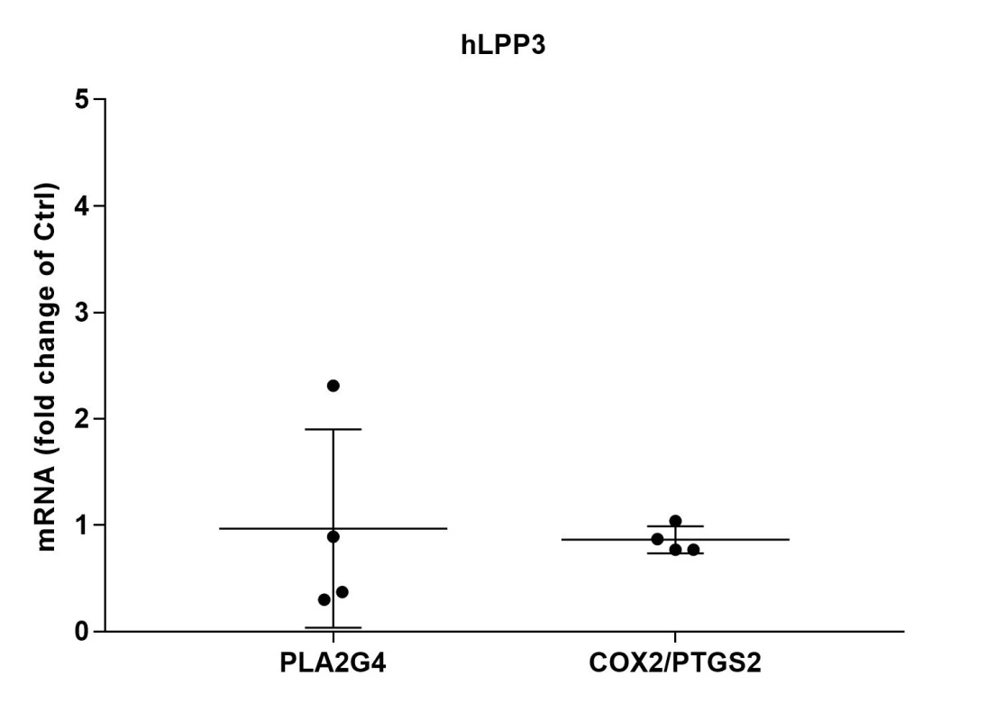
Figure S5. LPP3 dowregulates PLA2G4A and PTGS2 expression in HAECs
A
*
*
B
ns
*

Slide 6
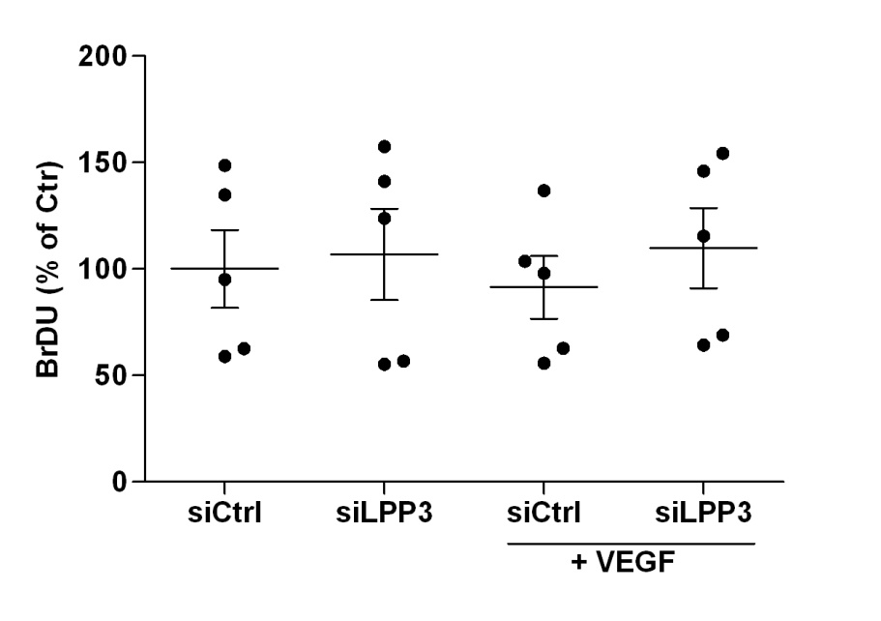
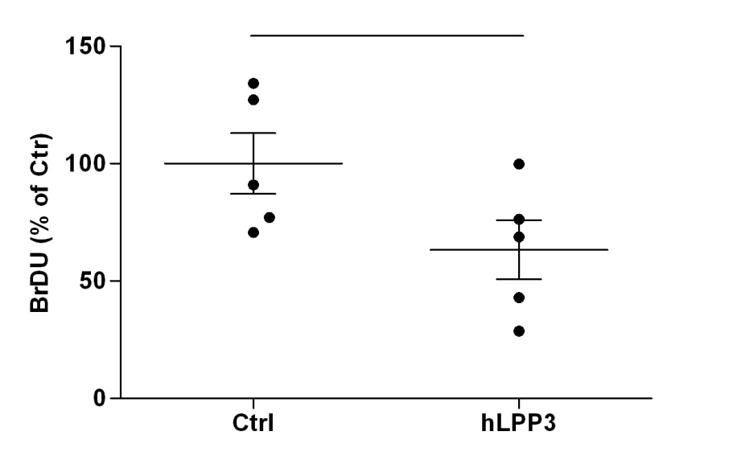
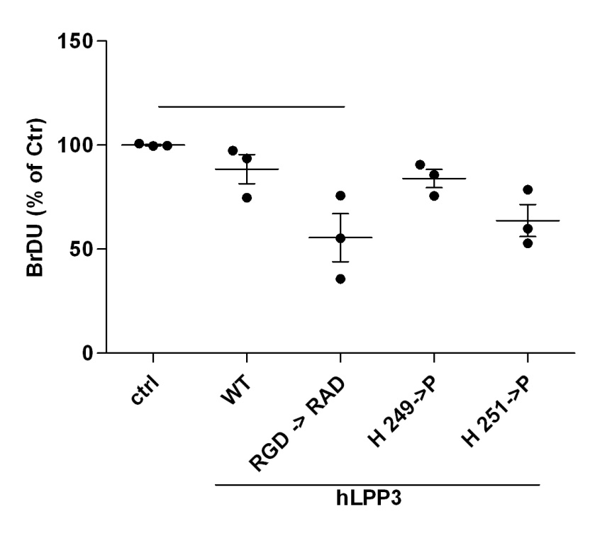
Figure S6. Effect of LPP3 on HAECs proliferation.
A
ns
*
B
**
C
*

Slide 7
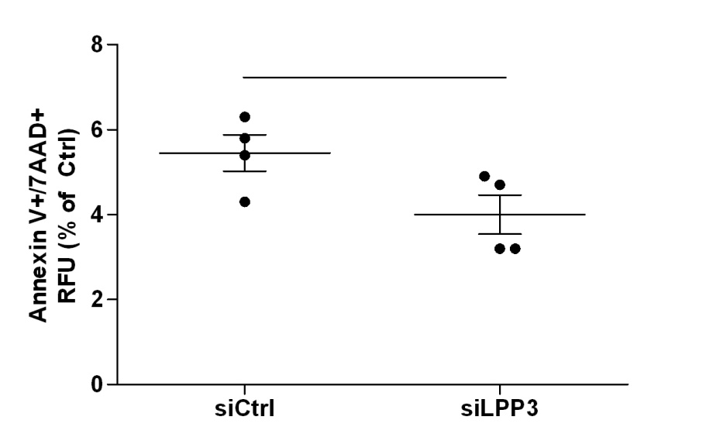
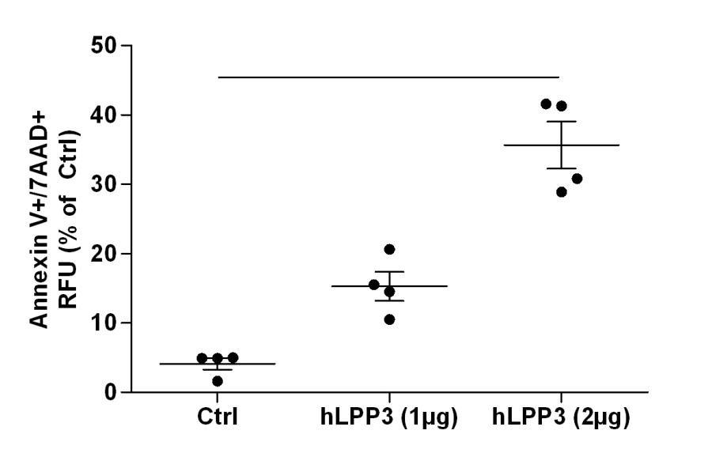
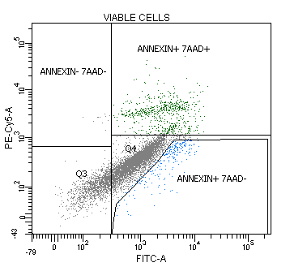
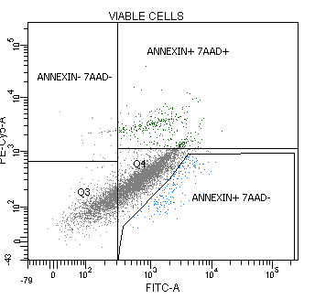
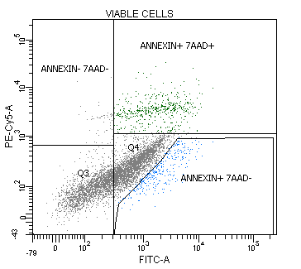
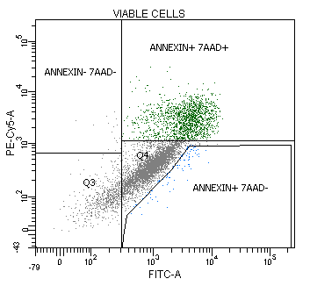
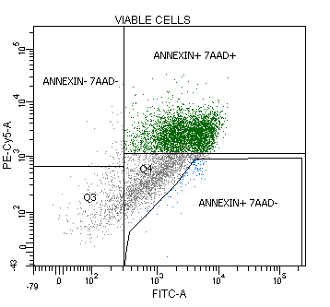
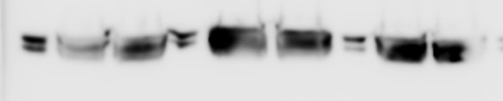



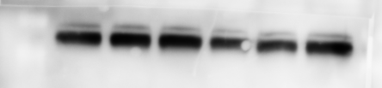
Figure S7. LPP3 increases apoptosis in HAECs.
A
ns
**
B
siCtrl
6.3%
siLPP3
3.2%
Ctrl
hLPP3 (1µg)
hLPP3 (2µg)
4.9%
15.5%
41.6%
C
siLPP3
hLPP3
siCtrl
Ctrl
p-ERK1/2
42-44 kDa
Total ERK1/2
42-44 kDa
Tubulin
50 kDa

Slide 8
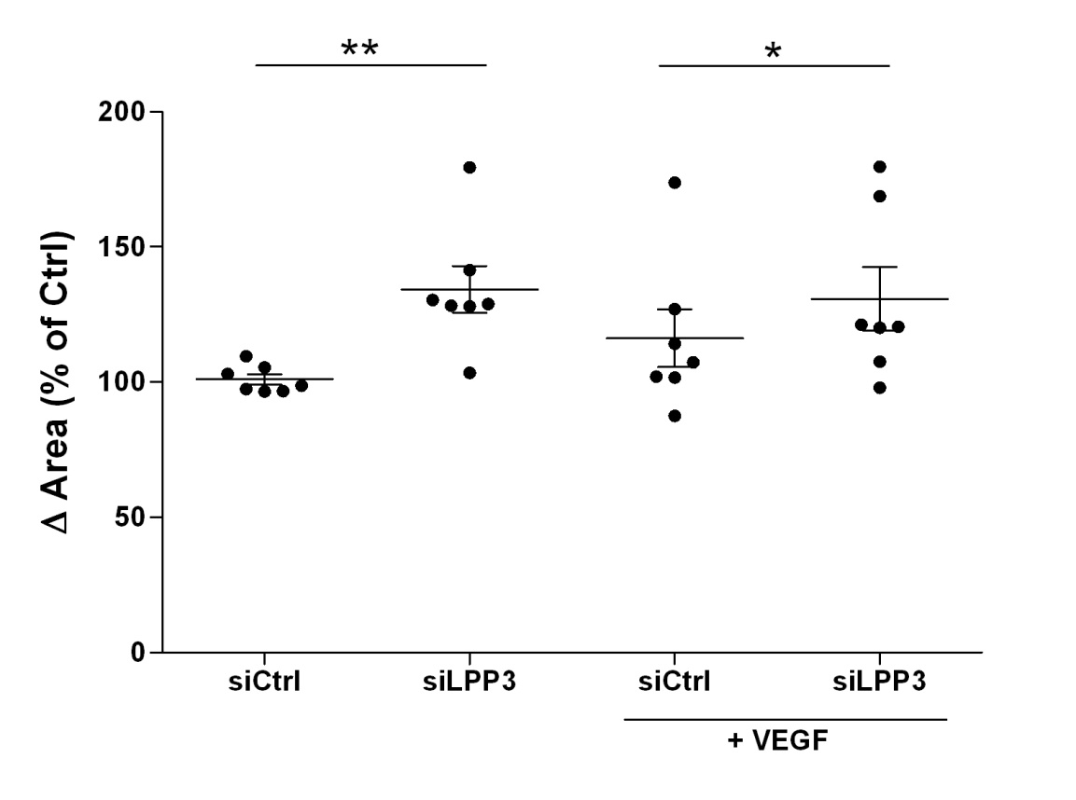
Figure S8. Effect of LPP3 on HAECs migration.

Slide 9
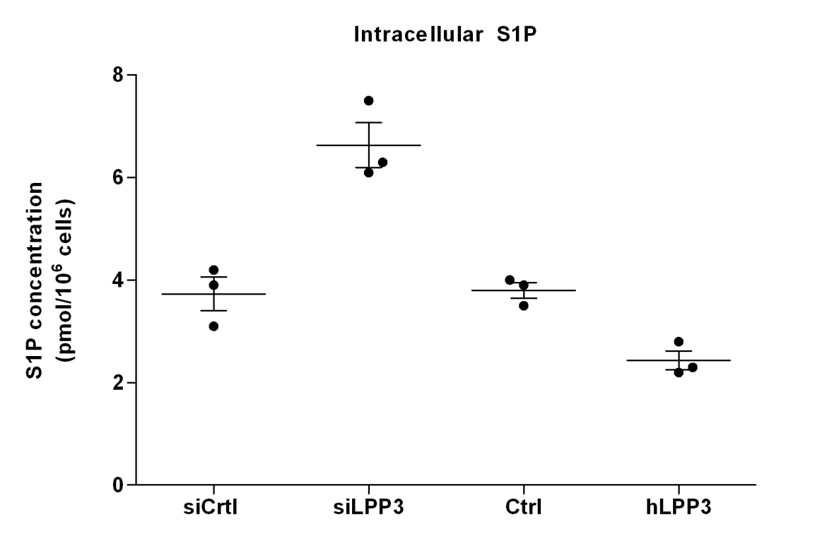
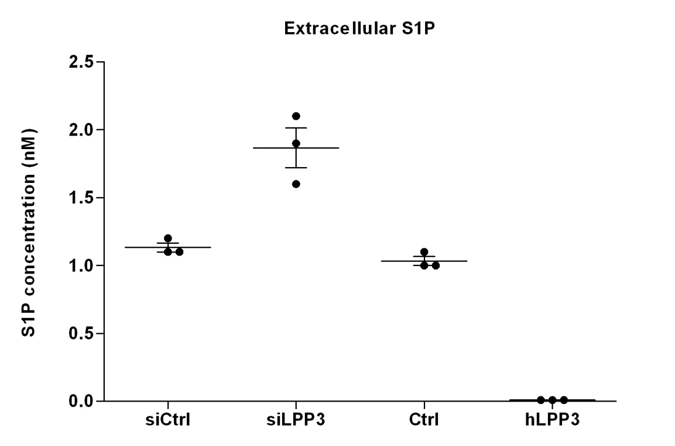
Figure S9. S1P levels in HAECs extracts and supernatants
A
B
nd

Slide 10
Figure S10. Graphical summary of principal results explaining the function of LPP3 in HAECs.
A
Endothelial dysfunction
B
Angiogenesis
Initiation:
Vasodilatation
Destabilisation of vascular wall
Degradation of extracellular matrix
Proliferation and migration of ECs
Resolution:
Inhibition of migration and proliferation
Reconstitution of extracellular matrix
Formation of cellular junctions
Assembly of the vascular wall

