Slide 1
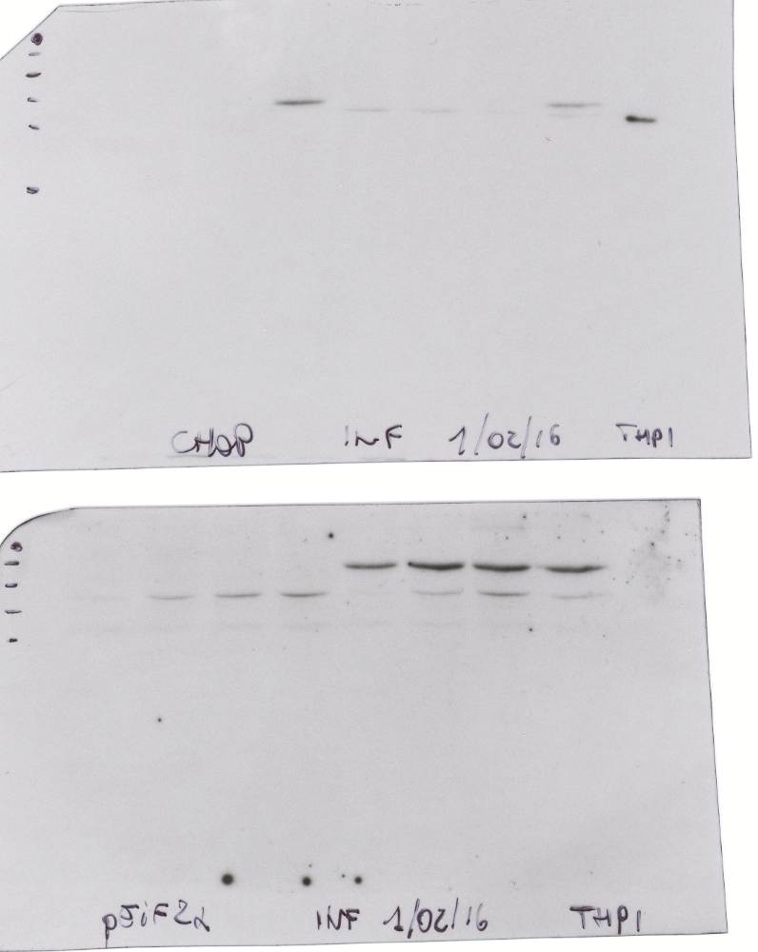
THP1
L. infantum
-
-
-
-
+
+
+
+
+
TUN 0.5 µg/ml
-
1 h
2 h
4 h
-
1 h
2 h
4 h
-
p-eIF2α
CHOP
Actin

