Slide 1
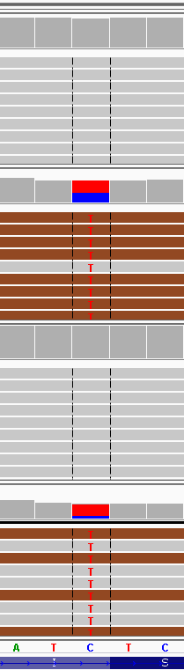
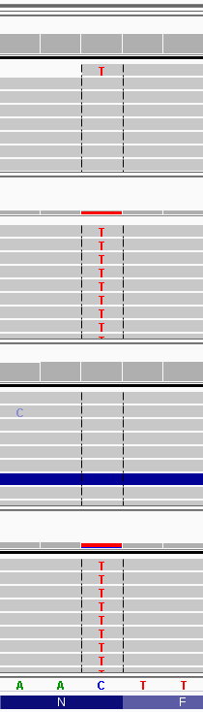
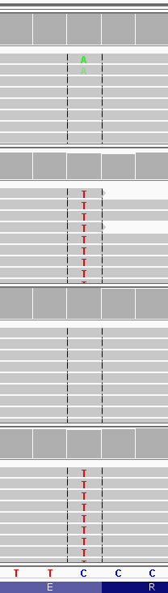
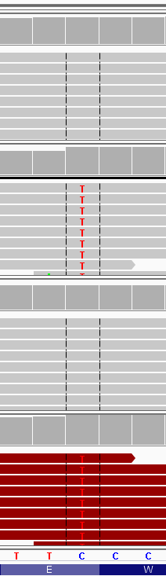
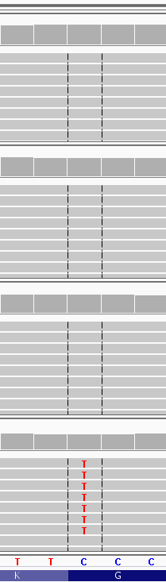
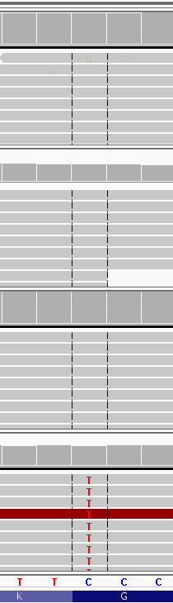
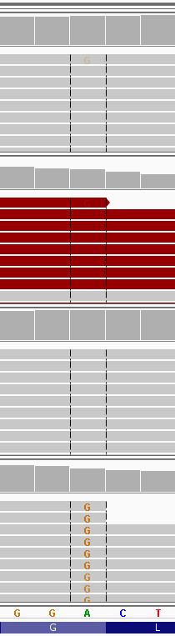
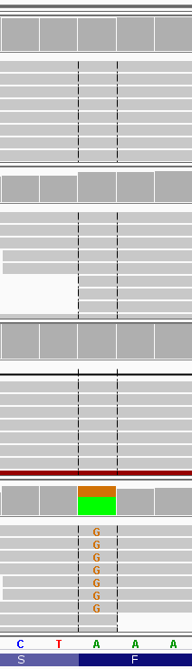
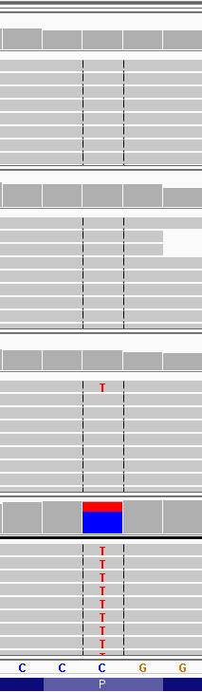
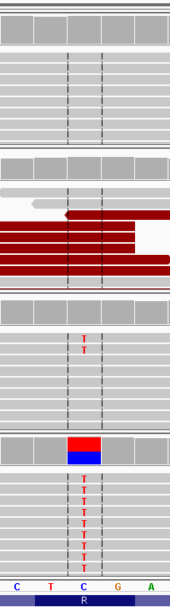
Supplementary Figure 1. IGV visualization of novel positions called as RNA editing by RNA2DNAlign. The gene and the position are shown on the top. The variant position is called in the normal and tumor transcriptomes (RNAed) or only in the tumor transcriptomes (T-RNAed).
LIMK2
chr22: 31673066 C>T
GLUD2
chrX: 120182384 C>T
KIAA1715
chr2: 176857119
C>T
SMEK2
chr2: 55831128
C>T
ZBTB41
chr1: 197168896
C>T
ANKRD50
chr4: 125590583
C>T
TRIM24
chr7: 138223458
A>G
ZNF132
chr19: 58945911 A>G
GSE1
chr16: 85691168
C>T
ABHD3
chr18: 19283602 C>T
Normal
Exome
Normal
Transcriptome
Tumor
Exome
Tumor
Transcriptome
RNAed
RNAed
RNAed
RNAed
T-RNAed
T-RNAed
T-RNAed
T-RNAed
T-RNAed
T-RNAed

