Slide 1
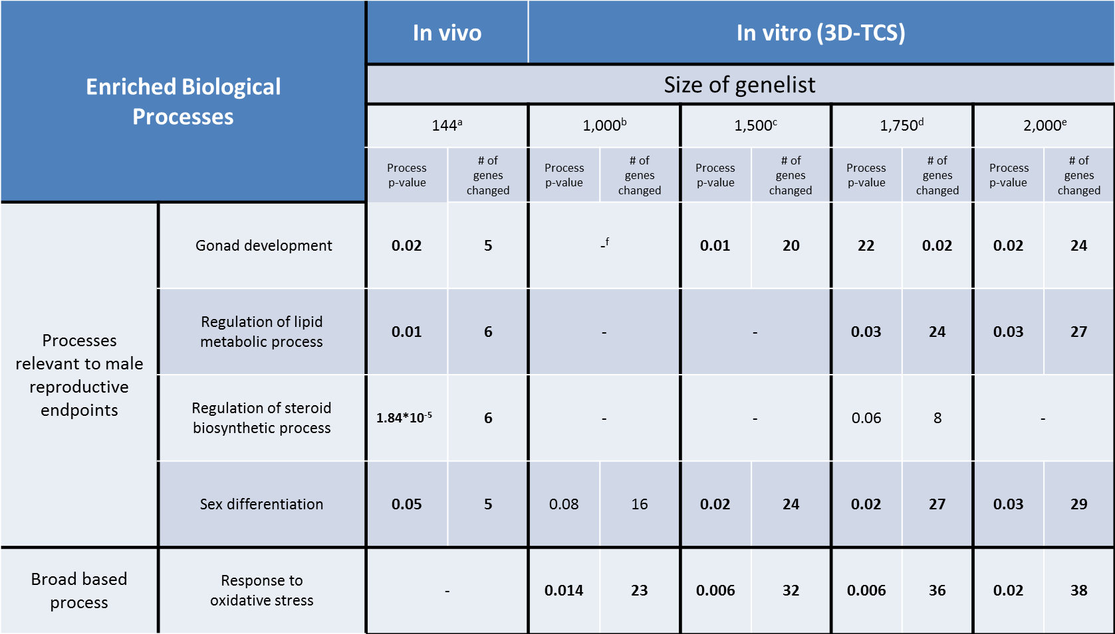
Supplemental Table 3: Analysis of power of detection for identifying male reproductive pathways
Genes significantly changed in at least one phthalate treatment compared to control were identified (F-test, FDR<0.05). Biological processes were identified using DAVID online software and were associated with both specific (male reproductive development) and non-specific (oxidative stress) responses in 3D-TCS. Processes were considered significantly enriched if genes changed ≥5 and p-values ≤0.05.
Significant p-values are listed in bold.
p-values associated with number of genes were ≤: ª0.001, ^{b}1x10⁻⁷, ^{c}9x10⁻⁷ , ^{d}6.6x10⁻⁶ or ^{e}4.78x10⁻⁵
^{f}-indicates biological process annotated in Gene Ontology, but not identified as significantly enriched
Significantly enriched values are listed in bold.

