Slide 1
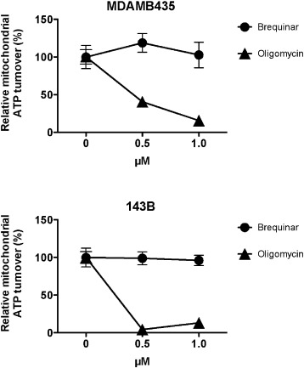
Supplementary fig. 1. In order to validate that inhibition of DHODHase with brequinar discriminately inhibits the DHODHase and not the ATP synthase, the rate of oxygen consumed by MDAMB435 and 143B cells was measured using the Seahorse XF Extracellular Flux An...
Claus Desler, Jane H. Frederiksen, Maria Angleys, Scott Maynard, Guido Keijzers, Birgitte Fagerlund, Erik Lykke Mortensen, Merete Osler, Martin Lauritzen, Vilhelm A. Bohr, Lene Juel Rasmussen
Increased deoxythymidine triphosphate levels is a feature of relative cognitive decline
Mitochondrion, Volume 25, 2015, 34–37
http://dx.doi.org/10.1016/j.mito.2015.09.002

