Slide 1
Supplementary Figure 1. Chemical structures of SR1078, SR0987, SR2211, ursolic acid, and desmosterol.
SR1078
SR0987
SR2211
Ursolic acid
Desmosterol

Slide 2
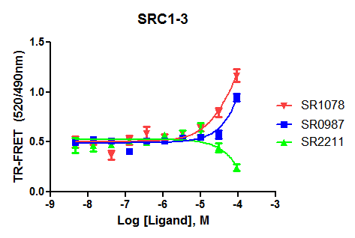
Supplementary Figure 2. CRC for SR1078 and SR2211 in the presence of ursolic acid (2μM) in the Gal4-RORγ::UAS-Luc reporter assay in HEK293T cells.
Supplementary Figure 3. CRC for SR1078, SR0987, and SR2211 in a TR-FRET assay using RORγ LBD and a FITC labeled SRC1 NR BOX 1 peptide.

Slide 3
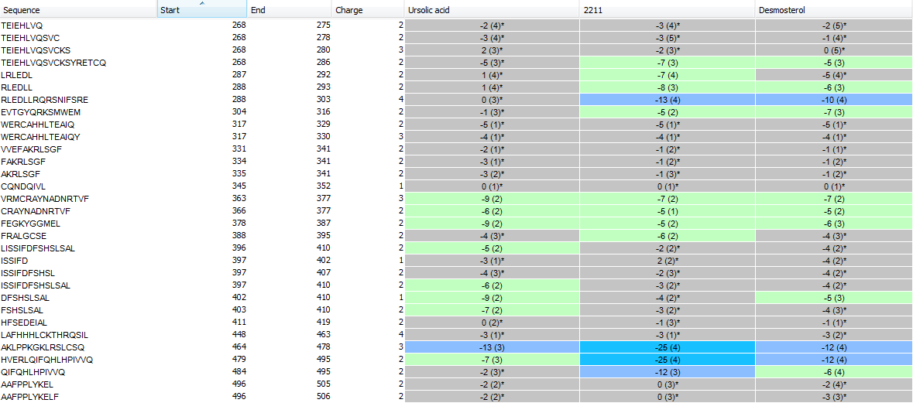
Supplementary Table 1a: Differential HDX Kinetics of RORγt ± Compounds.
Peptide Sequence
Charge
Start
End
RORγt ± Ursolic Acid (UA)
RORγt ± SR2211
RORγt ± Desmosterol
Structure
H1
H1
H1
H1
H2
H2
H2/H3
ΔHDX (%)
H3/H4
H4
≥ +10
H4
H4/H5
< +10
H4/H5
H4/H5
H5/H6
NS
H6/B1
B1
B2/H7
<-10
H7/H8
H8
<-20
H8
H8
H8
≥-20
H8
H8
H9
H10
H11
H11
H11
H12
H12

Slide 4
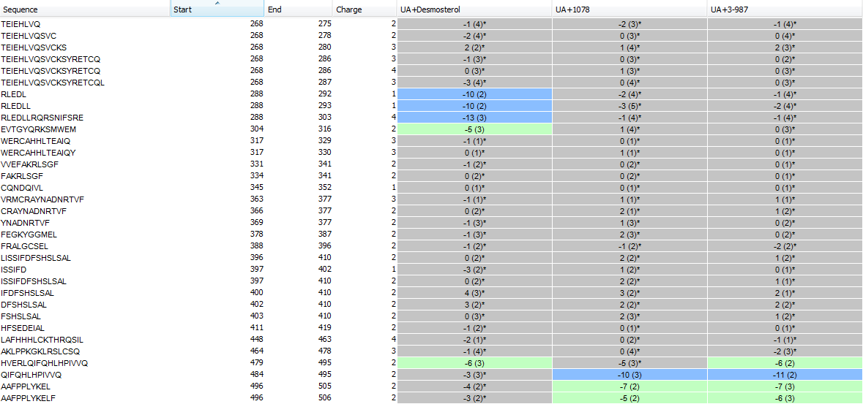
Supplementary Table 1b: Differential HDX Kinetics of RORγt pretreated with ursolic Acid ± Compounds.
Peptide Sequence
Start
End
Charge
RORγt/UA ± Desmosterol
RORγt/UA ± SR1078
RORγt/UA ± SR3-987
Structure
H1
H1
H1
H1
H1
H1
H2
H2
H2/H3
ΔHDX (%)
H3/H4
H4
≥ +10
H4
H4/H5
H4/H5
< +10
H5/H6
H6/B1
B1
NS
B1
B2/H7
<-10
H7/H8
H8
H8
<-20
H8
H8
H8
≥-20
H8
H9
H10
H11
H11
H11
H12
H12

Slide 5
Supplementary Table 2: Primer sequence for Q-PCR analysis
Gene name | Primer sequence
Granzyme B (forward) | CCT CCT GCT ACT GCT GAC
Granzyme B (reverse) | GTC AGC ACA AAG TCC TCT C
IL17A (forward) | CTC CAG AAG GCC CTC AGA CTA C
IL17A (reverse) | GGG TCT TCA TTG CGG TGG
PD-1 (forward) | CGT CCC TCA GTC AAG AGG AG
PD-1 (reverse) | GTC CCT AGA AGT GCC CAA CA

