Slide 1
30
25
20
CAT activity (μmol/min/g)
15
10
5
0
Col-0
1
Col-0
2
cat3
1
cat3
2
Supplementary Fig. 1 Catalase activity in CMV-inoculated Arabidopsis cat3 (CAT3-knockout Col-0 mutant). Catalase activity was determined by measuring OD (A₂₄₀) at 14 dpi. Total protein was extracted from the inoculated leaves of Arabidopsis at 14 dpi as essentially described before (Inaba et al. 2011). Catalase activity was expressed as μmol/min/g protein. The results of two individual plants are shown.

Slide 2
Supplementary Fig. 2 Expression levels of the CAT3 gene in wild-type (Col-0) and CAT3/cat3 transgenic T1 plants. RNA was extracted 1.5 month-old plants. Expression levels of CAT3 were determined by quantitative RT-PCR using the primer pair, AtCAT3-5 and AtCAT3-3 (Inaba et al. 2011). Values were normalized using mRNA levels of the β-tubulin gene. The averages ± SD of three biological replicates are shown.

Slide 3
a
pCY2 (CMV RNA2)
5′
2a
2b
3′
CMV-A1
StuI-stop-MluI-SnaBI
5′
2a
2b
3′
CMV-A1-DsRed2 (A1Ds)
StuI (NruI)
MluI
5′
2a
2b
Ds-Red2
3′
b
Y2b MELNVGAMTNVELQLARMVEAKKQRRRSHKQNRRERGHKSPSERARSNLRLFRFLPFYQV 60
N2b MELNVGAMTNVELQLARMVEAKKQRRRSHKQNRRERGHKSPSERARSNLRLFRFLPFYQV 60
Y2b DGSELTGSCRHANVAESPEPEASRLE-LSAEDHDFDDTDWFAGNEWAEGAF--------- 110
N2b DGSELTGSCRHANVAESPEPEASPLNGIWAILKNNEMLTWPEKIKFAIGLLPAIRVYVNL 120
Y2b -------------------
N2b PFRISLRFSVAGAELAVLL 139
Supplementary Fig. 3 The 2b fusion proteins in the recombinant constructs used in this study. A, Constructions of A1Ds expressing the 2b-Ds-Red2 fusion protein. B, Alignment of the amino acid sequences of Y2b and the 2b protein of CMV-N (N2b). The C-terminal of N2b was coincidentally created by inserting a DNA fragment into the CMV-A1 vector. The nucleotide sequence of N2b was deposited to GenBank (accession no. LC167300).
Notes:
There should be no space between the characters for the restriction sites. Also note that restriction sites and enzymes are no longer italicized (since 2003). I can send you the URL for the reference if you wish.
Good to know!

Slide 4
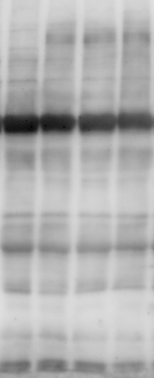
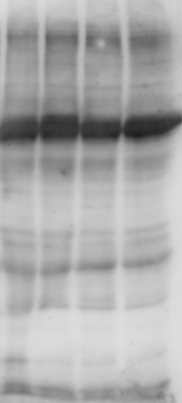


MG132
－
1
＋
4
1
2
3
4
2
3
(kDa)
100
75
CAT
(57 kDa)
63
48
35
25
CBB
staining
Supplementary Fig. 4 Representative image of a Western blot to analyze an effect of MG132 on CAT levels in Col-0 plants infected with CMV-Y. Four individual leaf samples were used for each treatment.

