Slide 1
Supplementary Information
Supplementary Materials and Methods
Immunohistochemical (IHC) and TUNEL staining
Samples of back skin from sacrificed, shaved control mice or mice at 43 hours or week 17 of the tumor induction experiment were collected and fixed with 4% paraformaldehyde and embedded in paraffin according to standard protocols. Hematoxylin/eosin staining and DAB immunohistochemical staining (IHC) was performed on 6 µm thick paraffin sections as previously described (1). The following primary antibodies were used for IHC (according to the manufacturer’s instructions): M7249 TEC-3 rat anti-Ki67 and A0452 rabbit anti-CD3 (DakoCytomation, Glostrup, Denmark), 550274 rat anti-CD31 (BD Pharmingen, Oxford, UK), 68672 rabbit anti-neutrophil elastase (AbCam, Cambridge, UK), MF48000 BM8 rat anti-F4/80 (Life Technologies Ltd., Paisley, UK) and H-220 rabbit anti-FURIN (Santa Cruz, Dallas, TX, USA). The blocking reagents used for IHC were S2O23 REAL and S0809 Antibody Diluent (Dako). In the case of blocking prior to CD3 or neutrophil elastase staining, G9023 goat serum or A4503 BSA (Sigma) were used respectively, at 5% in PBS. The horseradish peroxidase (HRP) conjugated secondary antibody reagents used were: PO448 goat anti-rabbit (Dako), 414311F anti-rat Histofine (Nichirei Bio, Tokyo, Japan) and for neutrophil elastase staining RMR622 Rabbit on Rodent (Biocare Medical, Concord, CA, USA). XMF963 XM-Factor (Biocare) was used to block before secondary staining with Rabbit on Rodent. Peroxidase reactive chromogens used were K3465 DAB (DAKO) and RAEC810 Romulin AEC (BioCare). Immunohistochemical TUNEL staining for apoptotic nuclei was performed using the K403-50 TUNEL IHC Kit (Biovision, Milpitas, CA, USA) with Methyl Green nuclear counter stain as previously described (1).
Quantitative analysis of immunostaining and histochemical staining
All slides were scanned using the Aperio ScanScope® CS and XT systems (Aperio Technologies Inc., California, USA) as previously described (1-2). Slides were viewed and analyzed remotely using desktop personal computers employing the web-based ImageScope™ viewer. The Spectrum digital pathology system analysis algorithm package and Image Scope analysis software (version 9; Aperio Technologies Inc.) were applied to quantify immunohistochemical signal. These algorithms calculate the area of positive staining, the average positive intensity (optical density), as well as the percentage of weak (1+), medium (2+), and strong (3+) positive staining. All quantified histochemical analyses (Ki-67, CD31, F4/80, CD3, elastase, TUNEL) were performed according to the protocols used to establish these algorithms for each respective staining. Approximately 5 000 cells were counted for each measurement from each sample.
For FURIN expression analysis, the slides were imaged via Olympus light microscope and Cell Sens Dimensions software and analyzed with ImageJ 1.44p software using thresholding method to measure the percentage of FURIN positive area in dermis from the total dermal area.

Slide 2
Extraction of RNA and quantitative PCR (qPCR) analysis
Samples of back skin were harvested into RNAlater RNA Stabilization Reagent (Qiagen, Hilden, Germany) and the mRNA was extracted using Invitrogen Trizol Reagent (Thermo Fisher Scientific, Waltham, MA, USA) according to the manufacturer’s instructions. Homogenization and RNA extraction was done as previously described (1). RNA was converted to cDNA by reverse transcription using the Thermo Maxima First Strand cDNA Synthesis Kit for RT-qPCR (Thermo Fisher Scientific) according to the manufacturer’s instructions. 40 ng cDNA (for IFNɣ, reference genes HPRT and TBP), or 80 ng cDNA (for IL-17A, HPRT and TBP) and Thermo Maxima SYBR Green/ROX qPCR Master Mix (2x) (Thermo Fisher Scientific) were used for qPCR analysis, performed in a 7500 Real-Time PCR System (Thermo Fisher Scientific). The thermal cycler profile for all primer sets was: 2min 50°C, 10 min 95°C, 40 x (15 sec 95°C, 30 sec 59°C, 32 sec 72°C). Raw fluorescence data were analyzed with the LinRegPCR program (version 2014.8, http://LinRegPCR.HFRC.nl), based on the methods and procedures described by Ruijter et al., 2009 (3).
Primer sequences were as follows: IFNɣ, 5’-CCAAGTTTGAGGTCAACAACC-3’ (forward) and 5’-GCTTCCTGAGGCTGGATTC-3’ (reverse). IL-17A, 5’-GACTCTCCACCGCAATGAA-3’ (forward) and 5’-GACCAGGATCTCTTGCTGGA-3’ (reverse). HPRT, 5'-AGGGATTTGAATCACGTTTGTGT-3' (forward) and 5'-GGCCACAGGACTAGAACACC-3' (reverse). TBP, 5'-CCCACCAGCAGTTCAGTAGC-3' (forward) and 5'-TCTGCTCTAACTTTAGCACCTGTT-3' (reverse). FURIN, 5'-CAG AAG CAT GGC TTC CAC AAC-3' (forward) and 5'-TGT CAC TGC TCT GTG CCA GAA-3' (reverse). 18S, 5'-GTG ATC CCT GAG AAG TTC CAG-3' (forward) and 5'-TCG ATG TCT GCT TTC CTC AAC-3' (reverse).
Supplementary references
(1) May U, Prince S, Vahatupa M, Laitinen AM, Nieminen K, Uusitalo-Jarvinen H, et al. Resistance of R-Ras knockout mice to skin tumour induction. Sci Rep 2015; 5: 11663.
(2) Järvinen TA & Ruoslahti E. Target-seeking antifibrotic compound enhances wound healing and suppresses scar formation in mice. Proc Natl Acad Sci USA. 2010; 107:21671-21676
(3) Ruijter JM, Ramakers C, Hoogaars WM, Karlen Y, Bakker O, van den Hoff MJ, et al. Amplification efficiency: linking baseline and bias in the analysis of quantitative PCR data. Nucleic Acids Res 2009; 37: e45.

Slide 3
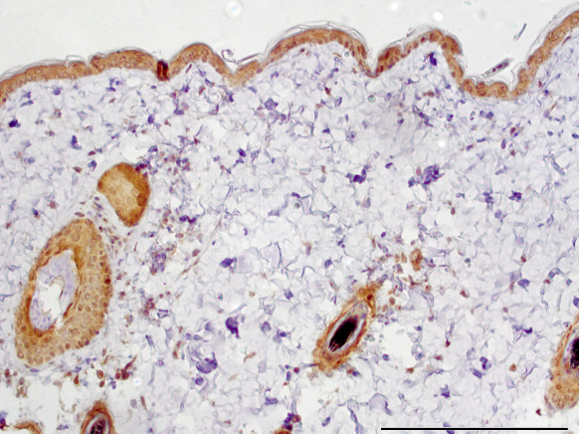
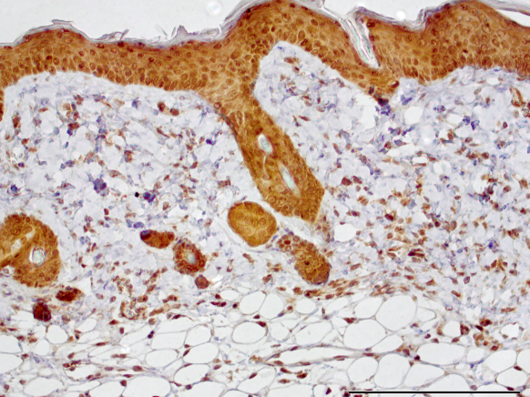
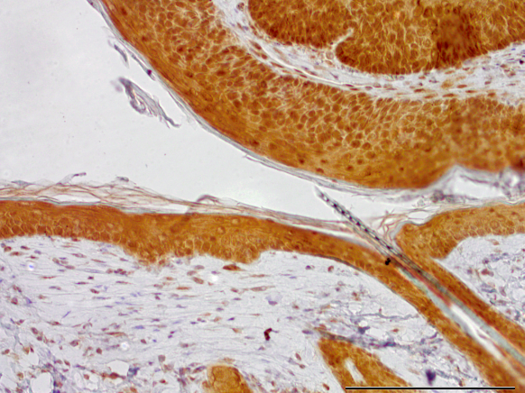
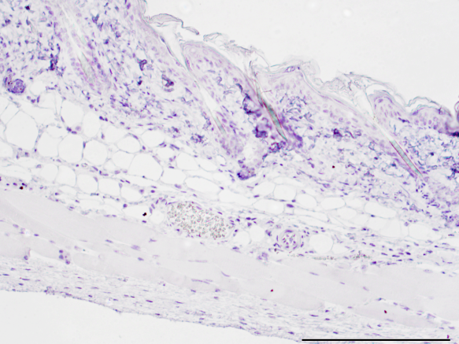
A
B
***
**
**
C
Untreated 43 h
17 wk neg. ctrl
Supplementary Figure S1. FURIN expression is induced in wild-type mouse skin after DMBA/TPA treatment. The back skins from untreated and DMBA/TPA-treated (for 43 h or 17 weeks) wild-type animals were collected for FURIN expression analyses. (A) FURIN positive cells in dermis were quantified using immunohistochemistry (IHC). Results are presented as mean ± 95% confidence intervals. The information of animal numbers and analyzed tissue regions is shown in Supplementary Table 1. (B) The FURIN and 18S (housekeeping gene) expressions in skin were determined by quantitative RT-PCR. The normalized FURIN expression in untreated skin was arbitrarily set to 1. Results are presented as mean ± SEM. The data were analyzed with one-way ANOVA and Tukey HSD test. Animal numbers; untreated n=4; 43 h n=3; 17 weeks n=4. (C) Representative photographs of the FURIN expression in the DMBA/TPA-model are shown. The black bars represent 200 µm. (P<0.001, ***; P<0.01, **)

Slide 4
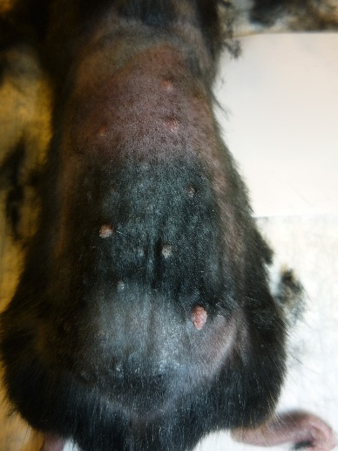
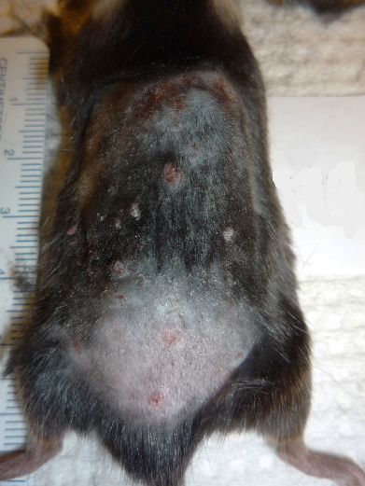
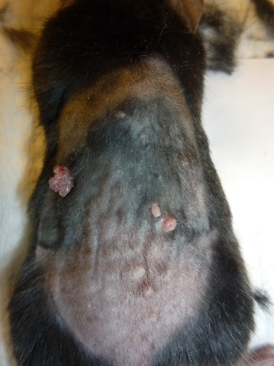
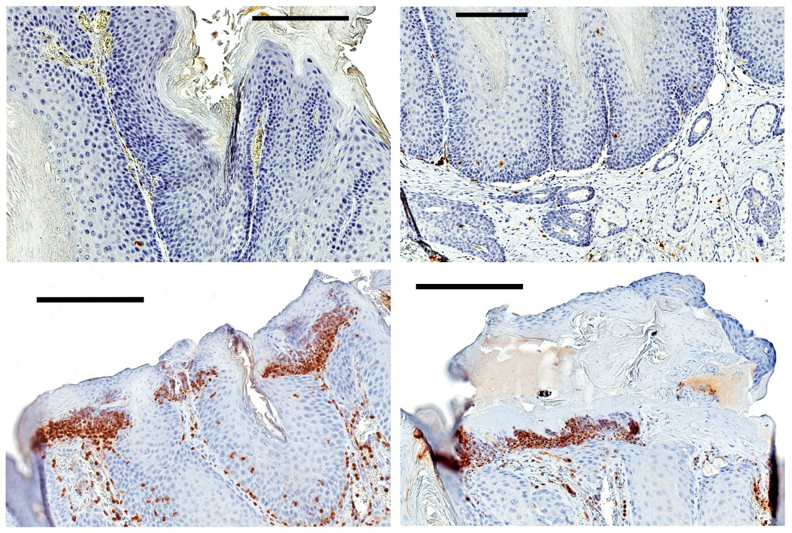
A
B
***
***
C
D
E
WT CD4cre KO LysMcre KO
F
CD4
WT
CD4cre
KO
Supplementary Figure S2.

Slide 5
Supplementary Figure S2. Skin tumors disappear and turn into skin ulcers in mice deficient of FURIN in T cells. WT, (CD4 WT and LysM WT combined) CD4cre and LysMcre KO mice were subjected to DMBA/TPA-induced skin carcinogenesis as described in methods. Changes in the tumor development were recorded for each individual tumor. (A) Distribution of <2 mm and ≥2 mm papillomas in each group of animals is shown as a percentage of total papillomas. The average percentage of tumors grouped by their size during the first three weeks after a papilloma had reached 1 mm in diameter is shown. Error bars represent standard deviations. (B) The distribution of events in tumor development is shown in percentages in WT (CD4cre + LysMcre), CD4cre KO and LysMcre KO animals. (P<0,001, ***, Pearson Chi-Square test). Representative images of LysM WT (C), CD4cre KO (D) and LysMcre KO (E) animals. Arrows point disappeared papillomas and the bracket points to chronic ulcerations. (F) Large clusters of neutrophils were seen in the epidermis of small papillomas (lower left corner) or ulcers (lower right corner) in CD4cre KO mice but not in CD4 WT mice (upper row). Scale bar represents 200 µm. The information of animal numbers and analyzed tissue regions is shown in Supplementary Table 1.

Slide 6
A
epidermal thickness
B
dermal thickness
CD4 WT
CD4cre KO
μm
μm
Untreated
Untreated
17 weeks non-tumor
17 weeks non-tumor
C
epidermal Ki67
D
dermal Ki67
CD4 WT
CD4cre KO
% of total cells
% of total cells
Untreated
17 weeks tumor
Untreated
17 weeks tumor
17 weeks non-tumor
17 weeks non-tumor
E
Untreated
17 weeks non-tumor
CD4
WT
CD4cre
KO
Supplementary Figure S3.

Slide 7
Supplementary Figure S3. Thicknesses of epidermis and dermis and skin cell proliferation. CD4 WT and FURIN CD4cre KO mice were subjected to DMBA/TPA-induced skin carcinogenesis as described in methods. Skin samples were collected, fixed and processed for IHC staining of proliferating nuclei. Quantitative digital pathology analyses of scanned slides were performed. Statistical analyses were performed with GraphPad Prism 6 software. Results are shown as mean ± 95% confidence intervals. The data were analyzed by standard unpaired two-tailed Student’s t-tests. (A) Measurements of epidermal thickness of non-tumor regions of skin from paraffin sections in triplicates from CD4 WT and T-cell-specific FURIN KO mice (CD4cre KO). (B) Measurements of dermal thickness were taken from CD4 WT and CD4cre KO mice. The results are expressed as mean ± 95 % confidence intervals. Proliferating nuclei were stained by IHC with rat anti-Ki67 antibody, and the % of proliferating nuclei determined (C) in epidermis and (D) in dermis. (E) Representative Ki67 staining for proliferating cells in untreated and DMBA/TPA-treated skin is shown for the CD4 WT and FURIN CD4cre KO animals. Black bar in images represents 300 µm. The information of animal numbers and analyzed tissue regions is shown in Supplementary Table 1. (P<0.0001, ****; P<0.001, ***; P<0.01, **)

Slide 8
A
epidermal TUNEL
dermal TUNEL
CD4 WT
CD4cre KO
% of total cells
% of total cells
Untreated
43 h
Untreated
43 h
17 weeks tumor
17 weeks tumor
17 weeks non-tumor
17 weeks non-tumor
B
Untreated
17 weeks tumor
CD4
WT
CD4cre
KO
Supplementary Figure S4. Quantification of apoptotic cells in DMBA/TPA treated WT and T-cell-specific FURIN KO mice. CD4 WT and FURIN CD4cre KO mice were subjected to DMBA/TPA-induced skin carcinogenesis. Skin samples were collected, fixed and processed for IHC staining of proliferating and apoptotic nuclei as described in supplementary methods. Quantitative digital pathology analyses of scanned slides were performed. Statistical analyses were performed with GraphPad Prism 6 software. Results are shown as mean ± 95% confidence intervals. The data were analyzed using standard unpaired two-tailed Student’s t-tests. (A) Apoptotic cells were stained by immunohistochemical TUNEL staining, and the % of apoptotic nuclei was determined. (P<0.0001, ****; P<0.05,*) (B) Representative photographs of apoptotic cells in untreated and DMBA/TPA treated CD4 WT and CD4cre KO skin. Nuclei are stained turquoise, and apoptotic nuclei brown/black. The black bar in images represents 300 µm. The information of animal numbers and analyzed tissue regions is shown in Supplementary Table 1.

Slide 9
A
dermal CD31
CD4 WT
CD4cre KO
% area microvessels
Untreated
17 weeks tumor
17 weeks non-tumor
B
Untreated
17 weeks non-tumor
CD4
WT
CD4cre
KO
Supplementary Figure S5. Microvessel density in the dermis in DMBA/TPA treated WT and T-cell-specific FURIN KO mice. FURIN CD4cre KO and CD4 WT littermates were subjected to DMBA/TPA-induced skin carcinogenesis as described in methods. Skin samples were collected, fixed and processed for IHC. (A) The percentage area of dermis with microvasculature was determined by immunohistochemical staining for CD31 of 4% paraformaldehyde fixed, paraffin embedded sections of back skin. Quantitative analysis of blood vessel density in dermis was performed by Spectrum digital pathology system/Image Scope analysis software as described in supplementary methods. The values are shown as mean ± 95% confidence interval. The data were analyzed using standard unpaired two-tailed Student’s t-tests (P<0.0001, ****). B) Representative CD31 staining for blood vessels in untreated and DMBA/TPA-treated skin is shown for the CD4 WT and FURIN CD4cre KO animals. Black bar in images represents 300 µm. The information of animal numbers and analyzed tissue regions is shown in Supplementary Table 1.

Slide 10
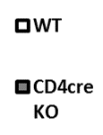
Supplementary Figure S6. QRT-PCR analysis of Ifng and Il17a gene expression in the skin of the DMBA/TPA treated WT and T-cell-specific FURIN KO mice. The animals were subjected to DMBA/TPA-induced skin carcinogenesis as described in methods. Skin samples were collected from untreated mice and from mice sacrificed at 3 h and 43 h after the 2nd TPA application, and after 17 weeks of treatment (twice weekly) from non-tumorous skin. The skin samples were processed for qRT-PCR analysis as described in supplementary methods. Results are shown as mean ± standard error of the mean. Numbers of mice: untreated n=4 (both genotypes); 3 h and 43 h n=3 (both genotypes); week 17 CD4 WT n=4; week 17 CD4cre KO n=3.

Slide 11



FURIN
T cell
Myeloid cell
papilloma
WT
DMBA
+ TPA (2x/week)
FURIN
1
weeks
17
T cell
Myeloid cell
papilloma
FURIN
CD4cre KO
Early stage
Th1-type ↑
Late stage
Th2/Th17-type ↑
Supplementary Figure S7. Schematic representation summarizing the outcome of T-cell specific deletion of FURIN in DMBA/TPA-induced skin cancer development.

Slide 12
Supplementary Table 1.
N numbers of immunohistological stainings. Shown are n numbers of animals and analyzed tissue regions ( n mouse / n tissue regions). Each tissue region contained mainly between 1000 and 5000 nuclei.
 | Ki67 and epidermal thickness | TUNEL | CD31 and dermal thickness | F4/80 | Neutrophil Elastase | CD3 | Furin
untreated WT | 5 / 27 | 4 / 27 for epidermis, 25 for dermis | 5 / 27 | 5 / 26 | 4 / 23 | 4 / 21 | 4/15
untreated KO | Ki67: 6 / 18; epid. thick.: 5 / 15 | 3 / 18 | 5 / 27 | 5 / 26 | 4 / 23 | 4 / 23 | not done
43 h treated WT | not done | 3 / 18 | not done | 1 / 6 | 3 / 18 | 3 / 18 | 3/16
43 h treated KO | not done | 3 / 17 | not done | 3 / 18 | 3 / 18 | 3 / 18 | not done
17 weeks treated WT non-tumor | 6 / 21 | 4 / 15 for epidermis, 14 for dermis | 6 / 21 | 6 / 21 | 6 / 24 | 5 / 21 | 3/14
17 weeks treated KO non-tumor | 4 / 21 | 4 / 13 | 4 / 20 | 4 / 21 | 4 / 22 | 3 / 17 | not done
17 weeks treated WT tumor | 4 / 6 | 2 / 3 | 4 / 5 | 1 / 1 | 4 / 4 | 4/ 8 | not done
17 weeks treated KO tumor | 4 / 17 | 2 / 5 | 4 / 13 | 3 / 14 | 4 / 12 | 4 / 10 | not done

