Slide 1
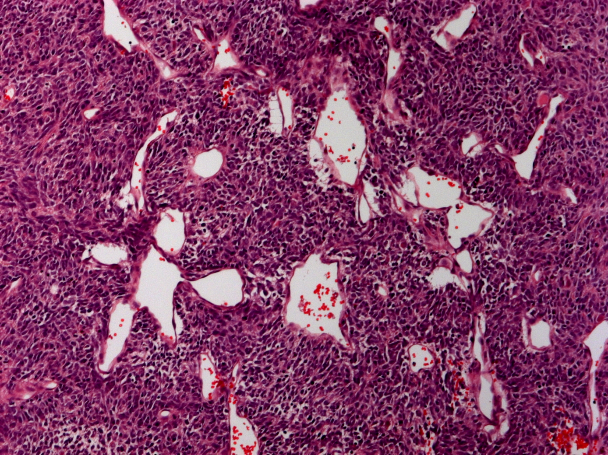
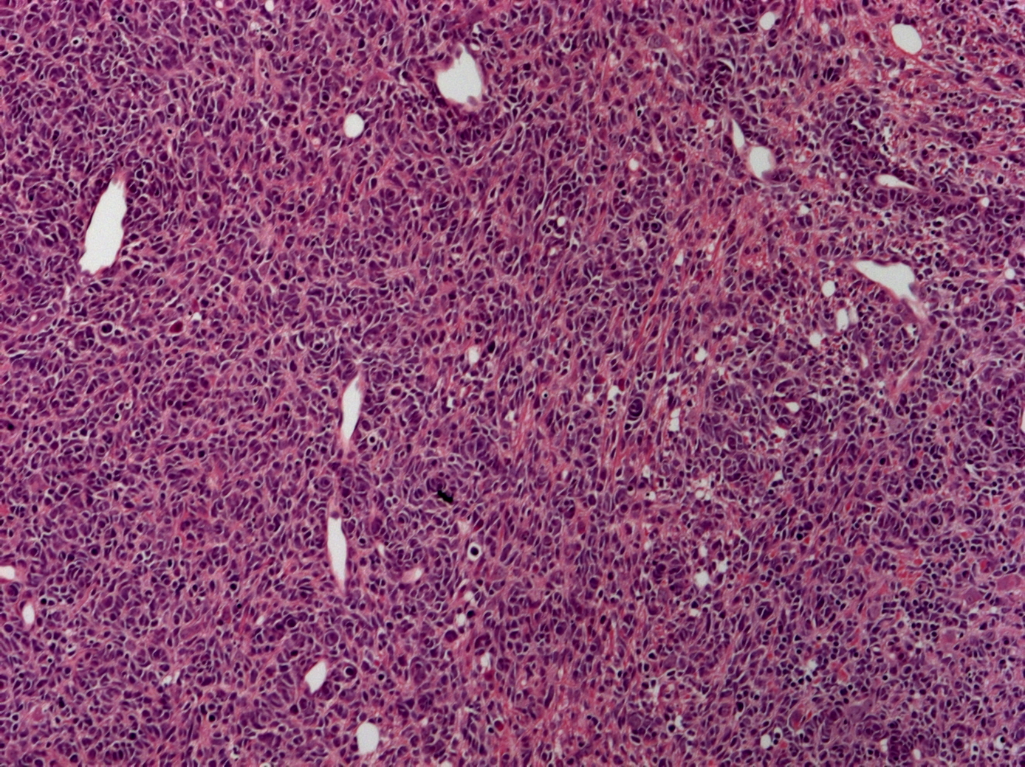
Figure S3
dKO Trp53^{cKO}
A
B
Notes:
Scale bar=50um

