Slide 1
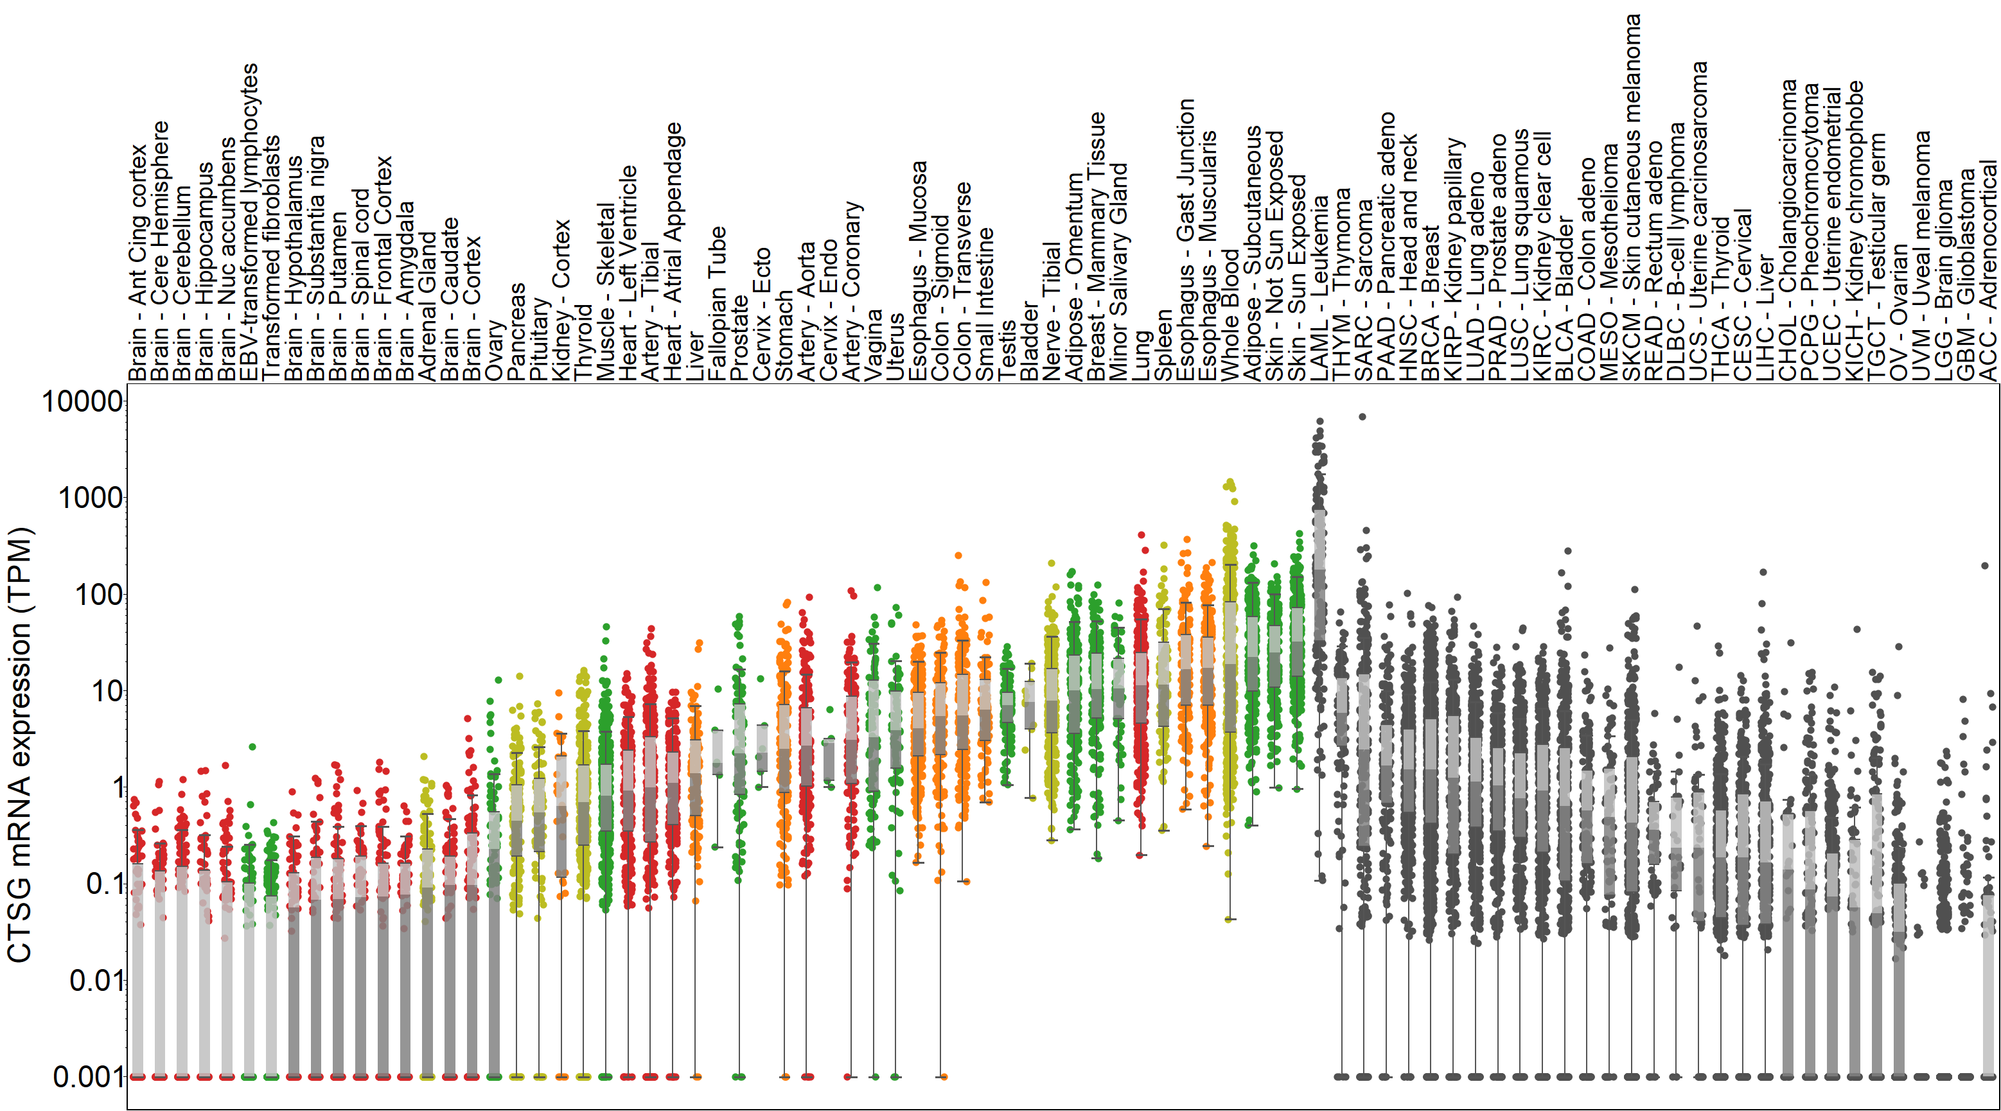
Supplemental Figure S4

