Slide 1
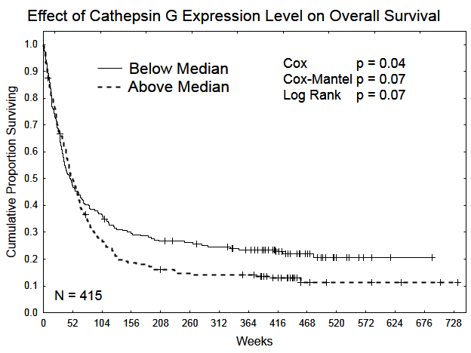
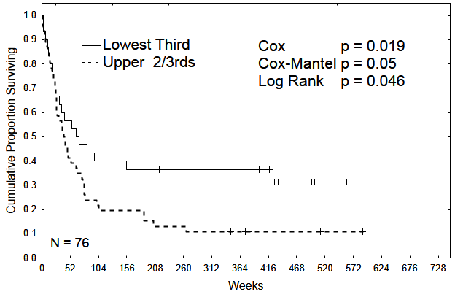
Supplemental Figure S5
a
Overall Survival
P=0.04
Cumulative Proportion Surviving
N=415
Weeks
b
Overall Survival
Intermediate Cytogenetics, FLT3 Mutated
P<0.05
Cumulative Proportion Surviving
N=76
Weeks

