Slide 1
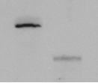
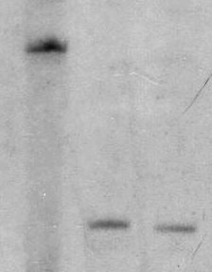
A
ptrA
B
Wild type
ΔAoatrR
kb
Genomic DNA
(Host strain)
AoatrR
5.7
SphI
Probe
SphI
SphI
5.7kb
3.4
Probe
Genomic DNA
(Transformant)
ptrA
SphI
SphI
SphI
3.4kb
C
D
ptrA
Wild
type
ΔAnatrR
1 2
Genomic DNA
(Host strain)
AnatrR
kb
Probe
11.3
SalI
11.3 kb
SalI
Genomic DNA
(Transformant)
Probe
ptrA
2.8
SalI
SalI
SalI
2.8 kb

