Slide 1
Figure S1
Intrahelical Assembly
Intermolecular Sticky-End Connectivity
Figure S1. Detailed sequence design and schematic for the assembly of 3D triangular nanoprisms from previously designed flat RNA triangle nanoparticles.

Slide 2
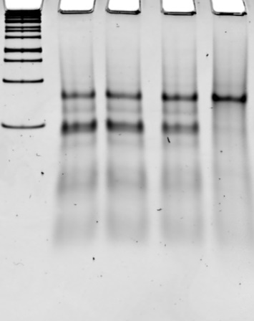
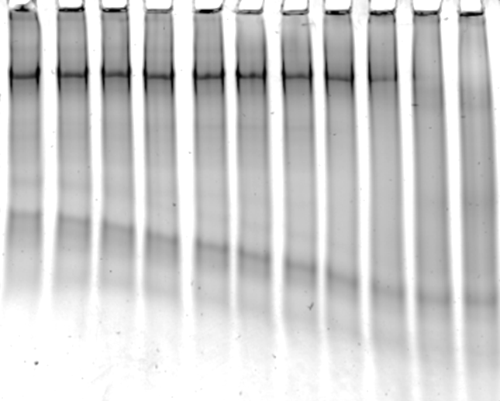


Figure S2
A
[MgCl₂], mM
B
Temperature (°C)
[2’F-frame] 0.5 uM
50
53
56
59
62
65
68
71
74
77
L
0.0
0.1
1.0
10
80
T_{M} ~74 °C
6% NATIVE PAGE
6% NATIVE PAGE
Figure S2. A. Magnesium effect on assembly of triangular nanoprism. Higher concentrations of magnesium ions dictate higher assembly efficiencies. B. TGGE melting gel analysis of 2’F prism frame. Melting temperature is taken to be 50% assembled nanoparticle.

Slide 3
Figure S3
Figure S3. Assembly of triangular prism and MG fluorescence assay. Fluorescence emission in lane 4, and faster migration than in lane 5, indicates the formation of compact triangular nanoprisms with encapsulated MG aptamer.

Slide 4
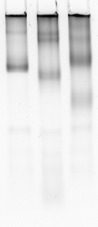

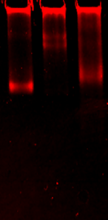
Figure S4
1
2
3
E.B.
1
2
3
MG
Figure S4. Control PAGE experiments excluding prism dimer and open prism constructs from gel shift assembly experiments. Decrease in migration in lanes 2 and 3 indicate that the prism dimer and open prism, formed by sequence engineering, will migrate much slower than the closed prism, as expected.

Slide 5
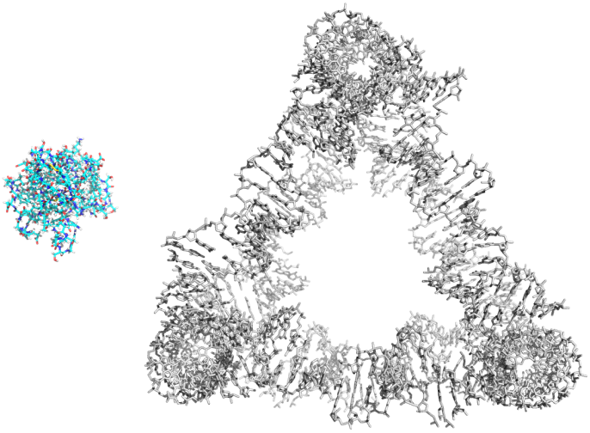
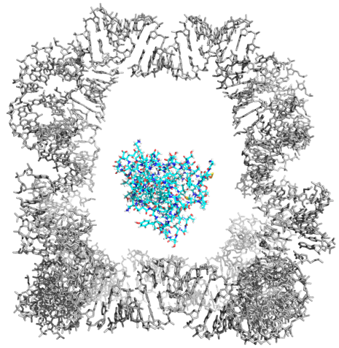
Figure S5
A
Triangle Nanoprism
B
RNase T1
56.7 Å
63.6 Å
37.1 Å
Figure S5. Swiss PDB viewer was used to fit RNase T1 inside the designed 3D nanoprism. The inner cavity of the large prism will fit RNase T1 inside, allowing digestion of the MG aptamer. RNase T1 cannot fit inside the small prism, enhancing the fluorescence half-life of MG.

Slide 6

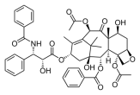
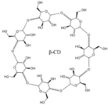
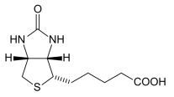

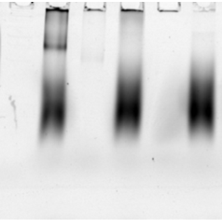
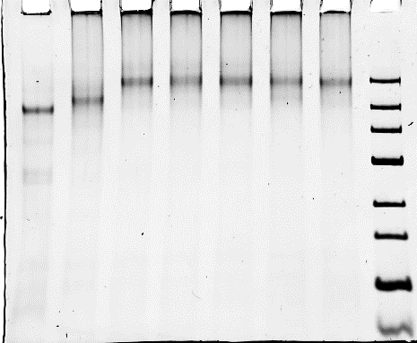


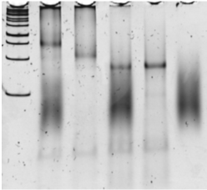
Figure S6
A. DNA-conjugates encapsulation scheme
DNA- Folate
DNA- Taxol
DNA- Cyclodextrin
hybridization
DNA- drug
DNA- biotin
DNA- Cy5
2’f-RNA
frame
B. Assay for DNA-conjugate encapsulation
C. Functional assay for biotin
L
1
2
3
4
5
Prism + DNA Cyclodextrine
frame + DNA biotin
Prism + DNA Folate
Prism + DNA Taxol
Prism + Core
Prism + DNA cy5
prism
L
Cy3
Cy3
Streptavidin only
Encapsulated
L
1
2
3
4
5
frame
Cy3
E.B.
Encapsulated
biotin and
streptavidin
Encapsulated
Cy3-DNA-biotin
Cy5
L
1
2
3
4
5
Frame only
Cy5
Cy3
6% native PAGE
E.B.
frame + streptavidin
Figure S6. A. Schematic of ssDNA and ssRNA oligonucleotides with functional modules encapsulation inside of the triangular nanoprism. B. Assembly of encapsulated functional modules conjugated to ssRNA and ssDNA oligonucleotides. C. Encapsulation and functional assays of streptavidin encapsulation inside the triangular nanoprism.

Slide 7
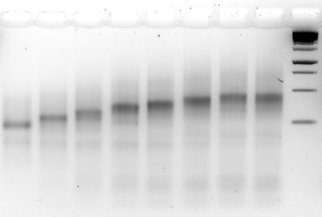
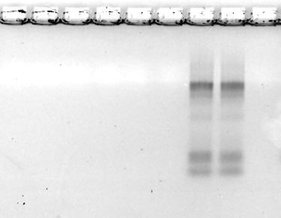
Figure S7
[DNA-FA],μM
2xCy5
0
0.5
1.0
1.5
2.0
2.5
Cy5
L
1500 bp
1000 bp
DNA-FA (folate)
750 bp
500 bp
DNA-Cy5
250 bp
[2’f-RNA frame]
0.5 μM
E.B. stain
2xCy5
0
0.5
1.0
1.5
2.0
2.5
Cy5
L
functionalized
frame
Cy5 channel
3% agarose in 1xTAE
Figure S7. Analysis of the 2’f-RNA frame hybridization with DNA-folate and DNA-Cy5 strands. Experiments were conducted on 6% native PAGE. The same gel was first scanned using Cy5 channel to detect signal from Cy5 fluorophore following staining in EB for total nucleic acid visualization. Lane Cy5 contains the following complex: 0.5 uM 2’f-RNA frame, 2.5 uM DNA-FA, and 0.5 uM DNA-Cy5; L = DNA ladder Thermo Scientific O’GeneRuler 1 kb

Slide 8
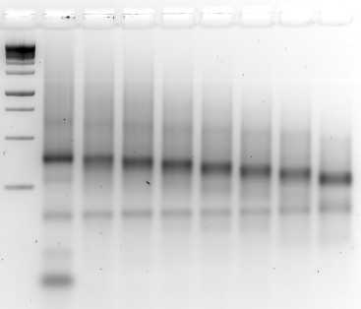
Figure S8
[CpG ODN] μM
0
0.5
1.0
1.5
2.0
2.5
3.0
5.0
L
CpG ODN
1500 bp
1000 bp
750 bp
500 bp
250 bp
[2’f-RNA frame]
0.5 μM
E.B. stain
Excess CpG ODN
3% agarose in 1xTAE
Figure S8. Analysis of the 2’f-RNA frame hybridization with CpG ODN for immunotherapy. Experiments were conducted on 3% Agarose gel in 0.5x TAE running buffer. Lanes correspond to the amount of [CpG ODN] added per fixed concentration of [2’f-RNA frame] NP in micromolar range. L = DNA ladder Thermo Scientific O’GeneRuler 1 kb

