Slide 1
Primer name | Sequence (5`-3`)
LF560f |  | CCCTTAATTAAGGAAGTGGACTGGCCCGGTCCGAGC
LF560r |  | CCCTCTAGAGATTCAGTCATGTGTTCATAT ATATCAACGGCCCTGATATATGTCAACACAG
RF560f |  | CCCTCTAGACTGGGCTGACGGCGCACCCAAACG
RF560r |  | CCCGATATCGGCGTCGATGTTCGATGGCGTCGCCC
Rv0560c-C`F1 |  | GGGGCGCCGGCTAGCGTTGTTACTG
Rv0560c-C`R1 |  | GGGTCAGCCCAGGTGGGCCGAGAGC
Rv0560cF1 |  | GGGGGCTCGTCGATCGACGACCGC
Rv0560cR1 |  | GGGCTATACGCGTCGTTTGGGTGCG
Rv0560cF2 |  | GGCTGCAGTCGATCGGTGGC
Rv0560cR2 |  | CGGCATCGTAGCTCTGCATGC
Table S1. Primers used in this study.
Restriction enzyme sites are underlined.

Slide 2
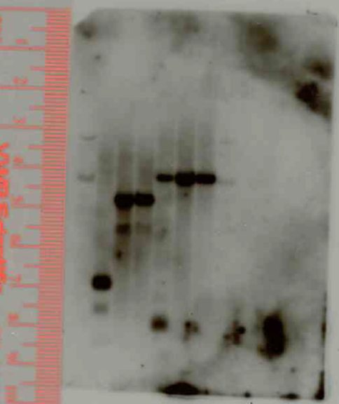
A
0.5 kb
4.0 kb
Rv0560c
D
0.9 kb
XmaI
ClaI
probe
4.0 kb
4.0 kb
B
4000 bp
Δ
3000 bp
2.8 kb
probe
1 2 3 4 5 6 7 8 9
1000 bp
C
800bp
500 bp
200bp
Rv0560cΔ
H37Rv
H37Rv
Rv0560cΔ
Figure S1. Construction of an unmarked in-frame deletion of Rv0560c in M. tuberculosis.
Chromosomal organization of Rv0560c in (A) the wild-type strain and (B) the deletion strain. XmaI sites are indicated below and ClaI sites indicate above, with the expected fragment sizes. The probe used for the Southern is indicated as a dark grey box below. Not drawn to scale. (C) PCR screen for deletion strains. Double crossover (DCO) colonies were subjected to PCR with primers (arrow in panel A) to amplify either wild-type (809 bp) or deletion (149 bp) alleles. Lanes 1, 3 and 9 are wild-type. Lanes 2, 4 and 5 are deletions. Lane 6 and 8 are single crossovers (both alleles). (D) Southern blot to confirm the genotypes. Genomic DNA was digested with XmaI or ClaI and probed with the indicated region. The expected sizes for the wild-type allele were 0.9 kb for XmaI and 0.45 kb and 4.0 kb for ClaI; for the deletion allele they were 2.8 kb for XmaI and a doublet of ~4.0 kb for ClaI. A weak additional band was seen with XmaI digestion in all strains.

Slide 3
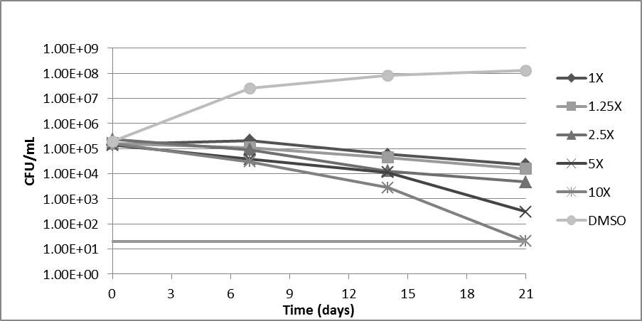
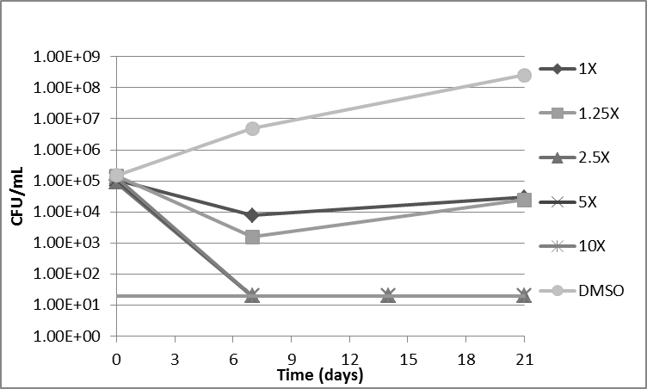
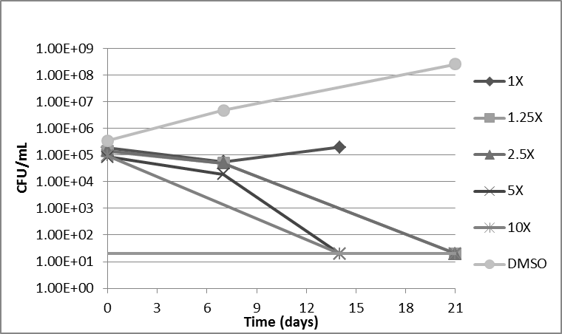
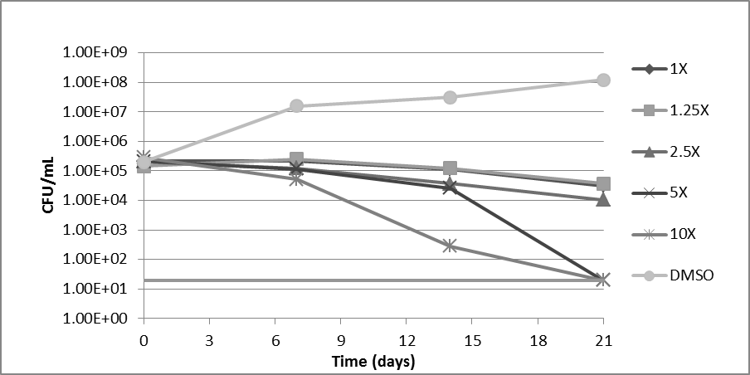
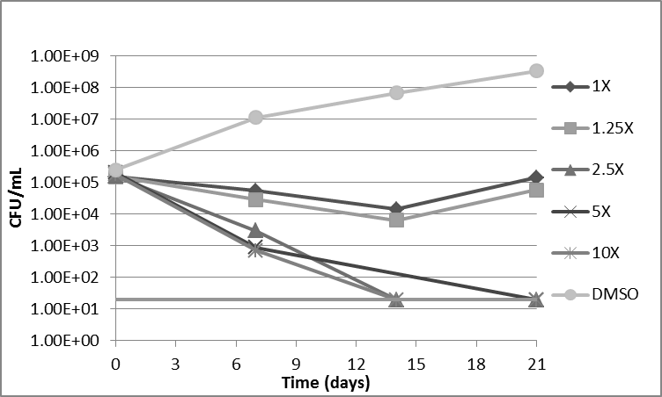
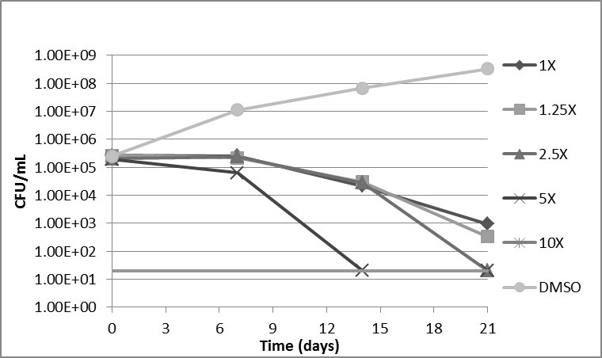
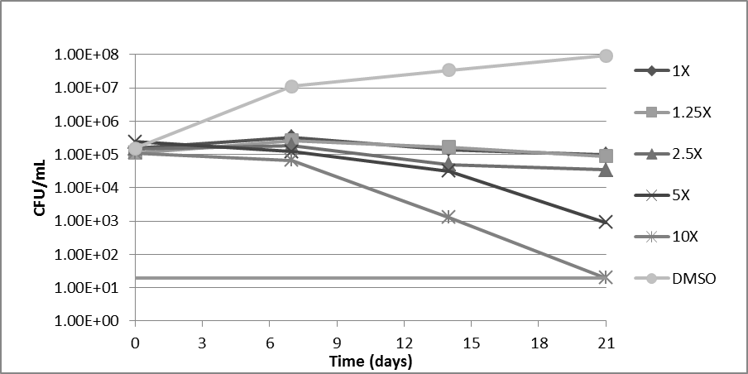
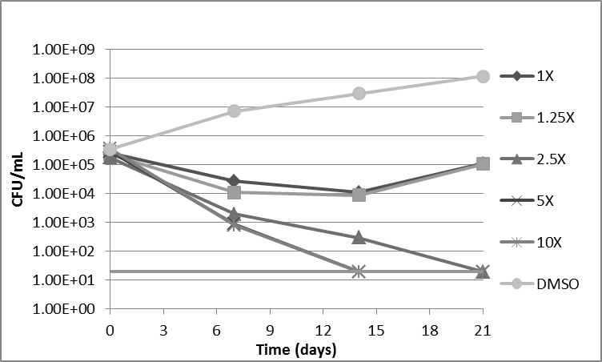
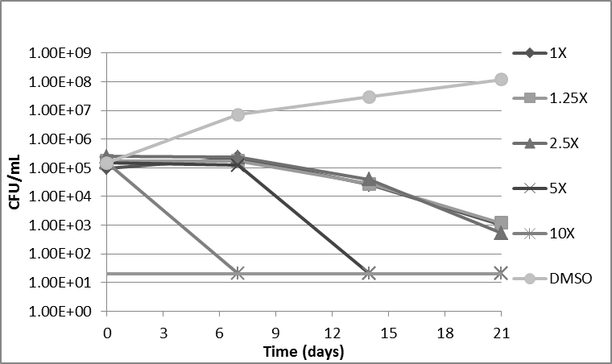
A
B
C
Figure S2. Kill kinetics. CFUs were determined in liquid culture after 0-21 days exposure to compounds at 1X, 1.25X, 2.5X, 5X and 10X MIC.The top graph in each panel is wild type; middle graphs are Rv0560cΔ; and bottom graphs are Rv0560c C’. The lower limit of detection is 20 CFU/mL. A. CCCP B. Ethambutol C. Plumbagin. MICS were 15 μM CCCP, 7 μM plumbagin, 1 μM ethambutol

