Slide 1
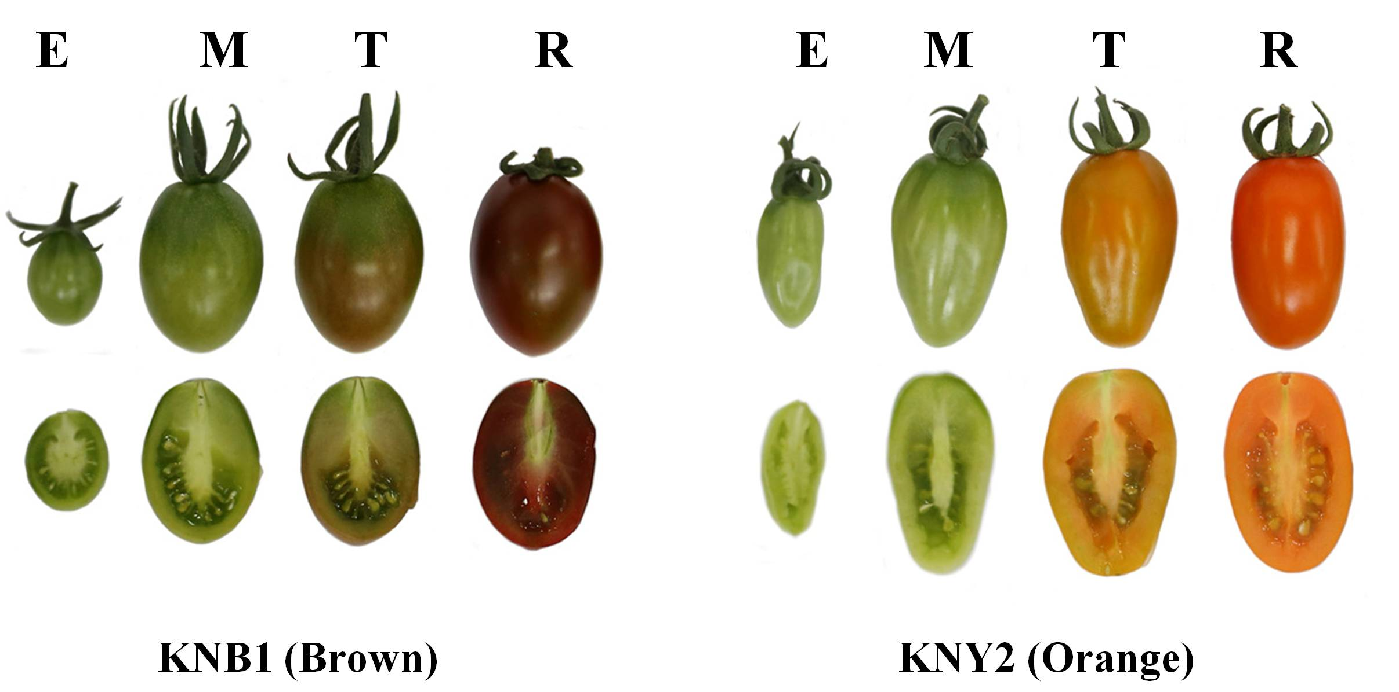
Supplementary Figure 1

Slide 2
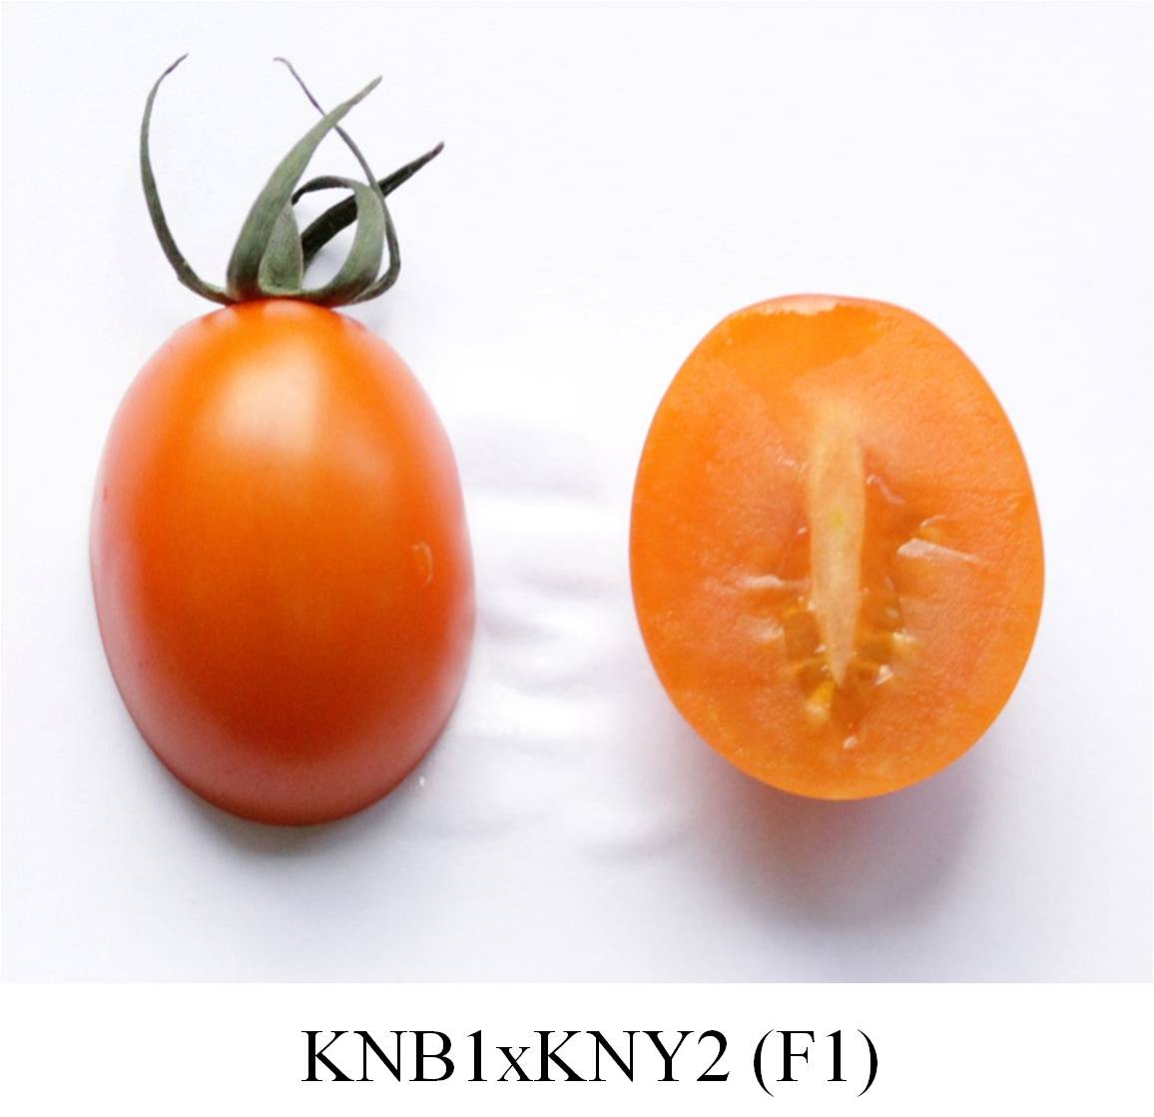
Supplementary Figure 2

Slide 3
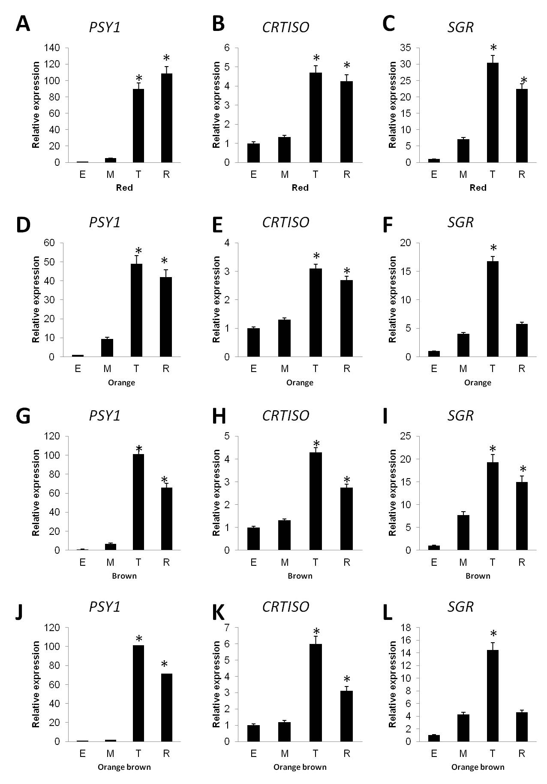
Supplementary Figure 3

