Slide 1
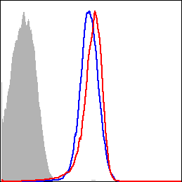
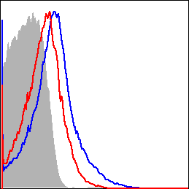
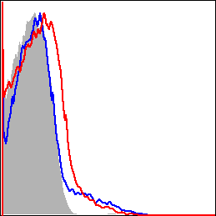
A
mCD28
mICOS
mOX40
% of Max
Non-Tg
HBZ-Tg
Isotype
B
mCD28
mICOS
mOX40
1750
n.s.
250
*
80
n.s.
1500
200
70
1250
60
MFI
1000
150
50
750
100
40
500
30
Non-Tg
250
50
20
HBZ-Tg
0
0
10
0
S2 Fig. Expression of co-stimulatory receptors in CD4⁺ T cells of HBZ-Tg and non-Tg mice

