Slide 1
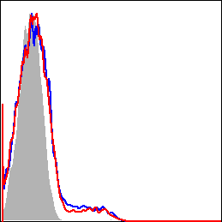
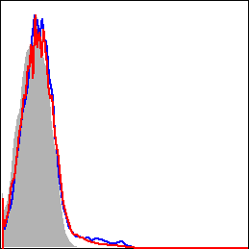
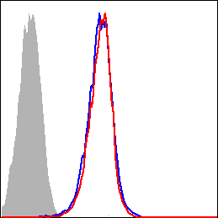
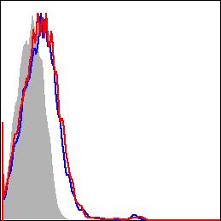
mTIGIT
mPD-1
mBTLA
mLAIR-1
% of Max
Non-Tg
tax-Tg
Isotype
S3 Fig. Expression of co-inhibitory receptors in CD4⁺ T cells of tax-Tg and non-Tg mice

