Slide 1
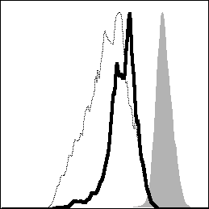
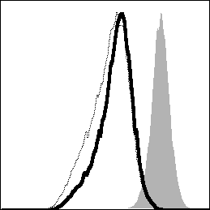
Non-Tg
HBZ-Tg
α-CD3/control.Fc
% of Max
α-CD3/HVEM.Fc
Day 0
CellTrace
S7 Fig. HBZ inhibits the suppressive effect of BTLA

