Slide 1
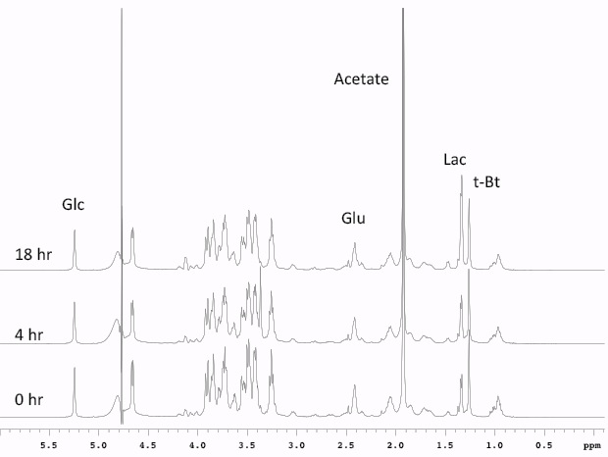
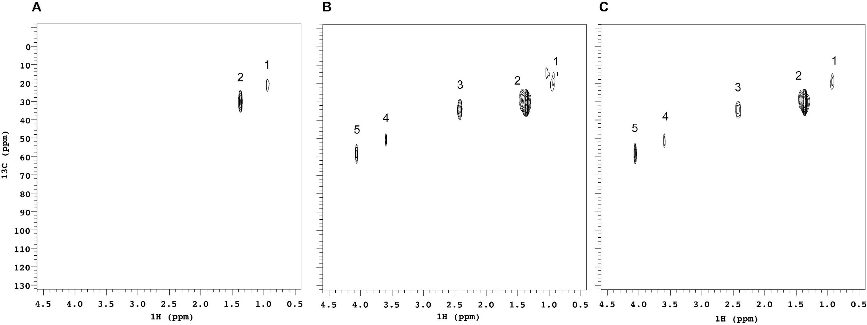
Supplementary figure 1
A
Time in culture
U266 18h
U266 4h
U266 t0
B
C
Normalized Acetate
Normalized Glucose
# cells/well
# cells/well
D
E
***
Normalized Lactate
Glutamate gHSQC/CPMG
t0 16h
# cells/well
Time
F
5TGM1
OPM2
-CH₃
-CH₃
¹³C (ppm)
-CH₂ -
-N(CH₃)₃
-CH₂ -
-CH-
¹H (ppm)

Slide 2
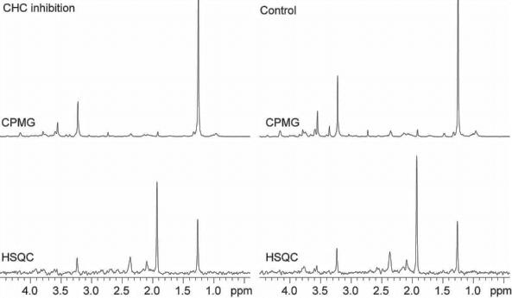
A
B
Supplementary figure 2
1
1
Acetate 1.91 ppm
Acetate 1.91 ppm
***
**
**
HSQC CPMG
% cell death
**
**
1
1
**
**
CHC 2.5 mM
Vehicle
[Orlistat] μM (24h)
C
D
**
**
% cell death
*
*
# adipocytes/well
**
**
**
**
**
**
0 24 48 0 24 48 0 24 48
Time Orlistat (50 μM)
F
[Orlistat] μM (14 days)
E
% cell death
% AnnexinV^{pos}
[CHC] mM (48h)
G
H
% cell death
% cell death
[CHC] mM (48h)
[CHC] mM (48h)

Slide 3
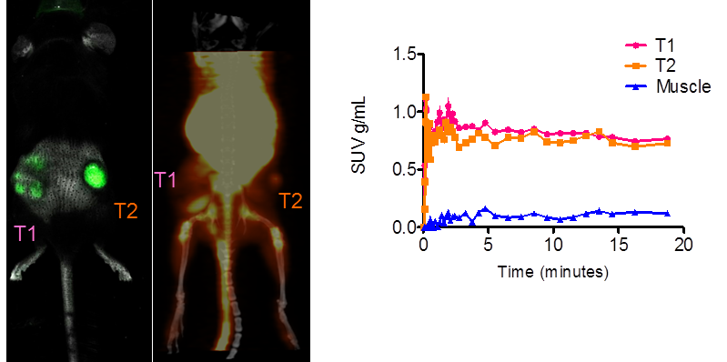
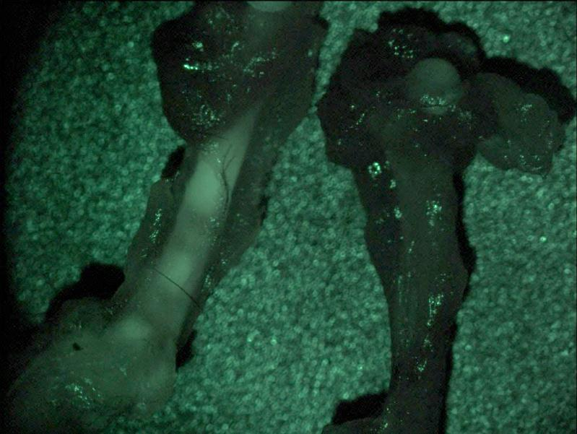
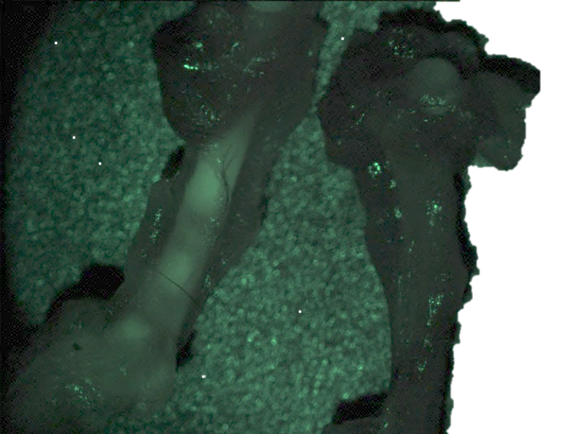
A
Supplementary figure 3
GFP
¹¹C-acetate-PET
¹¹C-Acetate SUV
**
Time (minutes)
B
C
mouse | Area mm²
 | GFP | ¹⁸F-FDG | ¹¹C-acetate
#1 | 112 | 82.1 | 83.4
#2 | 103 | 98.1 | 100
#3 | 51 | 65 | 54.1
¹¹C-acetate
tissue/blood ID%/g
Muscle OPM2 PCT
D
E
F
Control + 5TGM1
**
¹¹C-Acetate
tissue/blood ID%/g
% viable GFP+ cells
5TGM1 sq 5TGM1 iv
% viable GFP+ cells

Slide 4
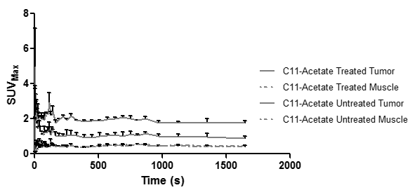
Supplementary figure 4
A
B
**
rs= 0.7
p=0.02
% dead cells
% viable tumor cells
V Btz V Btz V Btz
Legs Spleen Tumors
¹¹C-Acetate SUV g/ML
C
D
*
% dead cells- tumor
**
Vehicle Melphalan
E
F
% BM tumor cells
Ig
*
**
Saline Bortezomib
Saline Bortezomib

