Slide 1
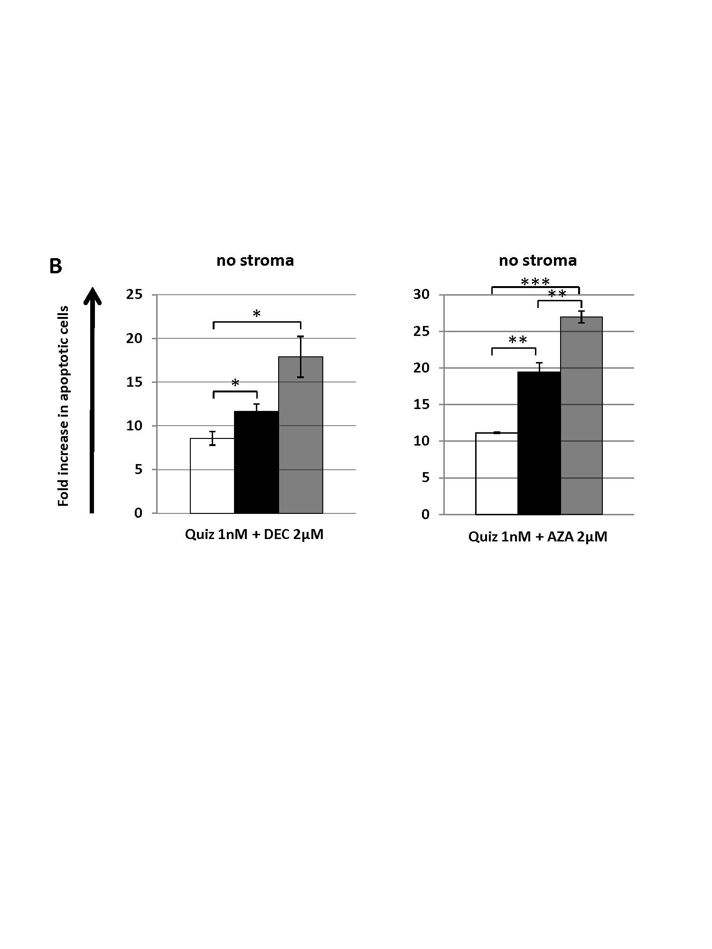
Supplemental Figure 1. Molm14 cells were cultured in drug supplemented medium in the absence of stroma, and drugs were added in sequential or simultaneous mode at the indicated concentrations. White bars indicate pretreatment with quizartinib for 24 hours, black bars show pretreatment with DEC or AZA for 24 hours, and gray bars denote simultaneous administration. Following pretreatment, cells were incubated for additional 48 hours before being harvested for analysis via flow cytometry.

