Slide 1
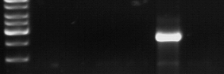
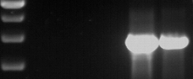
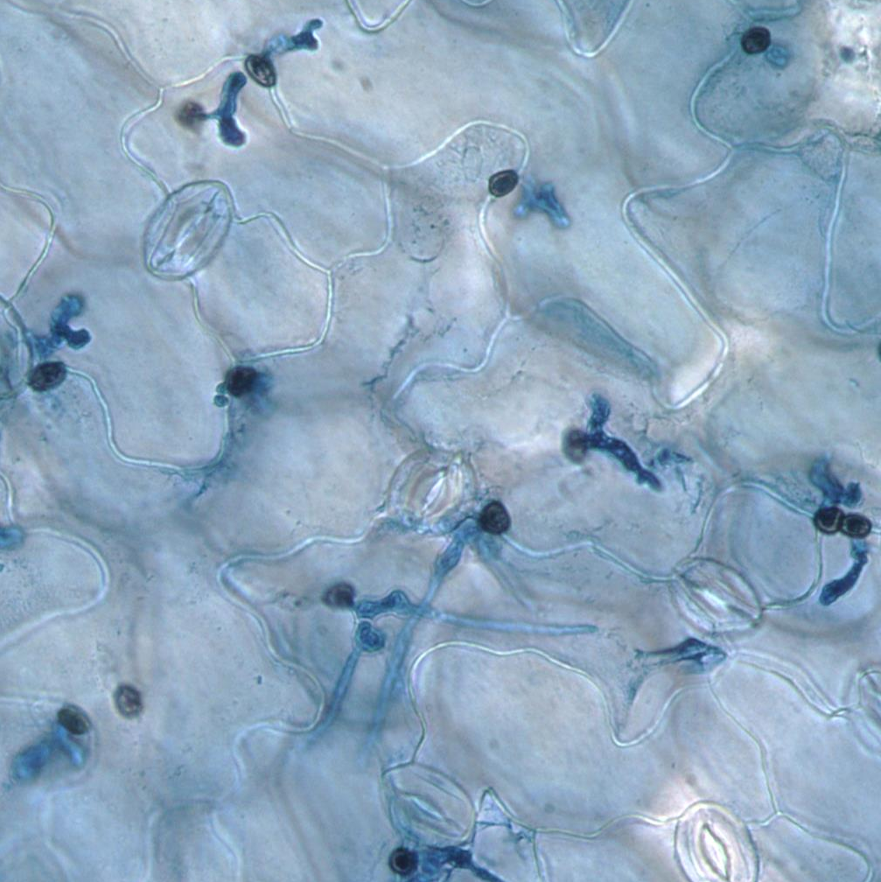
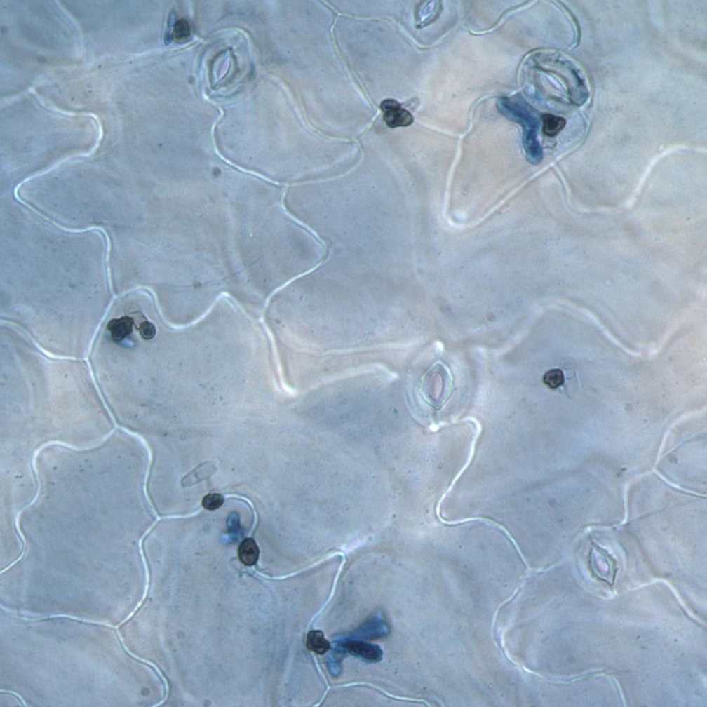
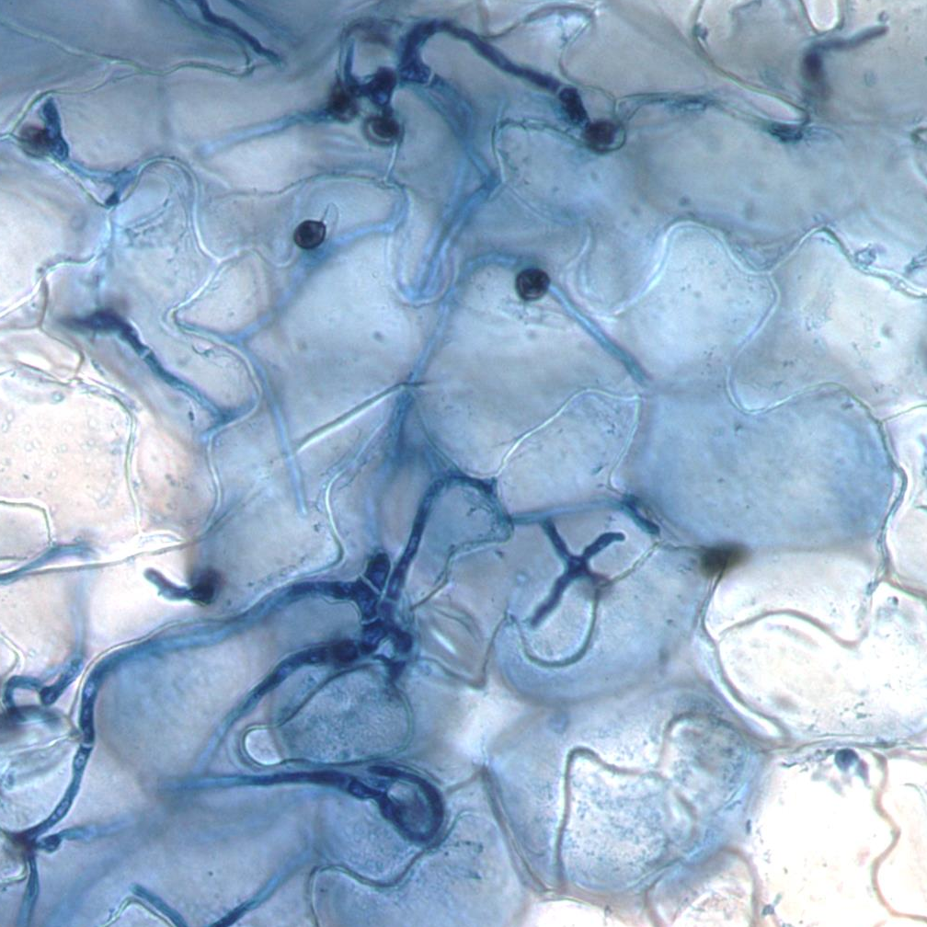
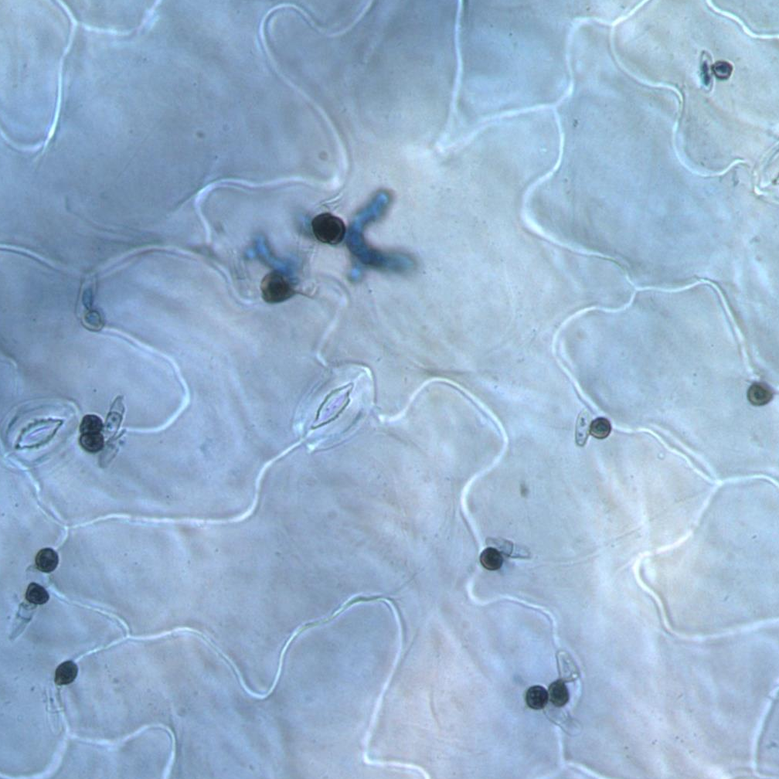
A
a
KU80 upstream
natR
KU80 downstream
ΔChku80 locus
d
c
KU80 upstream
ACE2
barR
KU80 downstream
pACE2
b
c
KU80 upstream
barR
KU80 downstream
empty vector
B
parental strain
Δace2 + pACE2
parental strain
Δace2 + pACE2
H₂O
Δace2
Δace2 + EV
H₂O
Δace2
Δace2 + EV
a + b
c + d
C
*
*
*
*
parental strain
Δace2
Δace2
+ pACE2
Δace2
+ EV
parental strain
Δace2
Δace2
+ pACE2
Δace2
+ EV
D
parental strain
Δace2
Δace2 + pACE2
Δace2 + EV

Slide 2
Additional file 7: Figure S5.pptx. The ΔChace2 mutant can be complemented by reintroduction of ChAce2.
ΔChace2 was transformed with pACE2 (pCK5265) encoding the wild-type ChACE2 locus (from -1067 to +2993) or with the empty vector control (pCK4939). The transforming T-DNAs are integrated by homologous recombination into the ΔChku80 locus to avoid position effects on gene expression. (A) Schematic representation of the ΔChku80 locus in the parental ΔChace2 mutant (top) and the plasmids used for transformation (bottom two). After successful homologous recombination the nourseothricin resistance cassette (natR) in the ΔChku80 locus is replaced by either ChACE2 together with the bialaphos resistance cassette (barR) or by barR alone in the case of the empty vector. (B) Diagnostic PCRs to test for correct integration of the expression cassettes. Primers for the test PCRs are shown as small arrows in panel (A). ChACE2 complementation transformants should show bands in both PCRs, while PCRs with transformants harboring the empty vector should only be positive with primers c and d depicted in panel (A). (C- D) The strains ΔChace2 (CY6353), ΔChace2 + pACE2 (CY7433), ΔChace2 + EV (CY7434) and their parental strain ΔChku80 (CY6021) were tested for their ability to produce conidia and to lead to successful infection. (C) Conidiation assay after 7 days. (E) Representative microscopic images of trypan blue stained leaves three days after infection. Scale bar = 20 µm.

