Slide 1
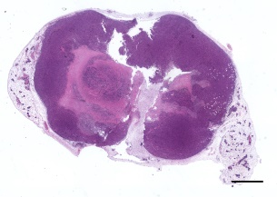
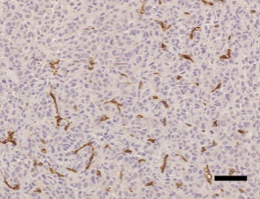
shControl
shEPCR#1
shEPCR#2
A
Size-matched tumors resected at different time points
H&E
Ki67
CD31
Caspase-3
F4/80 t. mass
B
ns
ns
F4/80 t. border
p=0.068
ns
ns
ns
Perurena N et al.
Sup. Fig. 3

