Slide 1
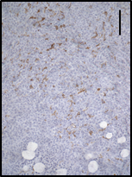
A
B
shControl
shEPCR#1
shEPCR#2
C
H&E
Tumors of different size resected at the same time point
Ki67
Caspase-3
CD31
F4/80 t. mass
D
ns
ns
F4/80 t. border
p=0.065
*
ns
ns
ns
Perurena N et al.
Sup. Fig. 4

