Slide 1
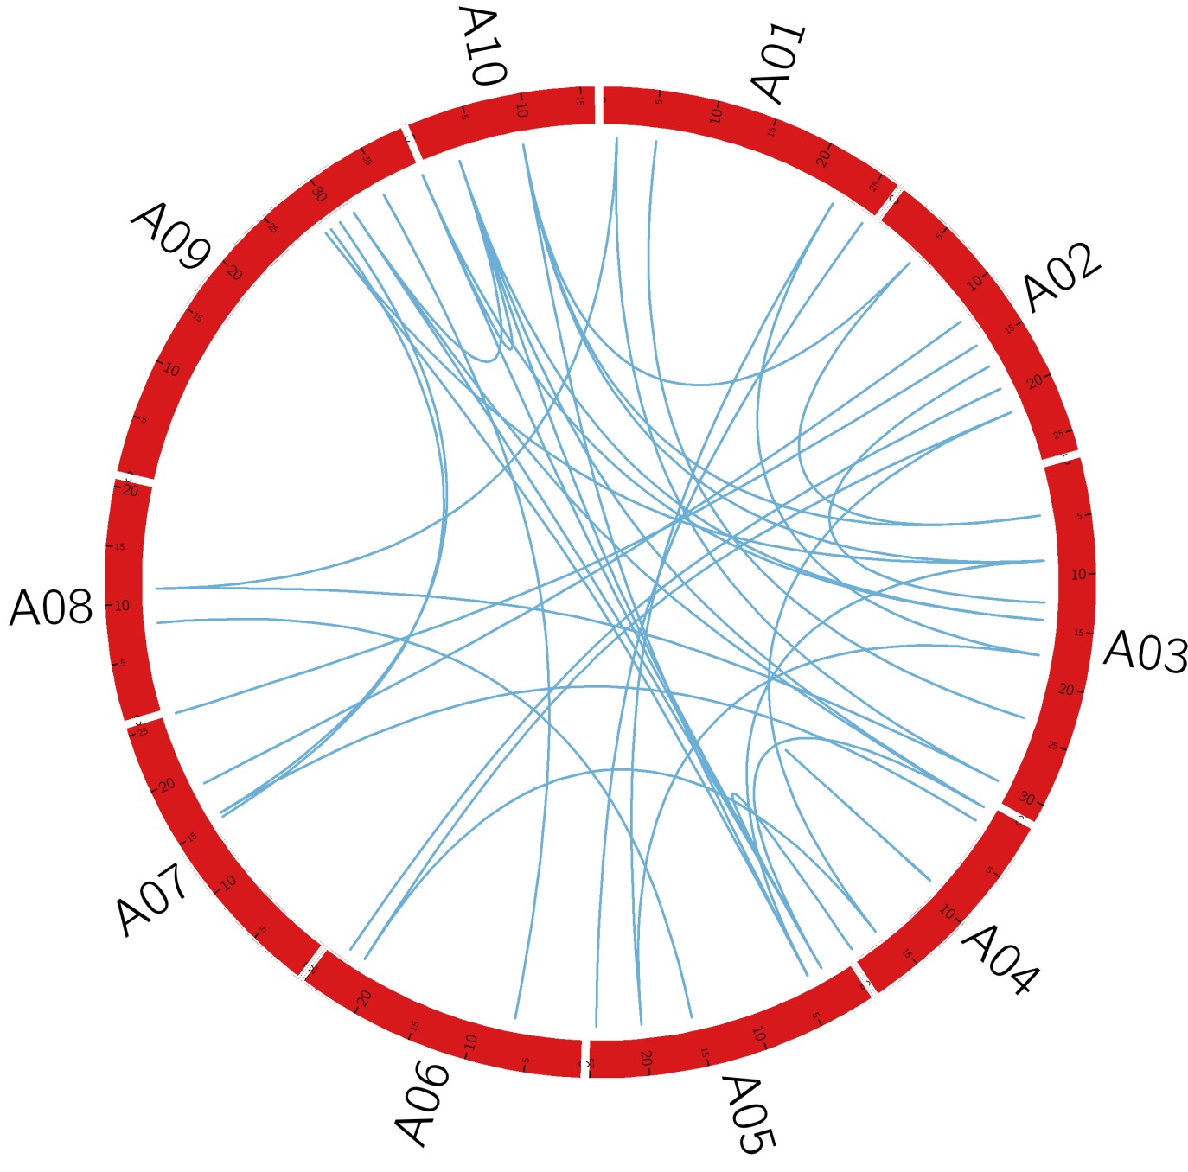
Figure S2
Depiction of BrAQP duplicated gene pair on 10 chromosomes of B. rapa.

