Slide 1
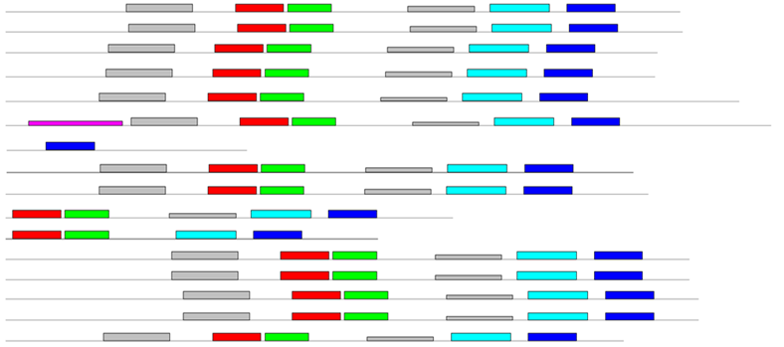
NIP subfamily
Gene name
E-value
Motif location
BrNIP1;2a 3.6e-67
BrNIP1;2b 1e-67
BrNIP2;1a 4.6e-60
BrNIP2;1b 2.2e-62
BrNIP3;1a 5e-68
BrNIP3;1b 5.8e-68
BrNIP4;1 2.6e-67
BrNIP4;2a 4.4e-70
BrNIP4;2b 2.4e-55
BrNIP4;2c 1.8e-48
BrNIP5;1a 1.1e-65
BrNIP5;1b 3.9e-65
BrNIP6;1a 8.7e-67
BrNIP6;1b 2.2e-65
BrNIP7;1 7.9e-48
SIP subfamily
BrSIP1;1a 2.5e-27
BrSIP1;1b 8.2e-27
BrSIP1;2 4.4e-21
BrSIP2;1a 1e-16
BrSIP2;1b 2.7e-17
BrSIP2;1c 4.3e-16
Figure S3

Slide 2
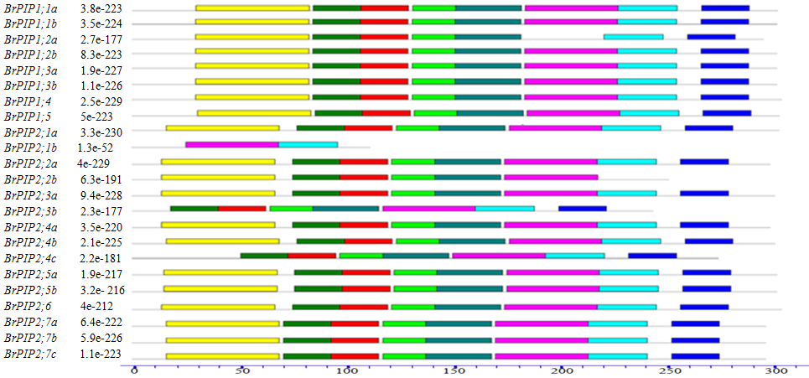
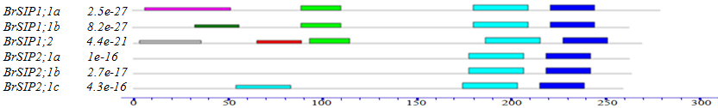
PIP subfamily
Gene name
E-value
Motif location
BrPIP1;1a
BrPIP1;1b
BrPIP1;2a
BrPIP1;2b
BrPIP1;3a
BrPIP1;3b
BrPIP1;4
BrPIP1;5
BrPIP2;1
BrPIP2;2a
BrPIP2;2b
BrPIP2;3a
BrPIP2;3b
BrPIP2;4a
BrPIP2;4b
BrPIP2;4c
BrPIP2;5a
BrPIP2;5b
BrPIP2;6
BrPIP2;7a
BrPIP2;7b
BrPIP2;7c
Figure S3

Slide 3
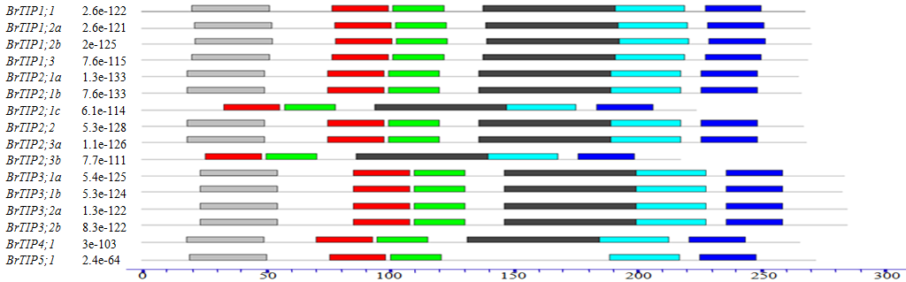
TIP subfamily
Gene name
E-value
Motif location
Figure S3
Figure S3
Schematic representation of motif compositions in the BrAQP protein sequences. Different motifs, numbered 1–10, are displayed
in different colored boxes. The names of all members are displayed on the left-hand side, while the length of motif is shown in
scale at bottom of the figure.

