Slide 1
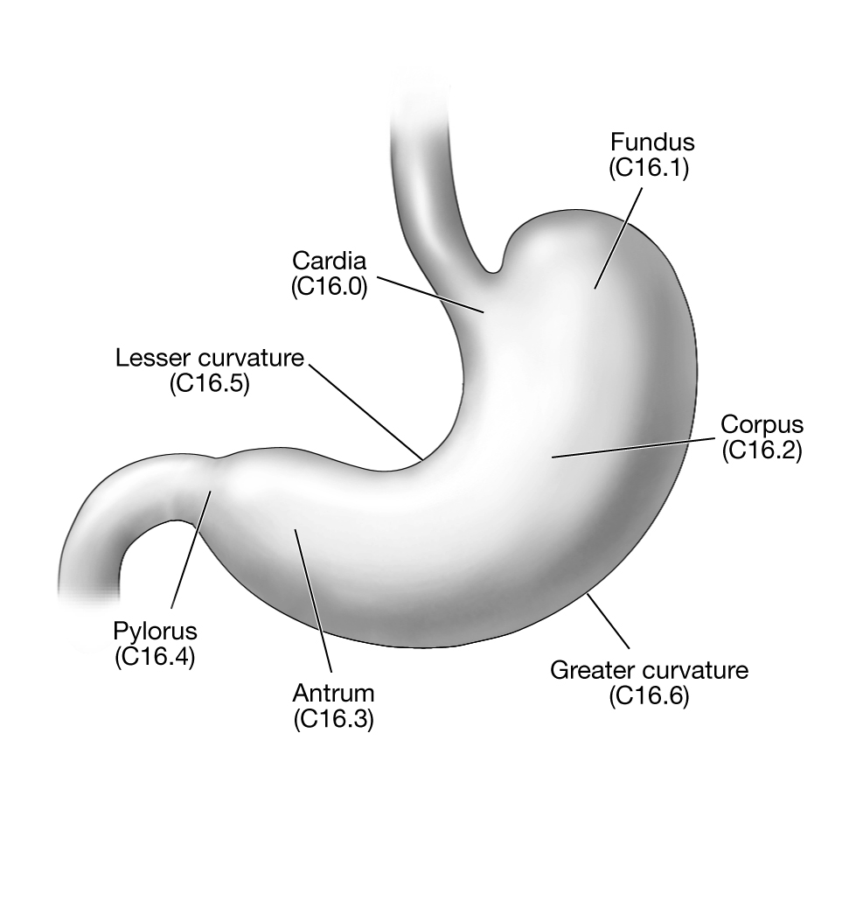
Supplementary figure 1. Anatomical subsite of gastric cancer

