Slide 1
Figure 1
coding: synonymous
missense
intergenic
intronic
non-coding
RNA
close
proximity
to 3’ or 5’
Notes:
Figure 1. Relationship of 214 SNPs associated with coronary artery disease and myocardial infarction to nearby genes.

Slide 2
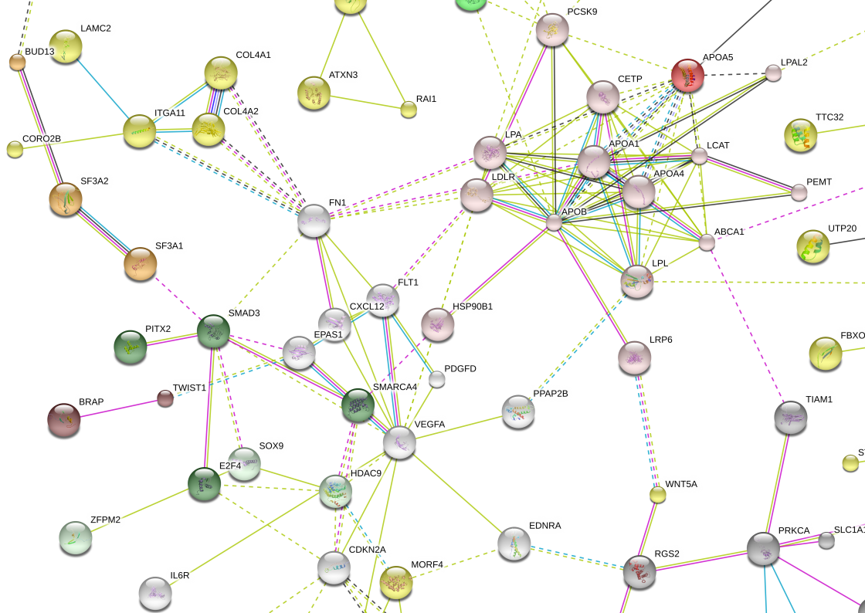
Figure 2
Figure 2
Notes:
Figure 2. Protein-protein interaction network of 320 genes associated with SNPs for CAD/AMI based on the STRING v9.1 database. For better legibility, only proteins which display interactions with other proteins are shown (the full protein-protein network is shown in Supplemental Figure 1). There is strong evidence for a central cluster consisting of genes/proteins regulating cholesterol metabolism (blue circle). Additional clusters include proteins involved in focal adhesion/extracellular matrix interaction (black circle: FN1, FLT1, COL4A1, COL4A2, VEGFA, ITGA11, LAMC2, PDGFD), and TGF-β signaling (red circle: E2F4, CDKN2A, SMAD3, PITX2). Genes/proteins interconnected by K-means clustering are colored. Edges, i.e. predicted functional links, consist of up to eight lines: one color for each type of evidence (STRING v9.1 integrates experimental, predicted and transferred interactions, together with interactions obtained through text mining).

Slide 3
Figure 3
*
*
*
*
Fold
enrichment
*
*
*
*
*
*
*
*
*
*
*
*
*
*
*
Notes:
Figure 3. Functional analysis with fold enrichment of genic vs. intergenic SNPs compared to expected rate against the whole genome. While cholesterol transport pathways were enriched in genic and intergenic regions, other pathways including focal adhesion, anti-apoptosis, regulation of smooth muscle (SMC) proliferation, angiogenesis, alternative splicing and RNA polymerase II transcription factor (TF) activity were enriched for SNPs in genic regions only. * indicates p<0.05.

