Slide 1
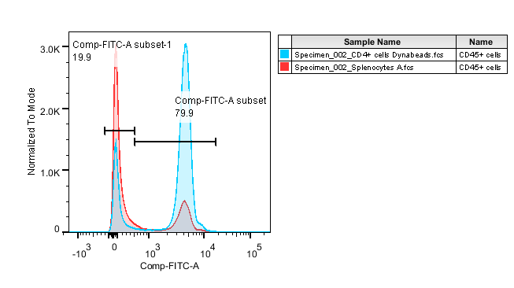
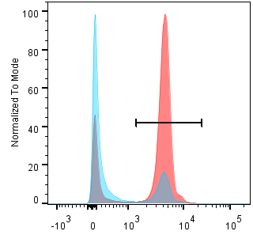
Supplement Figure S1
Pre-enrichment
Post-enrichment
CD4

Slide 2
Supplement Figure S2

Slide 3
Supplement Figure S3
A
B
C
D
E

Slide 4
Supplement Figure S4
A
B
*
*
*
*
*
*

