Slide 1
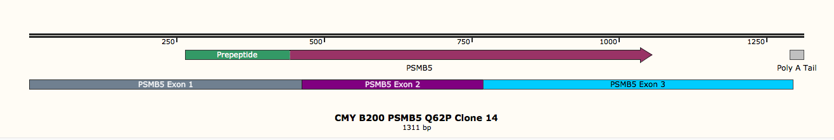
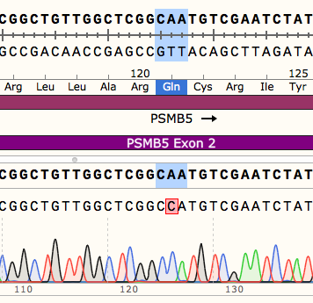
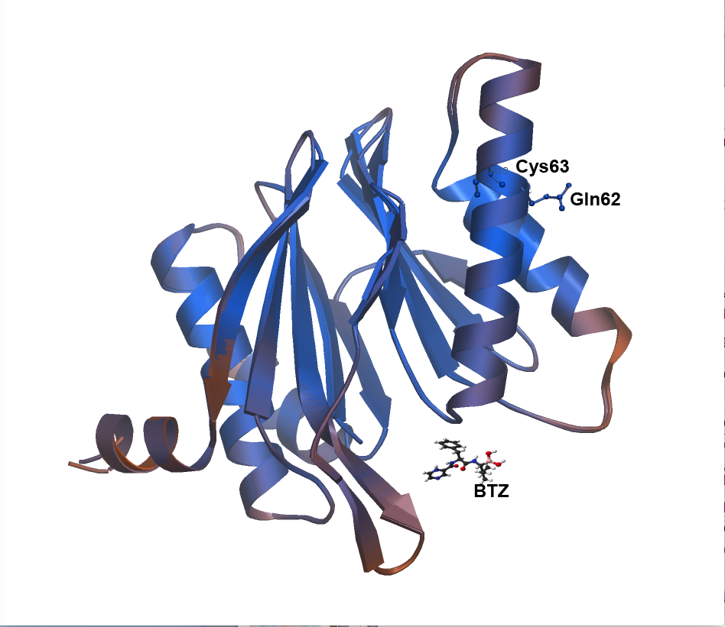
A
Exon 1
PSMB5 gene
Exon 2
Exon 3
PSMB5 mRNA
B
C
PSMB5
CMY
CMY B200
Supplementary Figure 1
Protein nomenclature is given considering the Ile of the mature NE as the first amino acid

