Slide 1
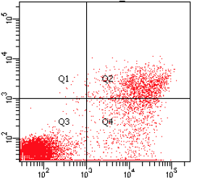
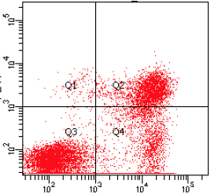
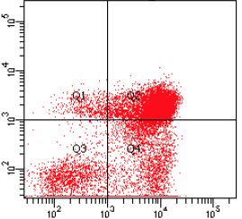
A
B
DMSO
DSF/Cu²⁺ 122 nM
0.1%
7%
0.9%
17%
75%
43%
17%
39%
PI
3%
42%
CMY
15%
DSF/Cu²⁺
500 nM
40%
Supplementary Figure 2
Annexin V
Notes:
Supplementary Fig. 2:

