Slide 1
Supplementary figure 1
Bone Marrow
p = 0.05
Supplementary figure 1 Rapamycin reduces EL4 bone marrow infiltration. Percentage of GFP⁺ tumor cells among live bone marrow cells. 1x10⁶ EL4-GFP cells were injected intravenously into WT mice, which were sacrificed 5 days later, and bone marrows were collected and assessed by flow cytometry. P value, unpaired t test.

Slide 2
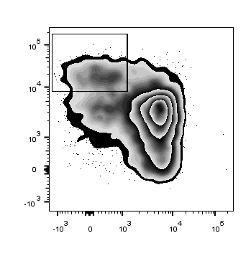
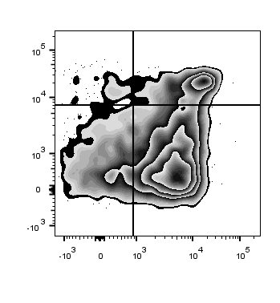
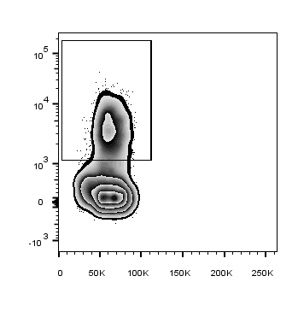
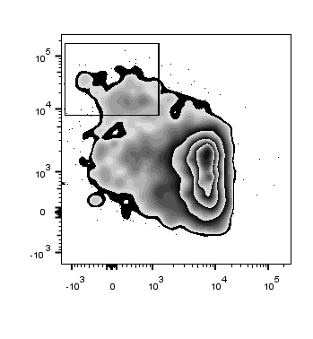
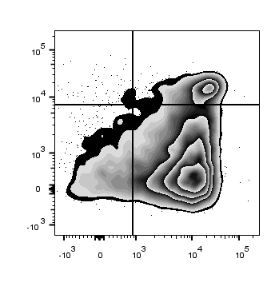
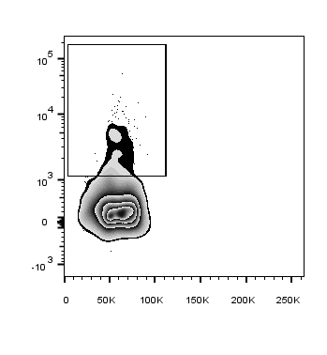
Supplementary figure 2
A
CD4⁺
CD8⁺
B
GFP⁻ Vβ12⁻
7.5
3.0
12.9
21.7
Control
Control
Control
Control
4.7
1.3
11.0
4.5
CD44
CD3
Rapamycin
Rapamycin
Rapamycin
CD62L
FSC
Supplementary figure 2 HD rapamycin impairs T cell activation and infiltration. WT mice were challenged s.c. with 40,000 EL4 cells on day 0. Rapamycin 8 mg/kg or vehicle control were administrated daily (day 4-20) until the day before sacrifice. (A) Representatives of CD44 versus CD62L expression among CD4⁺ and CD8⁺ T cells in TDLNs from control (top panels) and rapamycin-treated (bottom panels) mice. (B) Representatives of CD3⁺ T cells among non-tumor cells (GFP⁻Vβ12⁻) within tumor masses. FSC, forward scatter. Numbers in quadrants are percent positive cells in that quadrant.

Slide 3
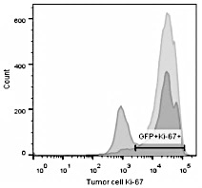







Supplementary figure 3
A
B
0
0.075
1
p-rpS6^{S240/244}
Control
rpS6
Rapamycin
p-4E-BP1^{T37/46}
4E-BP1
p-AKT^{S473}
AKT
p-p70S6kinase^{T389}
Ki-67⁺
p70S6kinase
β-Actin
EL4 Ki-67
Supplementary figure 3 Effects of rapamycin on mTOR signals and Ki67
(proliferation) in EL4 cells studied ex vivo. A. EL4 cells from Rag2 KO
mice after rapamycin treatment 2 mg/kg for 16 days, stained and
analyzed by flow cytometry. Representative Ki67 gating and staining is
shown. The Y-axis shows cell counts. B. WT mice treated with
rapamycin at indicated doses (rapamycin in mg/kg above the blot) or
vehicle control daily from day 4 and sacrificed on day 21.
Representative Western blot of tumor lysates is shown.
Notes:
Panel D: Geetha re-scan?

Slide 4
Supplementary figure 4
A
B
p = 0.001
ns
p < 0.0001
p = 0.01
ns
C
p = 0.0002
p = 0.007
CD44^{hi} CD62L⁺
% of CD8⁺
p = 0.50
p = 0.26
p = 0.53
CD8⁺ CD44^{hi} CD62L⁺
(x 10⁵ / TDLN)
p = 0.78
Supplementary figure 4 Dose response effects of rapamycin on EL4 in vivo. WT mice (N=6/group)
were challenged s.c. with 40,000 EL4 on day 0 and treated with rapamycin or vehicle control i.p. daily
from day 4 at indicated doses in A and B. Tumor growth analyzed by two-way ANOVA.
(C) Frequencies of CD44^{hi}CD62L⁺ cells among CD8⁺ T cells in TDLN (left) and numbers of
CD8⁺CD44^{hi}CD62L⁺ T cells per TDLN (right) by flow cytometry.
P values, t-test. Error bars, mean ± SEM. N= 8-10/group in A-B, and N= 6/group in C.

Slide 5
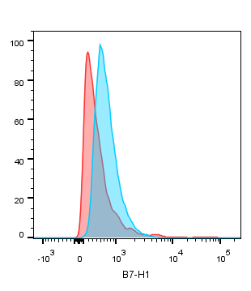
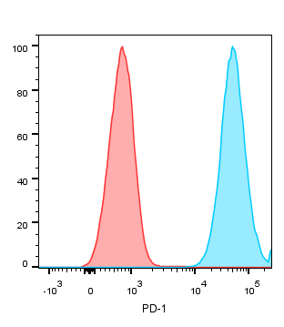
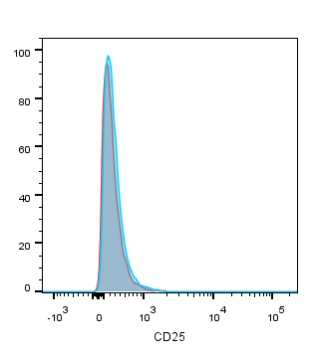
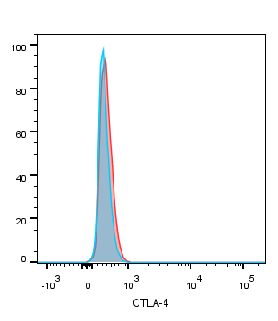
Supplementary figure 5
A
Isotype
EL4
B
B7-H1
PD-1
CD25
CTLA-4
C
p = 0.55
p = 0.35
Supplementary figure 5 EL4 is refractory to many standard immunotherapies.
(A) Phenotype of cultured EL4 cells by flow cytometry. (B-C) Male WT mice
were challenged with 50,000 EL4 cells s.c. Tumor growth with αB7-H1, αCTLA-4,
αPD-1 or αCD25 treatments as in Materials and Methods were analyzed with
two-way ANOVA. N=8-10/group. Error bars, mean ± SEM.

Slide 6
Supplementary figure 6
p = 0.001
p = 0.002
p = 0.04
% PI⁺ EL4
Supplementary figure 6. LD rapamycin plus DD-mediated EL4 cell death is not blocked by anti-CD25 in vivo. WT mice were challenged s.c. with 40,000 EL4 cells on day 0. LD rapamycin (0.075 mg/kg, Rapa) was given daily from day 4 through day 19. DD (5 ug) was administrated on day 4, 8, 12, 16. Anti-CD25 (200 μg) was given on day 3. Mice were sacrificed on days 19-24, and tumors were collected, digested and stained with PI. P value, unpaired t test. Error bars, mean ± SEM.

Slide 7
Supplementary figure 7
Control
LD rapamycin
DD
LD rapamycin + DD
Supplementary figure 7 LD rapamycin improves DD treatment efficacy of B16F10. Mice challenged with 500,000 B16F10 cells on day 0 and treated as in the legend to Fig. 6A. Individual B16 tumor growth for each tumor on WT mice with control, LD rapamycin (75 μg/kg), DD or both are represented.

Slide 8
Supplementary figure 8
EL4
B16
p = 0.0002
p = 0.007
p = 0.002
p < 0.0001
p = 0.001
p < 0.0001
p < 0.0001
p < 0.0001
Supplementary figure 8 Rapamycin + DD killing of EL4 and B16 cells is blocked with anti-CD25 + anti-CD22 in vitro. EL4 or B16F10 cell lines were culture for 5 days in vitro in control medium (Con), 100 pg/ml rapamycin (RA), 250 ng/ml denileukin diftitox (DD) or both, with or without ⍺CD25 + ⍺CD122 blocking antibodies. Viable cells were counted (top panels) and cell proliferation assessed using colorimetric assays (bottom panels). P value, unpaired t test. Error bars, mean ± SEM.

Slide 9
Supplementary figure 9
A
B16F10
Control
Rapamycin 100 pg/ml
CD122
CD25 MFI:
539
CD25 MFI:
458
CD25
B
ID8agg
Control
Rapamycin 100 pg/ml
CD122
CD25 MFI:
418
CD25 MFI:
330
CD25
Supplementary figure 9 CD25 and CD122 expression are not upregulated by rapamycin treatment in vitro in mouse tumor lines B16F10 or ID8agg. B16F10 (A) and ID8agg (B) cell lines were treated in vitro with 0 or 100 pg/ml rapamycin for 24 hrs. Representative flow cytometry dot plots of CD25 and CD122 expression. CD25 mean fluorescence intensity (MFI) of the total live gate indicated in red.

Slide 10
Supplementary figure 10
A
B16F10
Control
LD rapamycin
CD122
CD25 MFI:
2300
CD25 MFI:
2204
CD25
B
C
p = 0.6
p = 0.06
Supplementary figure 10 CD25 and CD122 expression are not upregulated by rapamycin treatment in vivo in mouse challenged with B16F10. WT mice were challenged with 500,000 B16F10 cells on day 0. Starting o day 7, mice were injected IP daily with vehicle (Control) or LD rapamycin (75 μg/kg) for 10 days. A) Representative flow cytometry dot plots showing CD25 and CD122 expression on the B16 tumor cells in control versus LD rapamycin-treated mice. B) Fraction of CD25⁺CD122⁺ B16 tumor cells in control (CTRL, n=4) versus LD rapamycin-treated (RAPA, n=6) mice. C) CD25 mean fluorescence intensity (MFI) on B16 tumor cells in control ( n=4) versus LD rapamycin-treated (n=6) mice

Slide 11
Supplementary figure 11
A
Jurkat CD4⁺ T cell lymphoma
Control
Temsirolimus 200 pg/ml
CD122
CD25 MFI:
850
CD25 MFI:
740
CD25
B
NM001 B cell lymphoma
Control
Temsirolimus 200 pg/ml
CD122
CD25 MFI:
1966
CD25 MFI:
1539
CD25
Supplementary figure 11 CD25 and CD122 expression on human NM001 and Jurkat cell lines is unchanged with temsirolimus in vitro. Jurkat (A) and NM001 (B) cell lines were treated in vitro with 0 or 200 pg/ml temsirolimus for 24 hrs. Representative flow cytometry dot plot of CD25 and CD122 expression. CD25 mean fluorescence intensity (MFI) of the total live gate indicated in red.

