Slide 1
Fig. S1
A
B
C
A549
U2OS
HepG2
noTF
noTF
sip53
sip53
noTF
noTF
noTF
noTF
siEGFP
siEGFP
sip53
sip53
sip53
sip53
siEGFP
siEGFP
siEGFP
siEGFP
ADR-
ADR+
ADR-
ADR+
ADR-
ADR+
Supplementary Figure S1.
Knockdown of p53 expression by sip53. (A) A549, (B) U2OS and (C) HepG2 cells were transfected with sip53 24 h before treatment with adriamycin (ADR). siEGFP and no transfection (noTF) were used as controls. At 48 h after treatment with 2 μg/ml of ADR, total RNA was subjected to qRT-PCR. Error bars represent the S.D. (n = 3). β-actin was used to normalize the expression levels.

Slide 2
Fig. S2
Ralative luciferase activity (folds)
pGL4
pGL4/p53BS1+2
pGL4/p53BS3
Supplementary Figure S2.
Results of the luciferase assay of the genomic fragments containing p53BSs using U373MG cells. The luciferase activity is indicated relative to the activity of the mock vector with S.D. (n = 2). Mutant p53 represents the plasmid expressing either human p53 with a missense mutation (R175H). U373 MG cells were used for these analyses.

Slide 3
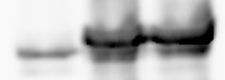
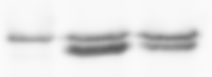
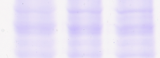
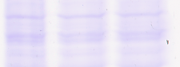
Fig. S3
A
B
p53R175H
mp53R172H
p53WT
mp53WT
Mock
Mock
p53
50
mp53
50
Supplementary Figure S3.
U373 MG cells were transfected with either (A) p53WT, p53R175H, (B) mp53WT, mp53R172H or mock vector. At 36 h after transfection, whole cell lysates were subjected to western blot analysis with an anti-p53 antibody. Coomassie brilliant blue staining is shown as a loading control.

Slide 4
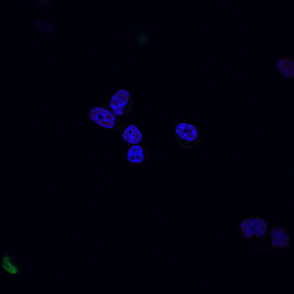
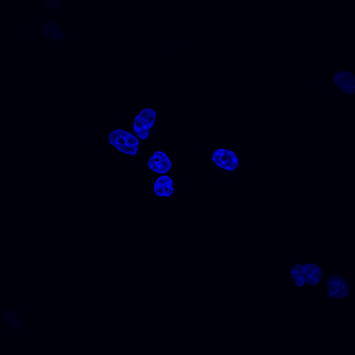
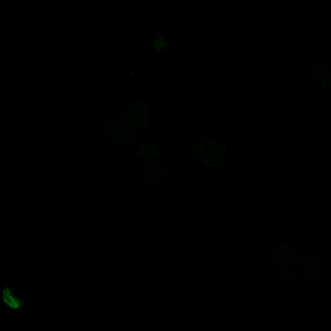
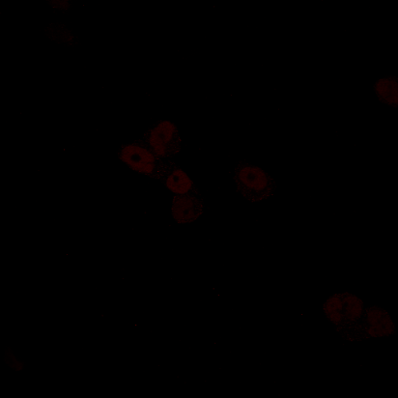
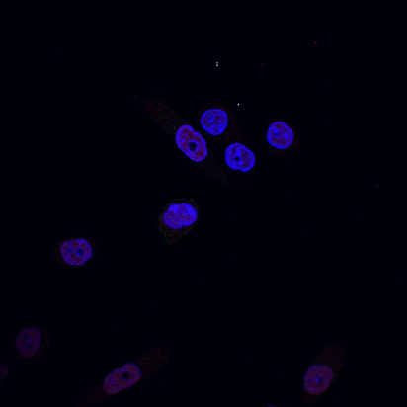
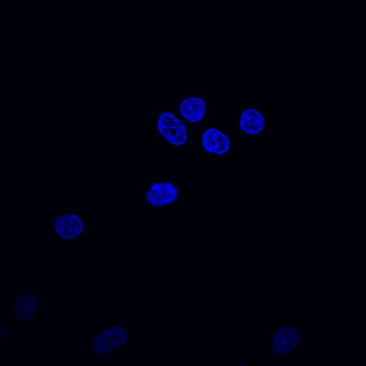

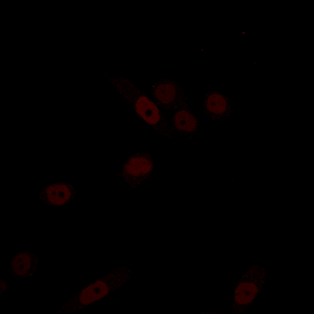
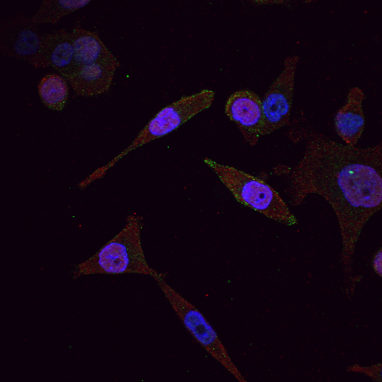
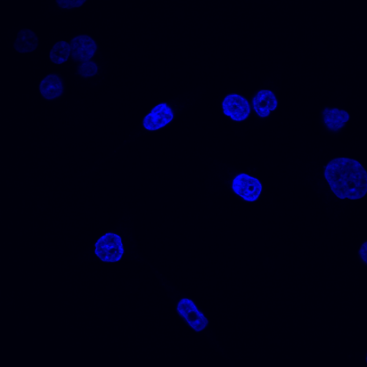
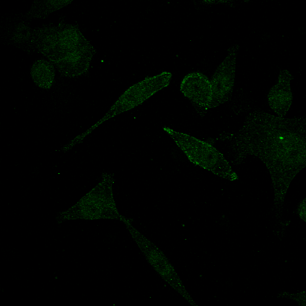
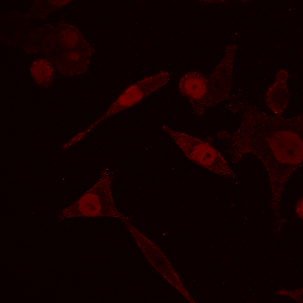
Fig. S4
12h
Merge
DAPI
EPN3
p53
24h
Merge
DAPI
EPN3
p53
48h
Merge
DAPI
EPN3
p53

Slide 5
Supplementary Figure S4.
HCT116 p53^{+/+} cells were treated with 2 μg/ml of ADR for 2 h and then incubated with normal medium for the indicated hours. Adherent cells were fixed with 4% paraformaldehyde in PBS and permeabilized with 0.2% Triton X-100 in PBS for 5 min at room temperature. EPSIN 3 (green) and p53 (red) were visualized using specific primary antibodies and fluorescein-conjugated secondary antibodies. Nuclei were stained with DAPI (blue).

Slide 6
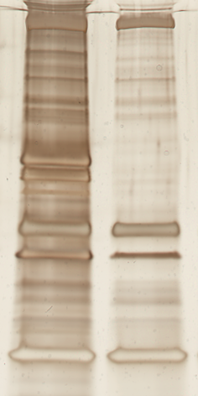
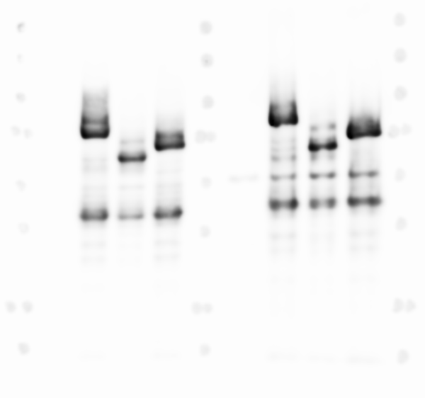
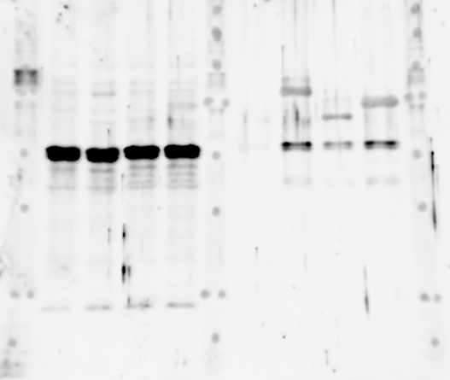
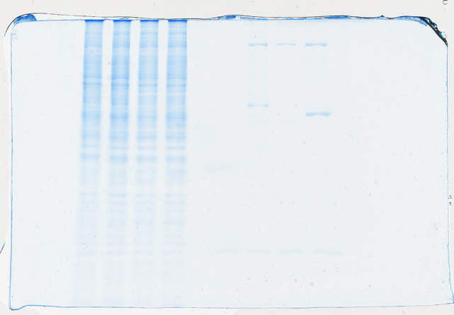
Fig. S5
A
B
Input
IP:HA
EPSIN 3C
Mock
EPSIN 3C
EPSIN 3C
Mock
Mock
CHC
150
kDa
100
100
75
75
EPSIN 3
EPSIN 3
50
50
EPSIN 3
37
37
50
p53
25
20
CBB
Supplementary Figure S5.
HEK293T cells were transfected with either EPSIN 3C or mock vector. At 36 h after transfection, whole cell lysates were subjected to immunoprecipitation with an anti-HA agarose antibody, and the immunoprecipitates were analyzed using SDS-PAGE and subsequent silver staining (A) or western blotting using anti-p53 antibody (B). (A) Mass spectrometric analysis revealed that the red-arrow-indicated protein band contained clathrin heavy chain. Green arrows indicate the protein bands of EPSIN 3.

Slide 7
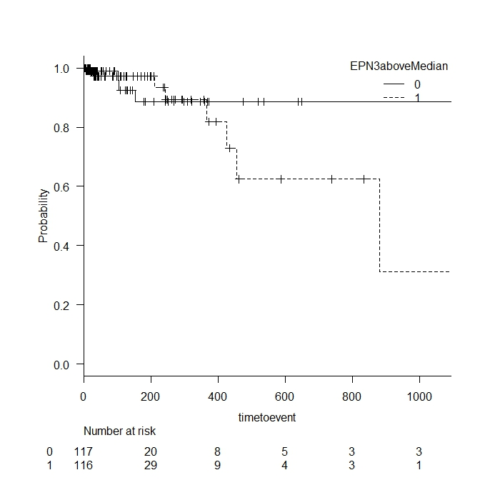
Fig. S6
1.0
Below median
0.8
0.6
Probability
P = 0.37
0.4
0.2
Above median
0
0
200
400
600
800
1000
Days after diagnosis
Number at risk
Below | 117 | 20 | 8 | 5 | 3 | 3
Above | 116 | 29 | 9 | 4 | 3 | 1
Supplementary Figure S6.
Kaplan-Meier curves of patients stratified by the expression levels of EPSIN 3 in gastric cancer tissues. Data on RNA sequence and clinical information were obtained from the TCGA database. The P value was calculated by using a log-rank test.

