Slide 1
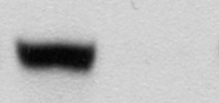
A
B
 | NEK6 wt castrated | NEK6 kd castrated
# tumors | 4/6 | 0/6
 | shAR -dox | shAR +dox
# tumors | 5/6 | 5/9
AR
Supplemental Figure S1

Slide 2
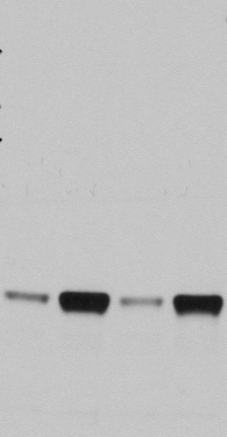
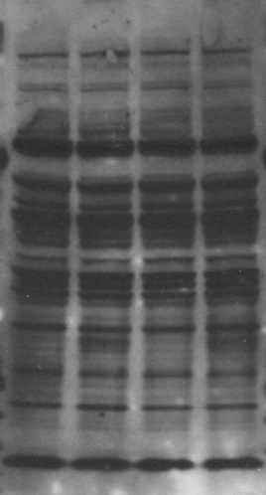
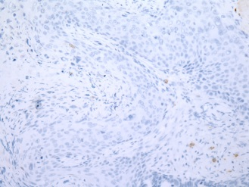
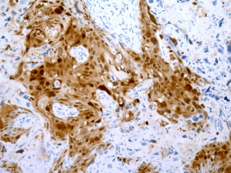
A
B
dox | - | + | - | + |  | - | + | - | +
150
100
75
50
37
25
20
15
-dox
+dox
NEK6
Epitomics 3789-1
Santa Cruz H-50
C
46/287=16%
Supplemental Figure S2

Slide 3
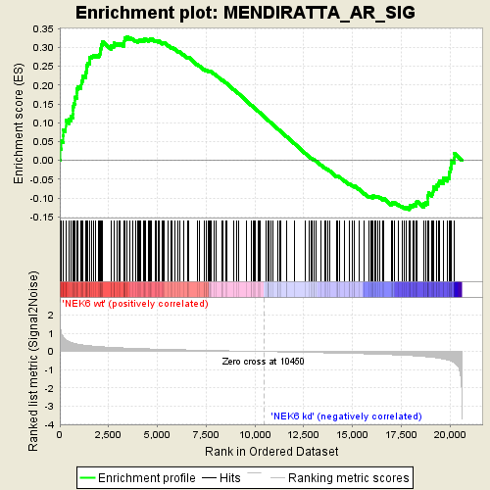
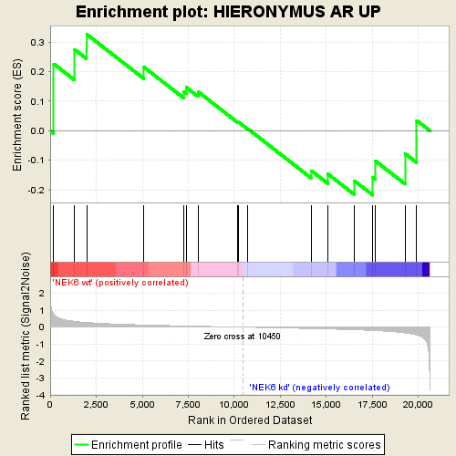
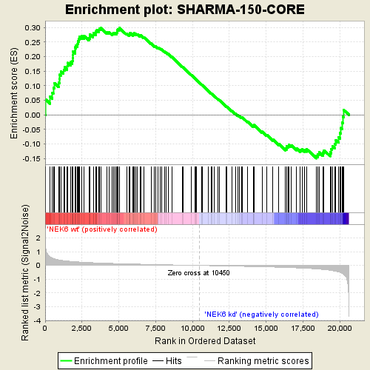
A
B
 | NEK6 wt |  |  |  | K74M/K75M |  |  |  | AKT1 |  |  |  | RAF1
 | untagged |  | -V5 |  | untagged |  | -V5 |  | untagged |  | -V5 |  | untagged |  | -V5
dox (1 µg/ml) | - | + | - | + | - | + | - | + | - | + | - | + | - | + | - | +
NEK6
AKT1
RAF1
C
D
Supplemental Figure S3

Slide 4
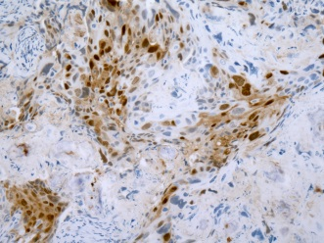
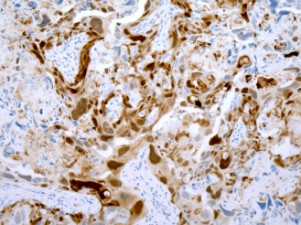
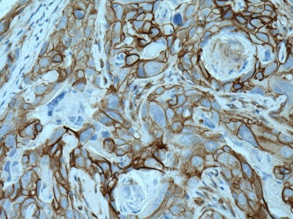
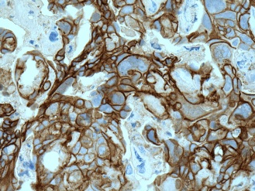
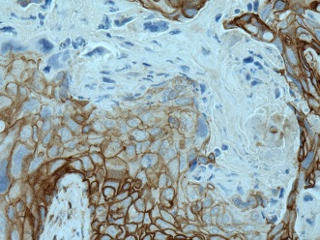

A
Day 0 | Day 2 | Day 5
NEK6
β-catenin
B
+dox -GF |  |  |  | -dox +GF 5min |  |  |  |  | +dox +GF 5min
NEK6 |  |  |  | GFP | NEK6 |  |  |  | GFP | NEK6
K74M/K75M | wt | Y108A | Δ13-44 |  | K74M/K75M | wt | Y108A | Δ13-44 |  | K74M/K75M | wt | Y108A | Δ13-44
NEK6
β-actin
pT412-RPS6KB1
pS727-STAT3
C
pTRIPz-GFP |  |  |  |  |  | pTRIPz-NEK6
day 0 |  |  | day 2 |  |  | day 0 |  |  |  |  |  | day 2 |  |  |  |  |  | day 5
+dox |  |  |  |  |  | -dox |  |  | +dox |  |  | -dox |  |  | +dox |  |  | -dox |  |  | +dox
1 | 2 | 3 | 1 | 2 | 3 | 1 | 2 | 3 | 1 | 2 | 3 | 1 | 2 | 3 | 1 | 2 | 3 | 1 | 2 | 3 | 1 | 2 | 3
NEK6 (short)
NEK6 (long)
β-actin
pT412-
RPS6KB1
pS727-STAT3
Supplemental Figure S4

Slide 5
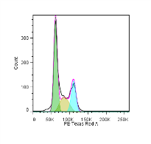
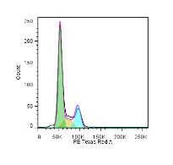
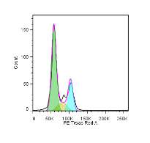
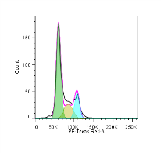
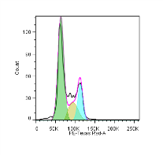
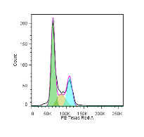
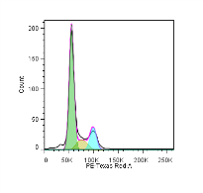
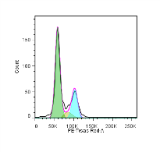
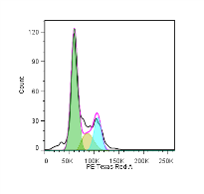
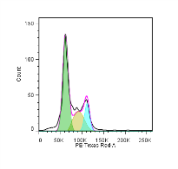










A
-dox
 | async |  | 0 h |  | 4 h |  | 8 h |  | 24 h
 | -dox | +dox | -dox | +dox | -dox | +dox | -dox | +dox | -dox | +dox
G0/G1 | 54.5 | 54.2 | 69.2 | 67.8 | 58.9 | 57.1 | 57.6 | 51.6 | 51.6 | 50.9
S | 15.5 | 16.2 | 8.4 | 7.1 | 13.6 | 13.1 | 16.9 | 16.9 | 19 | 17.8
G2/M | 25 | 23.5 | 18.4 | 14.9 | 19.3 | 22.3 | 19.1 | 20 | 21.9 | 19.5
sub-G1 | 5.1 | 4.7 | 4.0 | 10.0 | 6.8 | 5.8 | 6.0 | 9.7 | 6.9 | 10
+dox
B
C
LHSR-AR + pLX304-
LHSR-AR + pTRIPz-NEK6 +dox 48h
 | 18 hours |  |  |  | 4 hours
[etoposide] µM | 0 |  | 10 |  | 0 |  | 50
 | lacZ | NEK6 | lacZ | NEK6 | lacZ | NEK6 | lacZ | NEK6
18 hours |  |  |  | 4 hours
0 |  | 10 |  | 0 |  | 50
kd | wt | kd | wt | kd | wt | kd | wt
cleaved
PARP
p53
p21
V5
β-actin
NEK6
Supplemental Figure S5

Slide 6
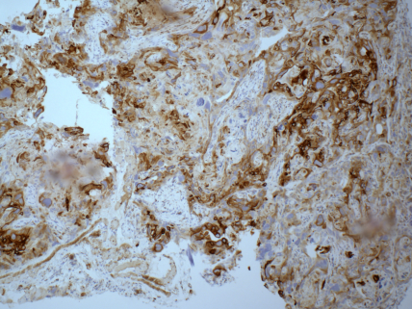
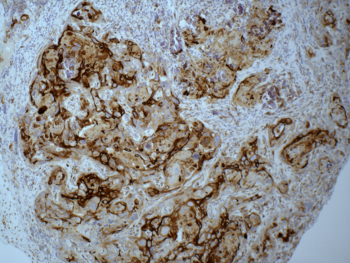
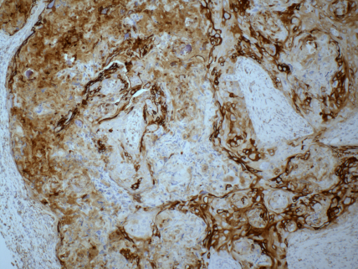
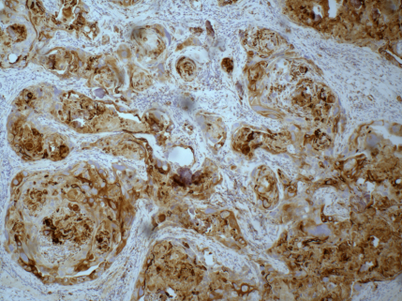
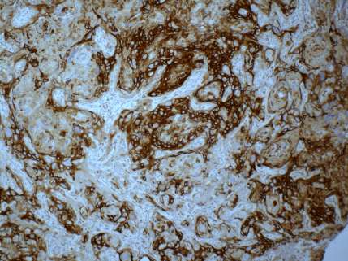
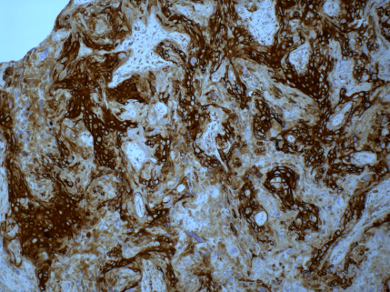
Day 0 | Day 2 | Day 5
-dox
+dox
Supplemental Figure S6

