Slide 1
Slides for Osteoporosis
Focus Groups
Notes:
November 5, 2015 – have taken in comments from RT, TH, PG, JH, KM- and reviewers VN, MC and JD – and revised following pilot 1 and pilot 2.

Slide 2

Community attitudes to diagnosis of osteoporosis

Slide 3
Introduction
Welcome and thanks
Brief introductions
Aims of session
Recording of session

Slide 4

A few short questions

Slide 5

Structure of today
1st segment – discussion about a few questions
2nd segment – 4 brief presentations – each followed by discussion

Slide 6
Time for initial discussion

Slide 7
Initial Discussion – Question 1
What is osteoporosis?
Notes:
FOR MODERATOR TO ASK
What do you know and feel about osteoporosis?
How does osteoporosis get diagnosed?
What are the benefits of diagnosing it?
Are there any downsides to being diagnosed with osteoporosis?
Is it a disease?

Slide 9
Initial Discussion – Question 2
Apart from the density of your bones, are there other things that might increase the chances that you will have a fracture in the future?
Notes:
FOR MODERATOR TO ASK
(if needed – “a fracture is a broken bone – for example a hip fracture”)
Are there other factors that increase the risk of having a fracture?
What are they?
How important is bone mineral density in relation to all the other factors – in terms of increasing your risk of having a fracture?

Slide 11
Initial Discussion – Question 3
How well do common medications for osteoporosis work?
Notes:
FOR MODERATOR TO ASK
(if there is need to be specific, explain the most common medications are bisphosphonates, one of which is alendronate, or Fosamax)
What are the benefits of using medications to treat osteoporosis?
Can you describe the benefits using numbers? (could lead in gently – eg – if someone says ‘prevents fractures’ – could ask how many have a fracture prevented – or does everyone have a fracture prevented, or just some )
Can you estimate, using numbers, the chances of a woman in her 50s having a hip fracture?
What are the harms or downsides of treating osteoporosis with medications?

Slide 13
Initial Discussion - Question 4
Among people who are diagnosed with osteoporosis, how many of them will never have a fracture?
Notes:
FOR MODERATOR TO ASK
Almost all? About half? Very few? None
Have you ever heard about the problem of overdiagnosis?
(If people ask what do you mean, say we will explain later in the focus group)
What do you know about overdiagnosis?
Can someone who is diagnosed with osteoporosis be overdiagnosed?

Slide 15
Presentation explanation
We will now present some information about osteoporosis that may be somewhat different from what you’ve heard before
We’re interested in your responses to the information – there’s no right or wrong
The information will be presented by video by Professor Paul Glasziou, who’ll join us later briefly to answer any questions

Slide 16
This is where video presentation 1 based on following slides was (if you need it Ray can send)

Slide 17

Presentation: Part 1 – What is osteoporosis?

Slide 18
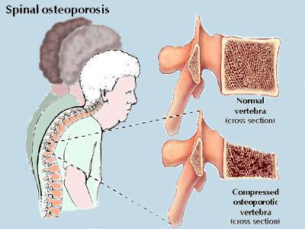
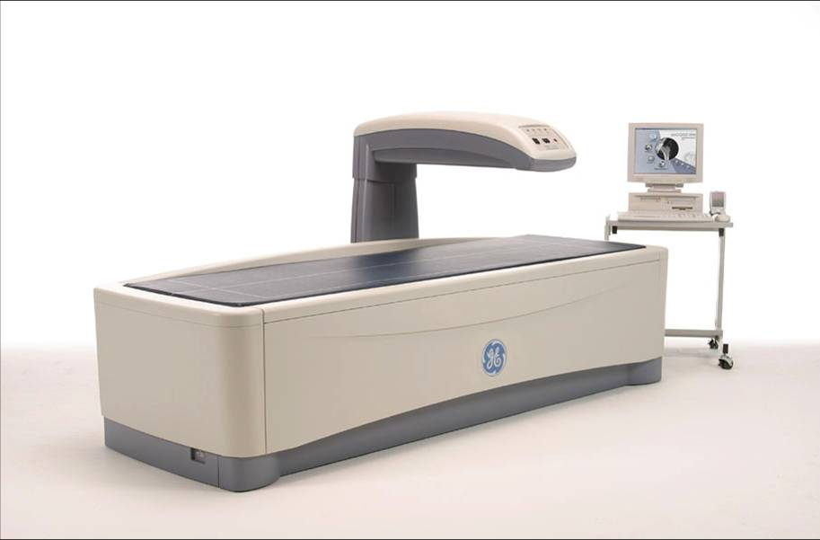
What is osteoporosis?
1820-1960’s Osteoporosis was a diagnosis limited to people who had painful spinal fractures
In 1970s & 80s new measurement devices allowed the study of bone mass changes over ages
Notes:
References:
Pre-1994 definition comes from : M. Brooke Herndon, Lisa M. Schwartz, Steven Woloshin and H. Gilbert Welch
Implications Of Expanding Disease Definitions: The Case Of Osteoporosis Health Affairs, 26, no.6 (2007):1702-1711

Slide 19
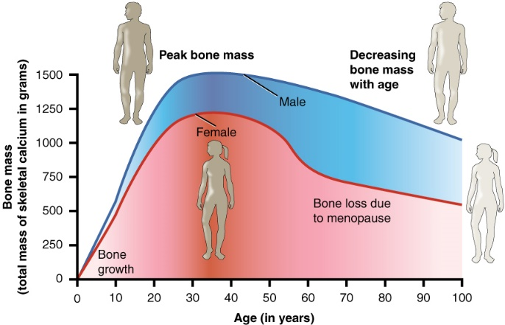
How osteoporosis is defined now
In 1994 a WHO study group decided to define the bone density of young women as “normal”
If density was a certain amount of difference from young “normal” – a woman was labelled as having osteoporosis
Financial support was from 3 pharmaceutical companies
Bones – like hair and skin – get thinner with age, the new definition meant over 1 in 5 women over 50 years old are classified as having osteoporosis
Notes:
References:
‘Over 1 in 5 women over 50’ figure comes from: Australian Institute of Health and Welfare 2014. Estimating the prevalence of osteoporosis. Cat. no.
PHE 178. Canberra: AIHW: pvi ;
1994 definition: J.A. Kanis, “Assessment of Fracture Risk and Its Application to Screening for Postmenopausal
Osteoporosis: Synopsis of a WHO Report,” Osteoporosis International 4, no. 6 (1994): 368–381.
Pre-1994 definition and mention of industry support comes from : M. Brooke Herndon, Lisa M. Schwartz, Steven Woloshin and H. Gilbert Welch
Implications Of Expanding Disease Definitions: The Case Of Osteoporosis Health Affairs, 26, no.6 (2007):1702-1711

Slide 20

Osteoporosis a “disease” or “risk factor” ?
Commonly described as “disease”, but some doctors don’t agree with this, because the way it’s defined means many otherwise healthy women are automatically labelled
Some researchers prefer to describe low bone mineral density as a “risk factor” – a factor that increases the risk of having a broken bone – rather than a “disease”
Notes:
References:
Järvinen T, et al Overdiagnosis of bone fragility in the quest to prevent
hip fracture BMJ 2015 BMJ 2015;350:h2088
Moynihan R, Heath I, Henry D. Selling sickness: the pharmaceutical industry and disease Mongering BMJ 2002;324:886–91

Slide 21
Discussion of Part 1
How do you feel about describing osteoporosis as a “risk factor” or a “disease”?
Have you ever heard this information before?
  If you have questions or things you want to clarify Professor Glasziou will be here later to answers questions

Slide 22
This is where video presentation 2 based on following slides was (if you need it Ray can send)

Slide 23
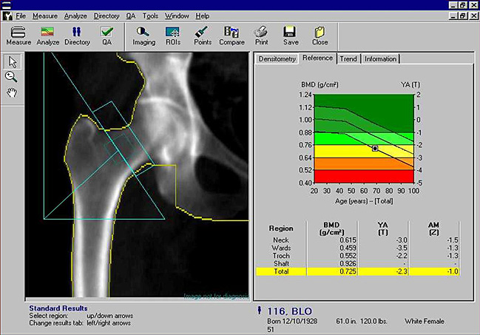
Presentation: Part 2 – Apart from bone density what else increases fracture risk?

Slide 24
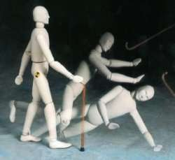
What else increases risk?
Bone density is only a small part of your overall risk of fracture - some researchers believe it’s a poor predictor of fracture in an individual
We will discuss medication soon, but there are other ways to try and reduce your risk of falls and fractures – eg. certain kinds of exercise – though evidence supporting these strategies is not as strong as for medications
Notes:
References:
Järvinen T, et al Overdiagnosis of bone fragility in the quest to prevent hip fracture BMJ 2015 BMJ 2015;350:h2088
Järvinen T,et al. Shifting the focus in fracture prevention from osteoporosis to falls BMJ 2008 ;336:pp124-126
Australian Institute of Health and Welfare 2014. Estimating the prevalence of osteoporosis. Cat. no.
PHE 178. Canberra: AIHW: p4 covers prevention strategies; p20 covers problems with diagnosing
“Building Healthy Bones Throughout Life” MJA Open 2 Suppl 1 ∙ 4 February 2013 p2-4 covers non-drug options to reduce risk

Slide 25
What else increases risk ?
Age is a big factor:
Most hip fractures happen in those 80 or older
Younger women generally have very low risk of fracture
For a 50 year old, risk of hip fracture is around 1 in 5,000 per year
For an 80 year old – risk is almost 2 in 100 per year – or almost 1 in 10 over 5 years
Notes:
References:
All figures come from: Australian Institute of Health and Welfare 2014. Estimating the prevalence of osteoporosis. Cat. no.
PHE 178. Canberra: AIHW: p14

Slide 26
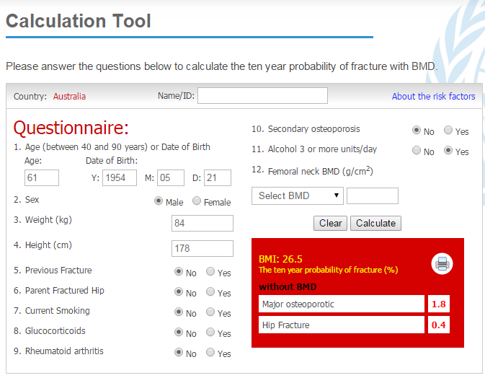
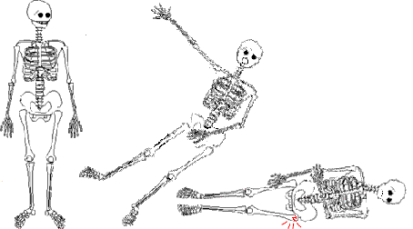
What else increases risk?
Bone mineral density is only one “risk factor” that
increases your chance of a future fracture
Other factors include:
your age, previous fracture, family history of fracture, use of alcohol, smoking, some other medicines, being physically inactive, having a fall…
Many people who have fractures don’t have low bone density – they don’t have “osteoporosis”
Notes:
References:
Järvinen T, et al Overdiagnosis of bone fragility in the quest to prevent hip fracture BMJ 2015 BMJ 2015;350:h2088
Järvinen T,et al. Shifting the focus in fracture prevention from osteoporosis to falls BMJ 2008 ;336:pp124-126
Australian Institute of Health and Welfare 2014. Estimating the prevalence of osteoporosis. Cat. no.
PHE 178. Canberra: AIHW: p20 (covers problems with diagnosing)

Slide 27
Discussion of Part 2
How do you feel about the importance of bone mineral density compared to other risk factors?
Have you ever heard this information before?

Slide 28
This is where video presentation 3 based on following slides was (if you need it Ray can send)

Slide 29
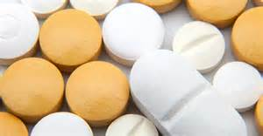
Presentation: Part 3 – How well do common medications work?

Slide 30
How well do medications work?
Bisphosphonate medications - including Fosamax – are the most common treatments for osteoporosis
They can lower the risk of fracture – and we are going to focus on this medicine in this presentation
Notes:
This section uses one of the most common treatment – bisphosphonates
References:
Figures drawn largely from: Wells G, Cranney A, Peterson J et al. Alendronate for the primary and secondary prevention of osteoporotic fractures in postmenopausal women
Cochrane Review 2008 ; 10.1002/14651858.CD001155.pub2
Also informed by: A Systematic Review of the Efficacy of Bisphosphonates. Therapeutics Initiative. UBC Canada. Therapeutics Letter #83 October 2011

Slide 31
How well do medications work?
We will present two different sets of evidence
1st…..evidence with women who mostly hadn’t had a fracture before…
2nd…..evidence with women who mostly had previously had a fracture …

Slide 32
How do the following diagrams work?
1 dot = 1 woman

Slide 33
How well do medications work?
1ST ….In evidence with women who mostly hadn’t had a fracture before…

Slide 34
Medication impact on hip fracture
Women without previous fracture. All taking calcium and some taking Vitamin D.
Of 100 women who
do not take medicine
for about 2 years,
1 woman will have a
hip fracture.
Of 100 women who
take medicine
for about 2 years,
1 woman will have a
hip fracture.
So…no hip fracture
is prevented by medicine.
No women get this benefit.
Notes:
References:
These figures from the Plain Language Summary of the 2008 Cochrane Review of Alendronate : Wells G, Cranney A, Peterson J et al. Alendronate for the primary and secondary prevention of osteoporotic fractures in postmenopausal women
Cochrane Review 2008 ; 10.1002/14651858.CD001155.pub2
NB: Re length of trials: The SR used data 1-4 years of follow up. The Decision Aid related to the SR, (Should I take alendronate (Fosamax®) for osteoporosis?
A Cochrane decision aid to discuss options with your doctor - developed by Rader, T. Maxwell, L. Ghogomu, E. Tugwell, P. Welch, V. Last Reviewed, February 2011.) used 1 -4 years and ‘an average of’ 2 years.
Mean age of people in all the trials included in the SR were 53 – 78. (Could not identify age or BMD for primary versus secondary)

Slide 35
Medication impact on spinal fractures
Women without previous fractures. All taking calcium and some taking Vitamin D.
Of 100 women who
do not take medicine
for about 2 years,
3 women will have a
spinal fracture.
Of 100 women who
take medicine
for about 2 years,
1 woman will have a
spinal fracture.
So…2 spinal fractures
are prevented by medicine.
98 of the 100 women taking medication do not get this benefit.
Notes:
References:
These figures from the Plain Language Summary of the 2008 Cochrane Review of Alendronate : Wells G, Cranney A, Peterson J et al. Alendronate for the primary and secondary prevention of osteoporotic fractures in postmenopausal women
Cochrane Review 2008 ; 10.1002/14651858.CD001155.pub2
NB: Re length of trials: The SR used data 1-4 years of follow up. The Decision Aid related to the SR, (Should I take alendronate (Fosamax®) for osteoporosis?
A Cochrane decision aid to discuss options with your doctor - developed by Rader, T. Maxwell, L. Ghogomu, E. Tugwell, P. Welch, V. Last Reviewed, February 2011.) used 1 -4 years and ‘an average of’ 2 years.
Mean age of all women in included trials was 53 – 78. (Could not identify age or BMD for primary versus secondary prevention)

Slide 36
How well do medications work?
2nd….in evidence with women who mostly had previously had a fracture …

Slide 37
Medication impact on hip fracture
Women with previous fracture. All taking calcium and some taking Vitamin D.
Of 100 women who
do not take medicine
for about two years,
2 women will have a
hip fracture.
Of 100 women who
take medicine
for about two years,
1 woman will have a
hip fracture.
So…
1 hip fracture
is prevented by medicine.
The other 99 of these 100 women taking medications do not get this benefit.
Notes:
References:
These figures from the Plain Language Summary of the 2008 Cochrane Review of Alendronate: Wells G, Cranney A, Peterson J et al. Alendronate for the primary and secondary prevention of osteoporotic fractures in postmenopausal women Cochrane Review 2008 ; 10.1002/14651858.CD001155.pub2

Slide 38

How well do medications work?
Benefits of medications are very different for women in different age groups …

Slide 39
Medication impact on non-spinal fracture
Women with previous fracture. All taking calcium and some taking Vitamin D.
If 100 women aged 65-69
take medicine for about 5 years,
1 woman will have a
fracture prevented.
The other 99 taking medicine
will not get this benefit
If 100 women aged 85-89
take medicine for about 5 years,
3 women will have a
fracture prevented.
The other 97 women taking medicine
will not get this benefit
Notes:
References:
These figures come from Wells G, Cranney A, Peterson J et al. Alendronate for the primary and secondary prevention of osteoporotic fractures in postmenopausal women Cochrane Review 2008 ; 10.1002/14651858.CD001155.pub2
They are drawn from the Non vertebral fracture Secondary Prevention rows of Figure 10.

Slide 40
Medication impact on non-spinal fracture
Women with previous fracture. All taking calcium and some taking Vitamin D.
If 100 women at LOW overall risk
take medicine for about 5 years,
2 women will have a non-spinal
fracture prevented.
The other 98 taking medicine
will not get this benefit
If 100 women at HIGH overall risk
take medicine for about 5 years,
6 women will have a non-spinal
fracture prevented.
The other 94 women taking medicine
will not get this benefit
Notes:
References:
These figures come from Wells G, Cranney A, Peterson J et al. Alendronate for the primary and secondary prevention of osteoporotic fractures in postmenopausal women Cochrane Review 2008 ; 10.1002/14651858.CD001155.pub2
They are drawn from the Hip Fracture Secondary Prevention rows of Figure 9.

Slide 41
What harm might come from medications ?
Side effects of bisphosphonates may include
  Upper gastrointestinal injury – eg nausea , indigestion, vomiting, heartburn (may happen to 1 in 10 women – though estimates are uncertain)
Extremely rare side effects may include
  unusual fractures of thigh bone or femur
  “dead jaw” - osteonecrosis of the jaw (may happen in 1 in 10 000, though estimates are uncertain)
Notes:
References:
Figures from :Should I take alendronate (Fosamax®) for osteoporosis?
A Cochrane decision aid to discuss options with your doctor This decision aid was developed by Rader, T. Maxwell, L. Ghogomu, E. Tugwell, P. Welch, V. Last Reviewed, february 2011.
Also informed by : A Systematic Review of the Harms of Bisphosphonates. Therapeutics Initiative, UBC. Therapeutics Letter #84 December 2011

Slide 42
Discussion of Part 3
How do you feel about the benefits of these common medications?
How do you feel about the potential harms of these common medications?
Have you ever heard this information before?

Slide 43
This is where video presentation 4 based on following slides was (if you need it Ray can send)

Slide 44

Presentation: Part 4 –Osteoporosis & Overdiagnosis

Slide 45

Overdiagnosis and osteoporosis
Being “overdiagnosed” means being diagnosed with a disease that would never cause you harm
For example being diagnosed with a painless slipped disc, which would never cause problems
Overdiagnosis is being recognised as a growing problem across many conditions
Notes:
References:
Welch G, Schwartz L, Woloshin S. Overdiagnosed: Making People Sick in the Pursuit of Health. Boston:Beacon;2011

Slide 46
Overdiagnosis and osteoporosis
Women are diagnosed and treated for osteoporosis to try and prevent fractures
But some women diagnosed and treated would never have had a fracture anyway
This is similar to other conditions – some diagnosed with high blood pressure would never have had a heart attack or stroke
Not clear what proportion, but possibly many women diagnosed would never have had a fracture anyway – so they’re “overdiagnosed”
Notes:
NB RE: SECOND POINT HERE - IN FIRST READ PAUL MENTIONED ‘…ALL THOSE BLUE DOTS YOU MIGHT REMEMBER’– THIS SEEMED TO WORK WELL
References:
Welch G, Schwartz L, Woloshin S. Overdiagnosed: Making People Sick in the Pursuit of Health. Boston:Beacon;2011 (p26)

Slide 47
Overdiagnosis and osteoporosis
Some researchers and doctors concerned that the 1994 definition means many women automatically labelled with osteoporosis are “overdiagnosed”
This means while some women benefit from a diagnosis and treatment, other women are:
  Experiencing side effects/hassle/cost of treatment without benefit
  Psychological impact of the label, with potential anxiety about falls and impacts on activity
Notes:
References:
Järvinen T, et al Overdiagnosis of bone fragility in the quest to prevent
hip fracture BMJ 2015 BMJ 2015;350:h2088
Järvinen T,et al. Shifting the focus in fracture prevention from osteoporosis to falls BMJ 2008 ;336:pp124-126
Welch G, Schwartz L, Woloshin S. Overdiagnosed: Making People Sick in the Pursuit of Health. Boston:Beacon;2011

Slide 48
Discussion of Part 4
How do you feel about the possibility some women diagnosed with osteoporosis might be overdiagnosed?
Have you ever heard this information before?

Slide 49
Questions for Professor Glasziou
Any general or specific questions/comments for Professor Glasziou

Slide 50
Final discussion

Slide 51
Final Discussion Questions
"What are the benefits of being diagnosed with osteoporosis and what are the downsides?"
"How do you respond to the idea that the definition of osteoporosis defines the bones of young women as normal?“
"Had you ever thought before about the way this condition was defined?“

Slide 52
Final comments
Anything else you’d like to add?

Slide 53
Thank You

