Slide 1
Serum
Blotters
Control
Case
Control
Case
Notes:
Figure S1a

Slide 2
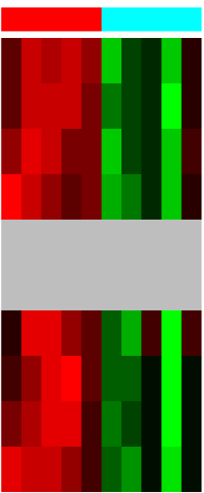
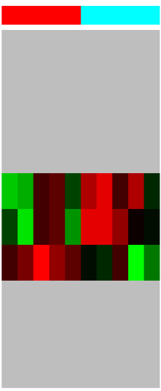
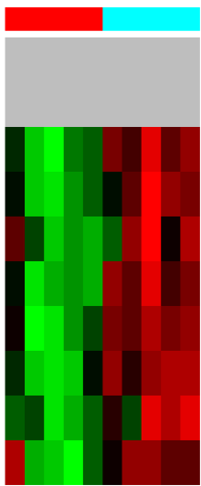
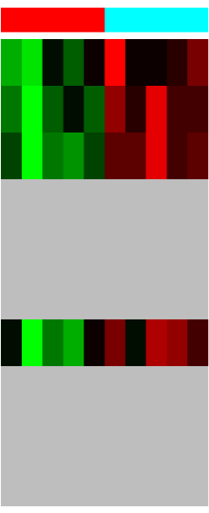
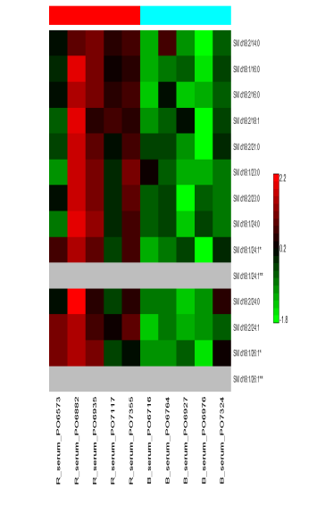
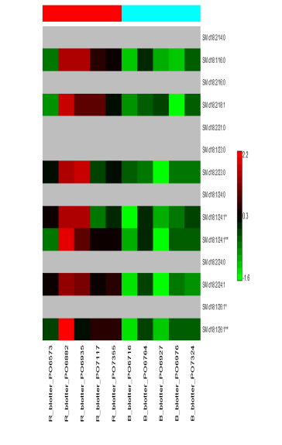
Serum
Blotters
ceramide |  |  | Cer d18:1/22:0*
 |  |  | Cer d18:1/23:0
 |  |  | Cer d18:1/24:0*
 |  |  | Cer d18:1/24:1*
 |  |  | Cer d18:1/26:0
 |  |  | Cer d18:1/26:1
hexosyl-ceramide |  |  | HexCer d18:1/16:0
 |  |  | HexCer d18:1/22:0
 |  |  | HexCer d18:1/24:0
 |  |  | HexCer d18:1/24:1
monoacylglycerol |  |  | MG 18:1
diacylglycerol |  |  | DG 16:0/18:0
 |  |  | DG 16:0/18:1
 |  |  | DG 16:0/18:2
 |  |  | DG 16:1/18:2
 |  |  | DG 17:1/18:1
 |  |  | DG 18:1/18:1
 |  |  | DG 18:1/20:1
 |  |  | DG 18:1/20:4
 |  |  | DG 18:1/22:5
sphingomyelin |  |  | SM d18:2/14:0
 |  |  | SM d18:1/16:0
 |  |  | SM d18:2/16:0
 |  |  | SM d18:2/18:1
 |  |  | SM d18:2/21:0
 |  |  | SM d18:1/23:0
 |  |  | SM d18:2/23:0
 |  |  | SM d18:1/24:0
 |  |  | SM d18:1/24:1*
 |  |  | SM d18:1/24:1**
 |  |  | SM d18:2/24:0
 |  |  | SM d18:2/24:1
 |  |  | SM d18:1/26:1*
 |  |  | SM d18:1/26:1**
Control
Case
*, isomer A
**, isomer B
0%
100%
Notes:
Figure S1b

Slide 3
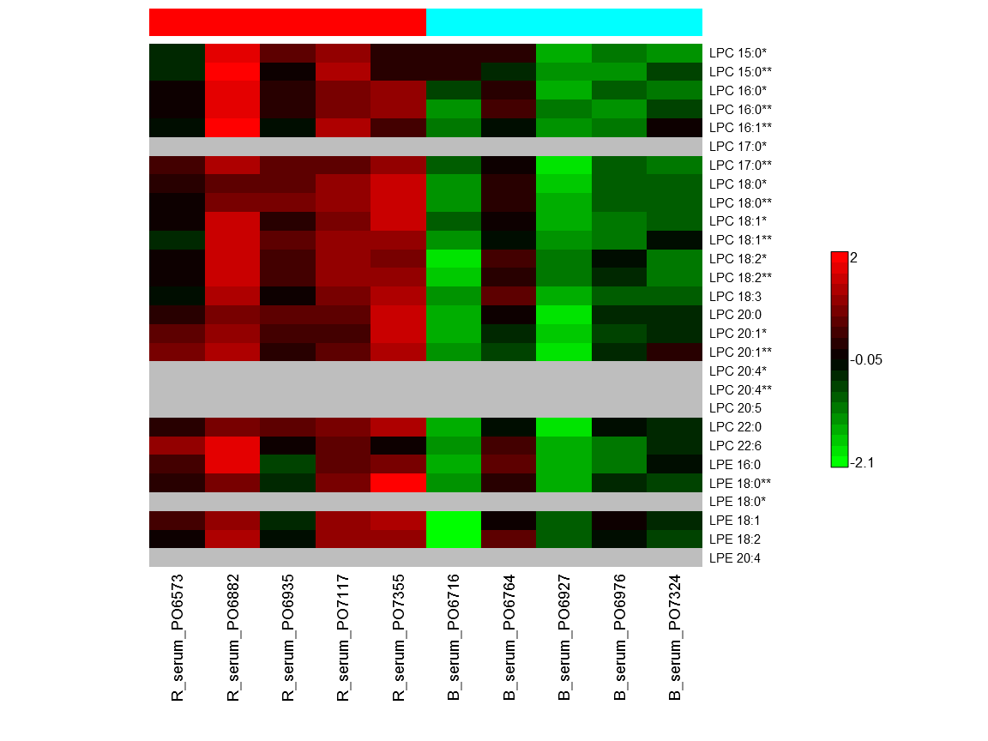
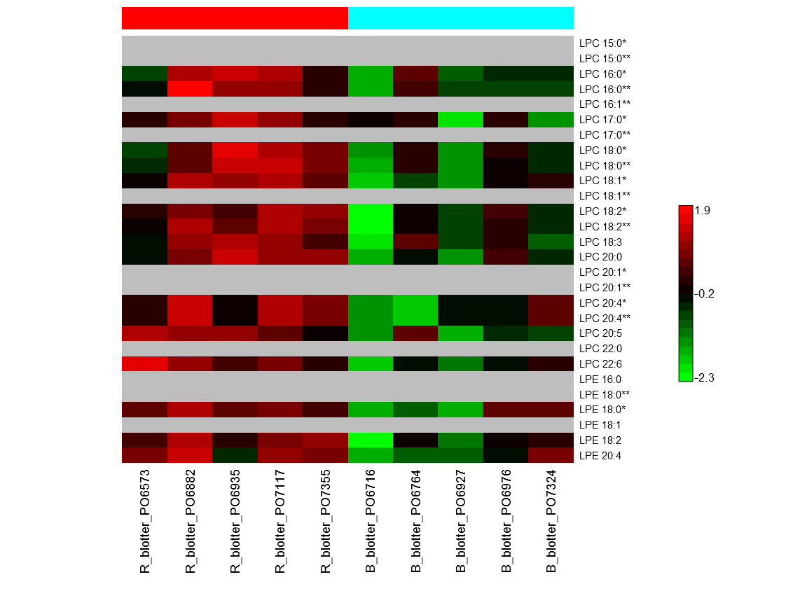
Serum
Blotters
choline |  |  | LPC 15:0*
 |  |  | LPC 15:0**
 |  |  | LPC 16:0*
 |  |  | LPC 16:0**
 |  |  | LPC 16:1**
 |  |  | LPC 17:0*
 |  |  | LPC 17:0**
 |  |  | LPC 18:0*
 |  |  | LPC 18:0**
 |  |  | LPC 18:1*
 |  |  | LPC 18:1**
 |  |  | LPC 18:2*
 |  |  | LPC 18:2**
 |  |  | LPC 18:3
 |  |  | LPC 20:0
 |  |  | LPC 20:1*
 |  |  | LPC 20:1**
 |  |  | LPC 20:4*
 |  |  | LPC 20:4**
 |  |  | LPC 20:5
 |  |  | LPC 22:0
 |  |  | LPC 22:6
ethanolamine |  |  | LPE 16:0
 |  |  | LPE 18:0**
 |  |  | LPE 18:0*
 |  |  | LPE 18:1
 |  |  | LPE 18:2
 |  |  | LPE 20:4
monacylglycoerophospho-
Notes:
Figure S1c

Slide 4
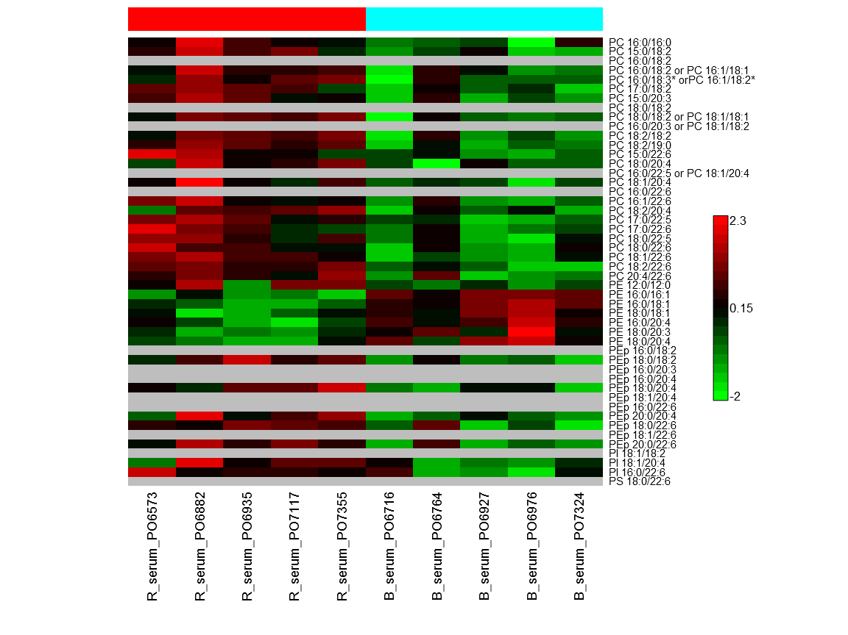
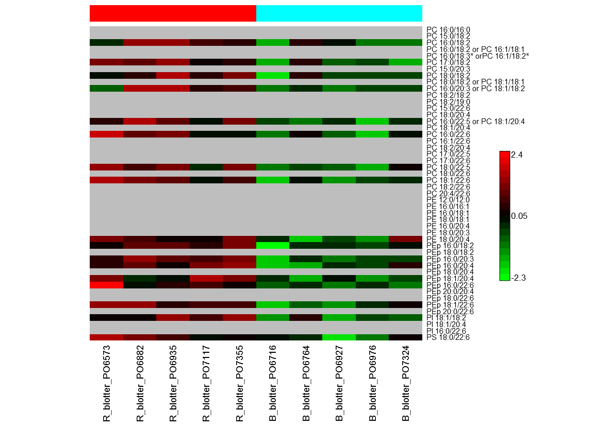
Serum
Blotters
choline |  |  | PC 16:0/16:0
 |  |  | PC 15:0/18:2
 |  |  | PC 16:0/18:2
 |  |  | PC 16:0/18:2 or PC 16:1/18:1
 |  |  | PC 16:0/18:3* or PC 16:1/18:2*
 |  |  | PC 17:0/18:2
 |  |  | PC 15:0/20:3
 |  |  | PC 18:0/18:2
 |  |  | PC 18:0/18:2 or PC 18:1/18:1
 |  |  | PC 16:0/20:3 or PC 18:1/18:2
 |  |  | PC 18:2/18:2
 |  |  | PC 18:2/19:0
 |  |  | PC 15:0/22:6
 |  |  | PC 18:0/20:4
 |  |  | PC 16:0/22:5 or PC 18:1/20:4
 |  |  | PC 18:1/20:4
 |  |  | PC 16:0/22:6
 |  |  | PC 16:1/22:6
 |  |  | PC 18:2/20:4
 |  |  | PC 17:0/22:5
 |  |  | PC 17:0/22:6
 |  |  | PC 18:0/22:5
 |  |  | PC 18:0/22:6
 |  |  | PC 18:1/22:6
 |  |  | PC 18:2/22:6
 |  |  | PC 20:4/22:6
ethanolamine |  |  | PE 12:0/12:0
 |  |  | PE 16:0/16:1
 |  |  | PE 16:0/18:1
 |  |  | PE 18:0/18:1
 |  |  | PE 16:0/20:4
 |  |  | PE 18:0/20:3
 |  |  | PE 18:0/20:4
ethanolamine plasmalogen |  |  | PEp 16:0/18:2
 |  |  | PEp 18:0/18:2
 |  |  | PEp 16:0/20:3
 |  |  | PEp 16:0/20:4
 |  |  | PEp 18:0/20:4
 |  |  | PEp 18:1/20:4
 |  |  | PEp 16:0/22:6
 |  |  | PEp 20:0/20:4
 |  |  | PEp 18:0/22:6
 |  |  | PEp 18:1/22:6
 |  |  | PEp 20:0/22:6
inositol |  |  | PI 18:1/18:2
 |  |  | PI 18:1/20:4
 |  |  | PI 16:0/22:6
serine |  |  | PS 18:0/22:6
diacylglycerophospho-
Notes:
Figure S1d

Slide 5
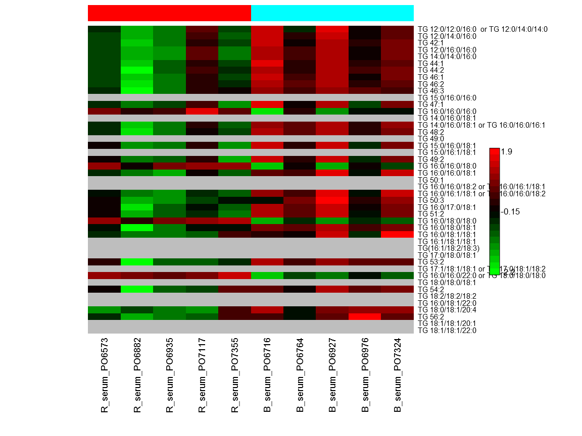
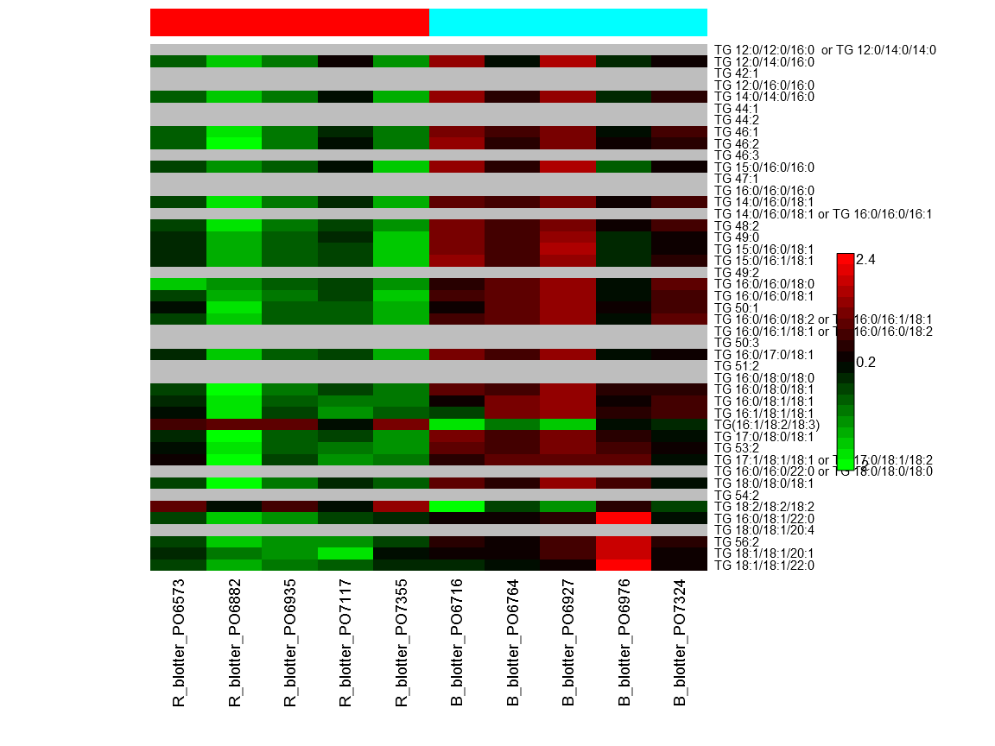
Serum
Blotters
triacylglycerol |  |  | TG 12:0/12:0/16:0 or TG 12:0/14:0/14:0
 |  |  | TG 12:0/14:0/16:0
 |  |  | TG 42:1
 |  |  | TG 12:0/16:0/16:0
 |  |  | TG 14:0/14:0/16:0
 |  |  | TG 44:1
 |  |  | TG 44:2
 |  |  | TG 46:1
 |  |  | TG 46:2
 |  |  | TG 46:3
 |  |  | TG 15:0/16:0/16:0
 |  |  | TG 47:1
 |  |  | TG 16:0/16:0/16:0
 |  |  | TG 14:0/16:0/18:1
 |  |  | TG 14:0/16:0/18:1 or TG 16:0/16:0/16:1
 |  |  | TG 48:2
 |  |  | TG 49:0
 |  |  | TG 15:0/16:0/18:1
 |  |  | TG 15:0/16:1/18:1
 |  |  | TG 49:2
 |  |  | TG 16:0/16:0/18:0
 |  |  | TG 16:0/16:0/18:1
 |  |  | TG 50:1
 |  |  | TG 16:0/16:0/18:2 or TG 16:0/16:1/18:1
 |  |  | TG 16:0/16:1/18:1 or TG 16:0/16:0/18:2
 |  |  | TG 50:3
 |  |  | TG 16:0/17:0/18:1
 |  |  | TG 51:2
 |  |  | TG 16:0/18:0/18:0
 |  |  | TG 16:0/18:0/18:1
 |  |  | TG 16:0/18:1/18:1
 |  |  | TG 16:1/18:1/18:1
 |  |  | TG(16:1/18:2/18:3)
 |  |  | TG 17:0/18:0/18:1
 |  |  | TG 53:2
 |  |  | TG 17:1/18:1/18:1 or TG 17:0/18:1/18:2
 |  |  | TG 16:0/16:0/22:0 or TG 18:0/18:0/18:0
 |  |  | TG 18:0/18:0/18:1
 |  |  | TG 54:2
 |  |  | TG 18:2/18:2/18:2
 |  |  | TG 16:0/18:1/22:0
 |  |  | TG 18:0/18:1/20:4
 |  |  | TG 56:2
 |  |  | TG 18:1/18:1/20:1
 |  |  | TG 18:1/18:1/22:0
Notes:
Figure S1e

Slide 6
A
B
Notes:
Figure S2.

