Slide 1
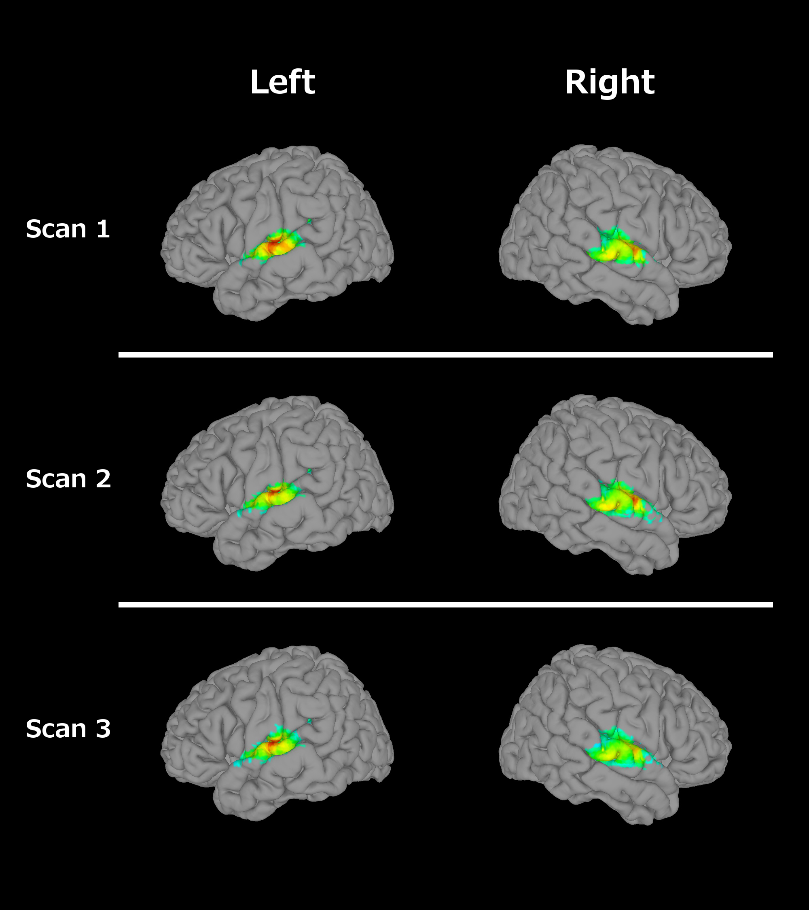
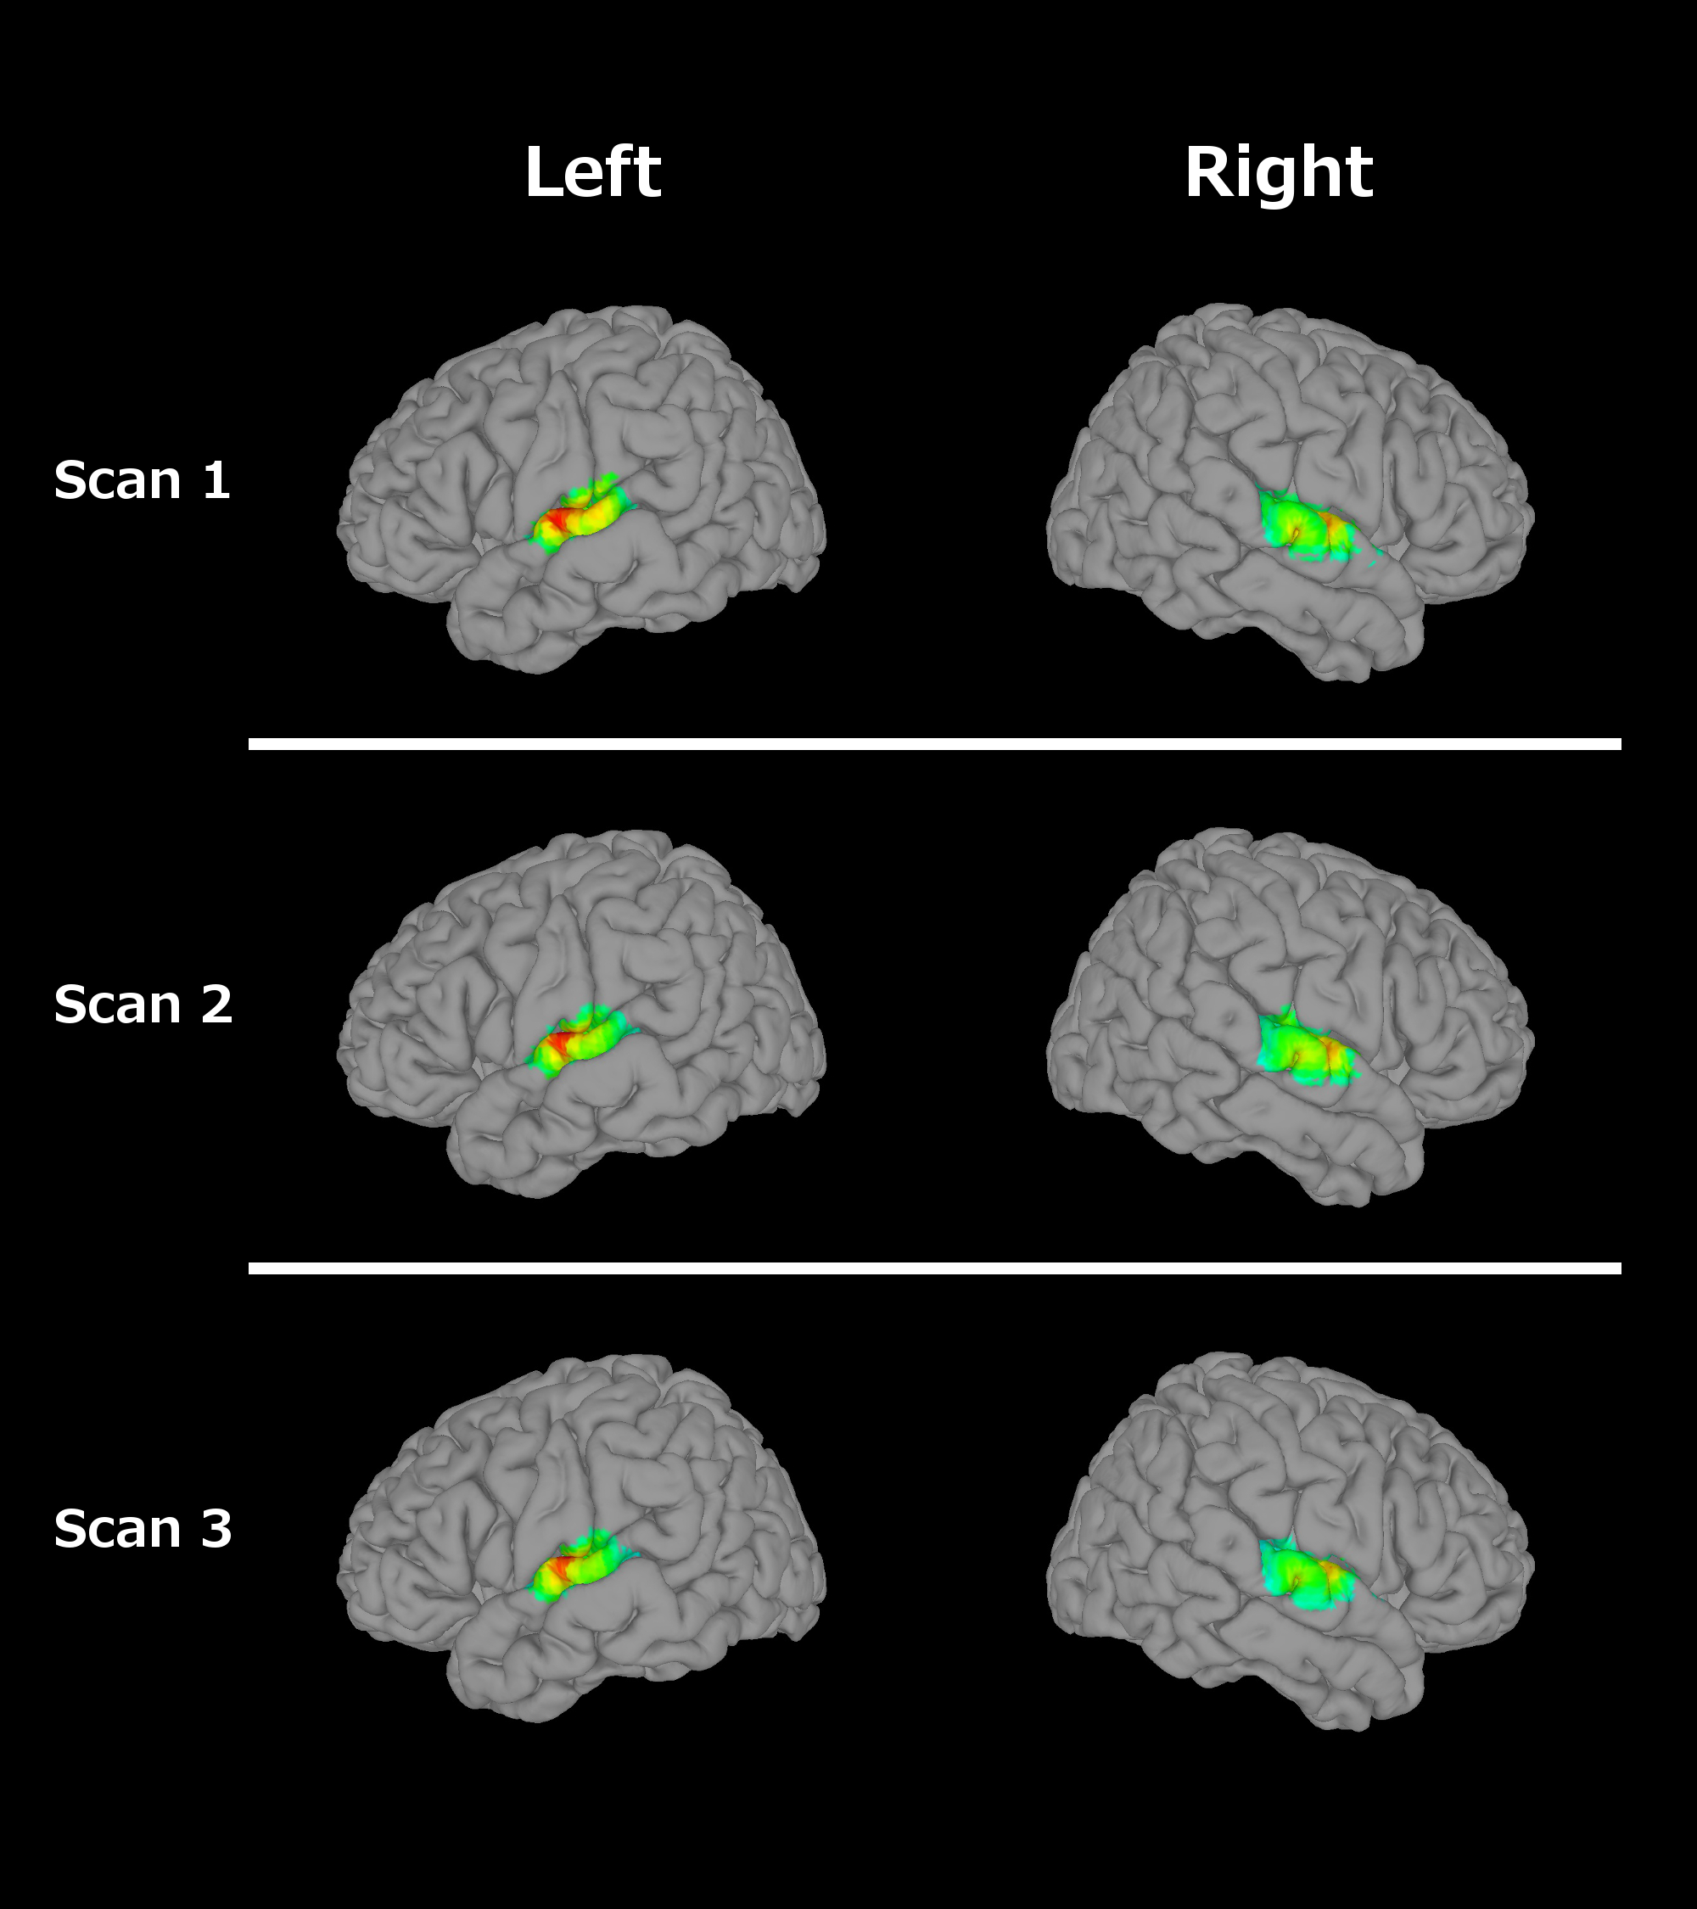
Supplemental Figure 1. GLM analysis results. Images are thresholded at a FWE rate of p<.05.
Normal Language Group Language Impairment Group

