Slide 1
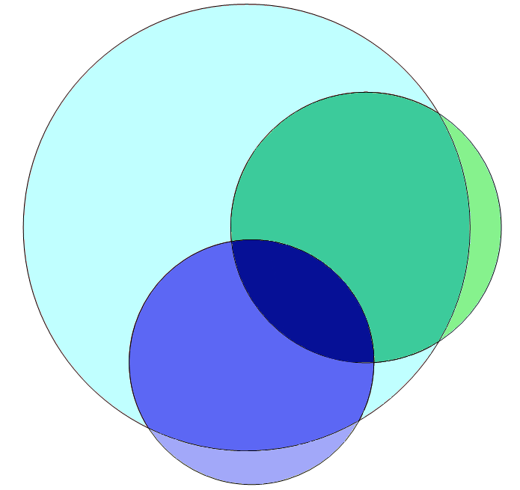
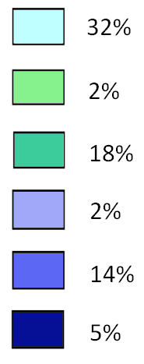
Supplementary Figure 1:
Swelling
IG
PH
+
-
-
Swelling
-
+
-
IG
+
+
-
-
-
+
+
-
+
+
+
+
PH

