Slide 1
Supplementary Table 1. A)Patient details for Fresh Frozen test cohort, B) Patient details for validation cohort
A)
B)
Age
Median | 64
Range | 41-89
Grade
1 | 3
2 | 14
3 | 10
Stage
pT1 | 9
pT2 | 10
pT3 | 8
pT4 | 0
Sub Type
Basaloid | 7
NOS | 9
Condyl | 11
Lymph Invasion
Positive | 12
Negative | 15
HPV Status
HPV Positive | 9
HPV Negative | 18
Age
Median | 68
Range | 35-92
Grade
1 | 5
2 | 36
3 | 29
Stage
pT1 | 10
pT2a | 21
pT2b | 16
pT3 | 21
pT4 | 2
Sub Type
Basaloid | 12
NOS | 40
Condyl | 18
Lymph Invasion
Positive | 30
Negative | 40
HPV
HPV Positive | 18
HPV Negative | 52
Sample Type
Fresh Frozen | 20
FFPE | 50

Slide 2
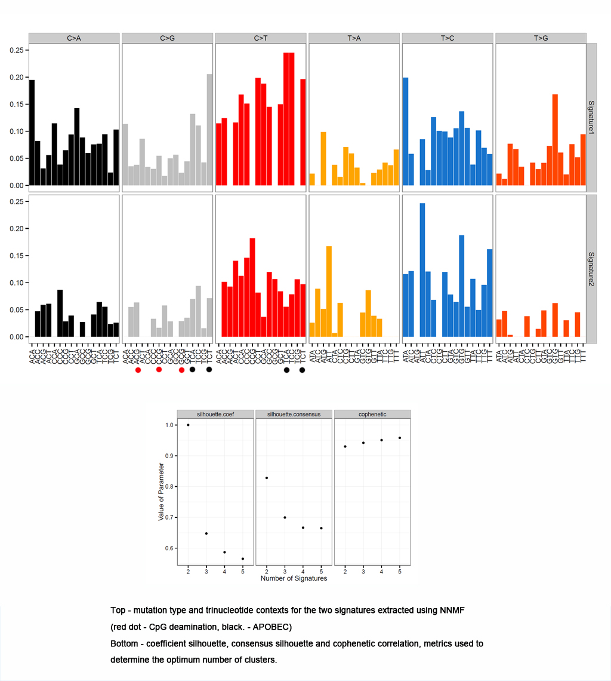
A)
B)
C)
Supplementary Figure 1. APOBEC mutation fraction of across multiple cancer types . B) Mutation type and trinucleotide contexts for the two signatures extracted from NNMF (
CpG Deamination, APOBEC). C) Coefficient silhouette, Consensus silhouette and cophenetic correlation metrics used to determine the optimum number of clusters.

Slide 3
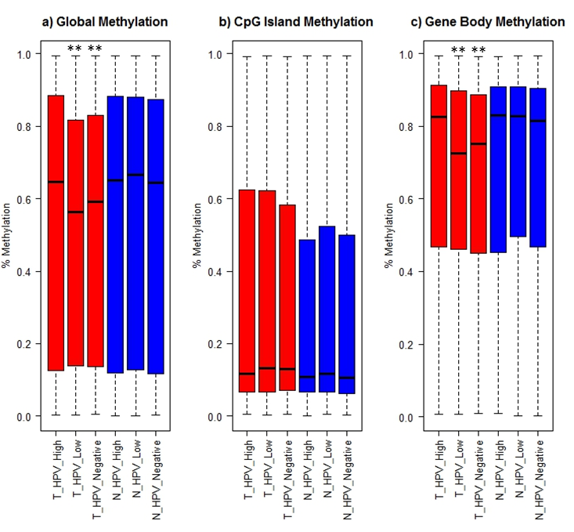
Supplementary Figure 2. DNA methylation in PeCa (red bars) and adjacent normal tissue (blue bars), for a) global methylation, b) CpG Islands and c) gene bodies in high viral load HPV positive PeCa, low viral load and none HPV infected PeCa tissue along with matched normal penile tissue. Normal tissue were all HPV negative and stratified by the HPV status of the paired tumour sample. HPV low viral load and HPV negative PeCas had a significantly lower mean methylation both globally and over gene bodies when compared to high viral load PeCas and normal squamous epithelium. There is no significant difference in mean methylation (across any feature) between HPV high viral load PeCa and normal (any viral load). Although there is a difference in the median age between patients in the differing HPV viral load groups, (age(median(range)): HPV high 55.6 (42-76), low 62(41-76), negative 65.3 (50-85)), which has been previously associated with both DNA methylation loss and NCGN alterations. No significant differences were observed when comparing the methylation profiles from matched normal tissue across differing viral loads, suggesting age is not a contributing factor to the loss of methylation seen with differing HPV viral loads. Kolmogorov–Smirnov test was used to determine the differences between methylation states. **< 0.001

Slide 4
Supplementary Figure 3. Candidate PeCa driver mutations . The central heatmap shows the mutation status of potential drivers based on IntOgen analysis for each tumor. Somatic mutations are colored according to functional class (lower panel) The upper panel shows patient phenotype data for age, stage grade, Ti/Tv ratio and HPV viral status.

Slide 5
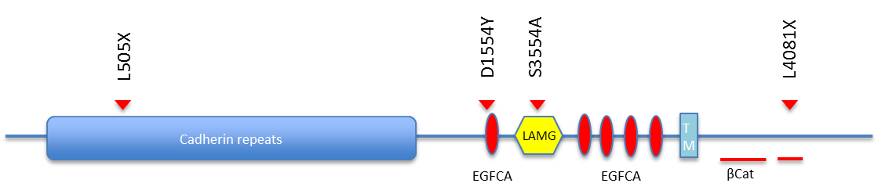
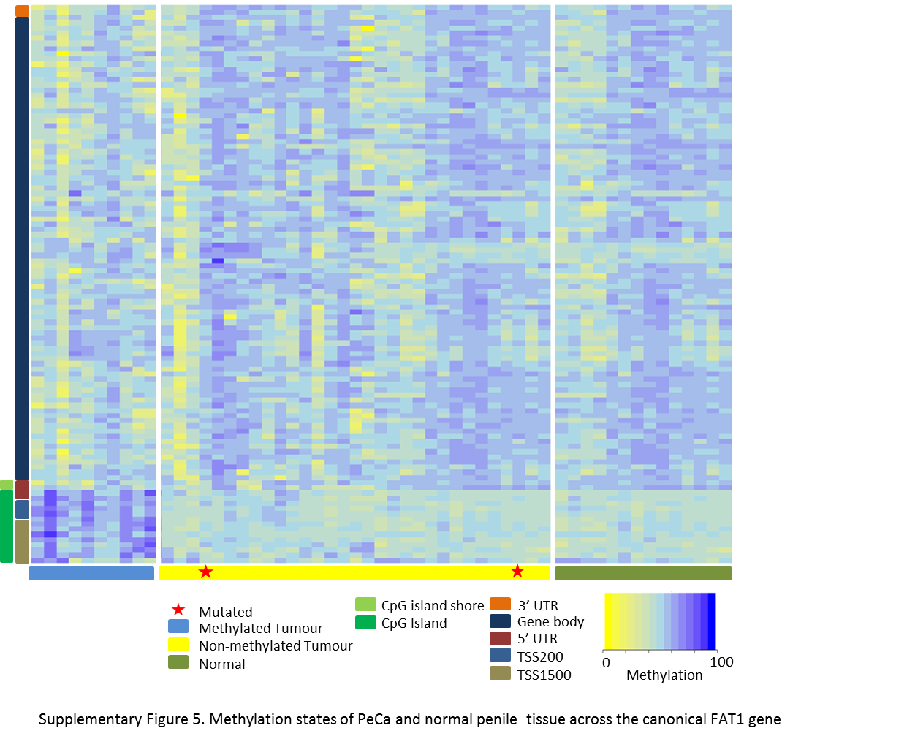
A)
B)
Supplementary Figure 4. A) Schematic of FAT1 is shown with locations of mutations. Arrowheads indicate the location of point mutations and boxes represent functional domains (TM, transmembrane; LAMG, laminin G domain; EGFCA, epidermal growth factor-like repeat; ßCat, putative ß-catenin binding regions). Red arrows denote frameshift or truncating mutations. B) Methylation states of PeCa and normal penile tissue across the canonical FAT1 gene

Slide 6
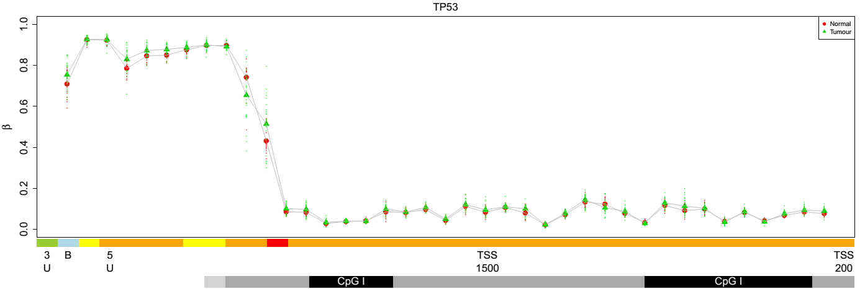
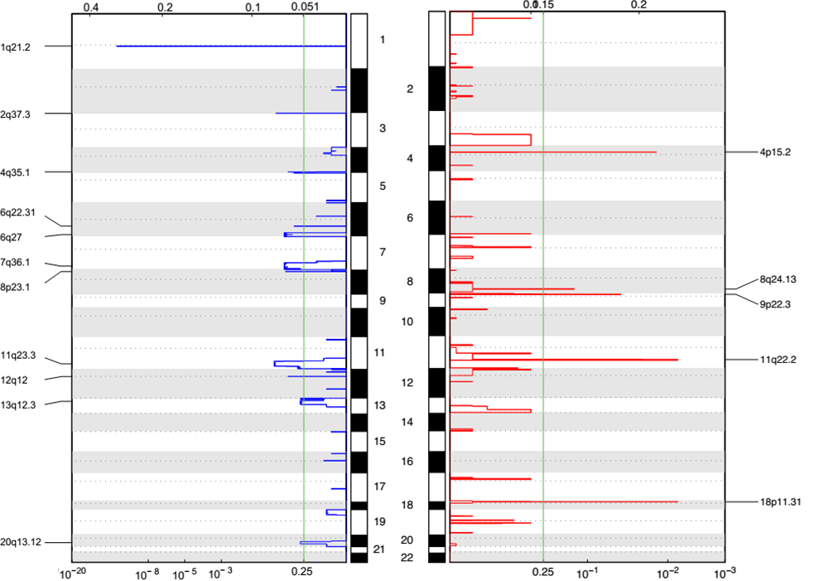
A)
B)
C)
Supplementary Figure 5. A) Example plot of Copy Number Alterations (CNA) in penile cancers, showing the deletion of TP53 (chr17). B) 450K methylation profiles for penile cancer and normal squamous epithelium across the canonical genomic feature of TP53. C) Output from GISTIC showing the frequency and significance of CNAs (deletions = blue, gains = red) in penile cancer.

