Slide 1
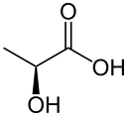
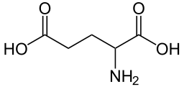
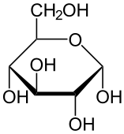

SENSING
DEVICE
Blood
Vessel
Delivery
Uptake and Metabolism
NO
O₂
Release
D_{ecf}
Uptake

Slide 2
