Slide 1
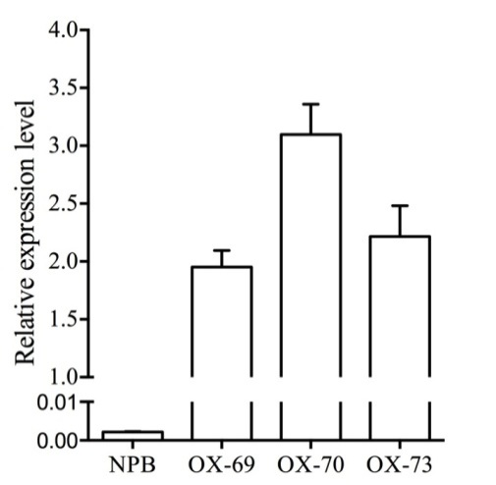
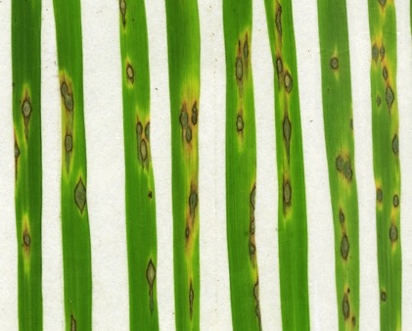
a
b
NPB OX-69 OX-70 OX-73
***
***
***
Figure S4 Overexpression of APIP12 does not alter the disease resistance to the virulent isolate. a The relative expression level of APIP12 in APIP12-OX transgenic lines by qRT-PCR. Lines of OX-69, OX-70 and OX-73 represent three individual APIP12 overexpression lines in NPB. The relative expression level of APIP12 was calculated by comparing to the Ubiquitin gene (OsUG) using the 2^{-△△Ct} method. Mean standard deviation (SD) was calculated using data from three replicates and asterisks indicate statistically significant differences in APIP12 overexpression lines compared with NPB (t test, *** P < 0.001). b Disease reactions of APIP12-OX lines and NPB against the virulent isolate KJ201 by spray inoculation. Photos are taken 7 days after inoculation (DAI).

