Slide 1

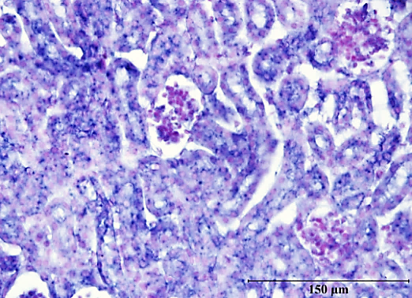
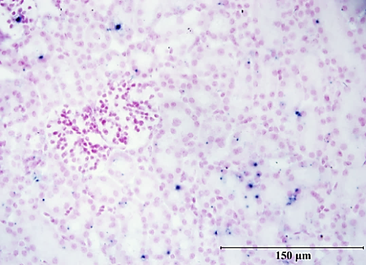
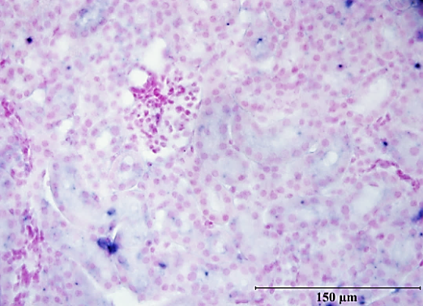
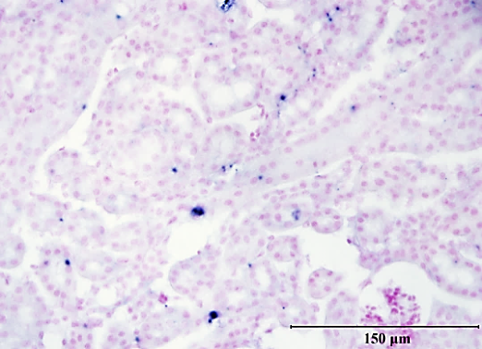
a
WT
PEDF^{-/-}
PEDF
GAPDH
b
WT
PEDF^{-/-}
PEDF anti-sense probe
PEDF sense probe
He et al., Supplemental Figure 2

